Slide 1
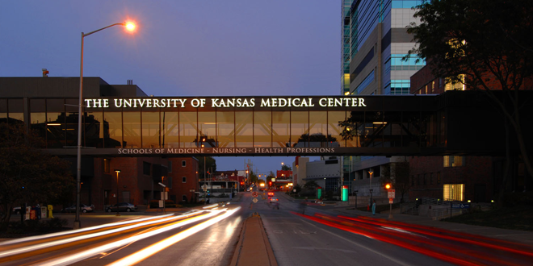
Inflammation: The Good, The Bad, & The Ugly
Miranda Machacek
MD/PhD Student at the University of Kansas Medical Center

Slide 2
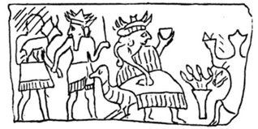
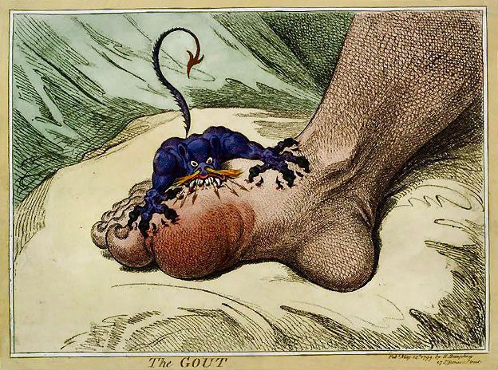
Inflammation has been described for thousands of years
Sumerian cuneiform
Assyrian burning brazier
James Gilray, The Gout, c.1799
Notes:
The Healing Hand: Man & Wound in the Ancient World, Guido Majno

Slide 3
4 Cardinal Signs of Inflammation
5
Rubor
Calor
Tumor
Dolor
Functio laesa
→ redness
→ heat
→ swelling
→ pain
→ loss of function

Slide 4
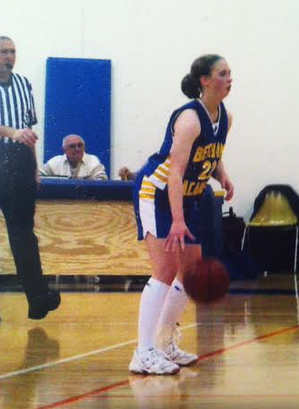
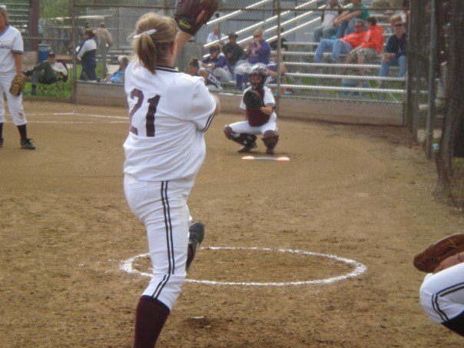
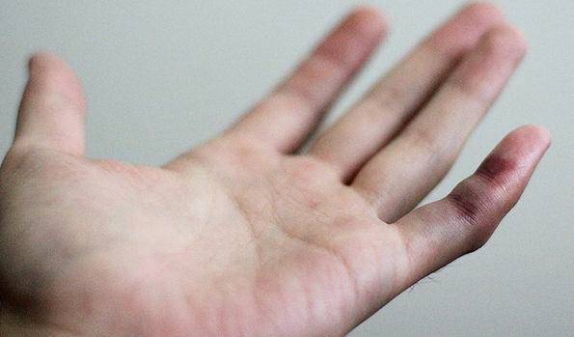
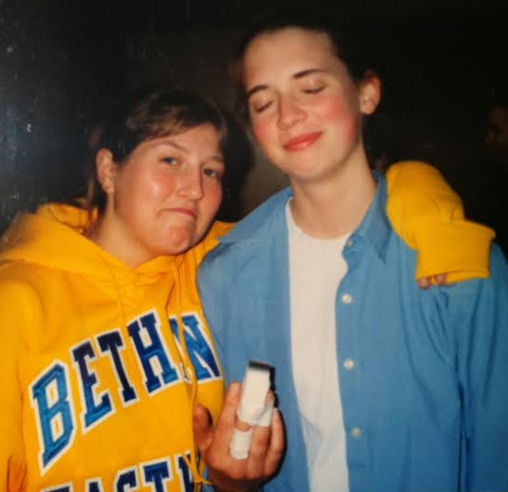
The Ugly
Me c. 2004-05

Slide 5
Why redness? Rapid (within seconds) histamine release from mast cells→ causes blood vessels to expand
Why heat? Drawing more blood to that area with expanded blood vessels
Why swelling? Because increased blood flow and influx of other immune cells that will attack invading pathogens and/or clean up dead tissue
Why pain/loss of function? Because of swelling!

Slide 6
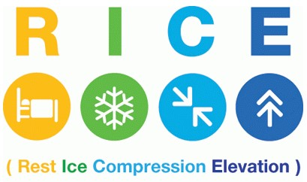
RICE therapy is a common treatment that treats the cardinal signs of inflammation

Slide 7
What triggers inflammation?
Trauma/dead cells
Infection
Inappropriate immune responses
Autoimmune diseases-immune response mounts attack against normal tissues in your body
Allergic reactions-immune response mounts attack against something that isn’t harmful (i.e. pollen, pet dander, peanuts)

Slide 8
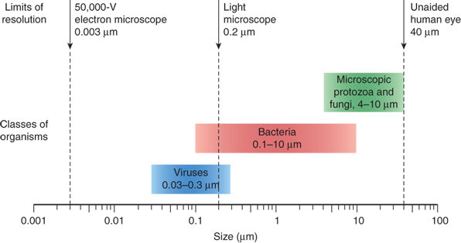
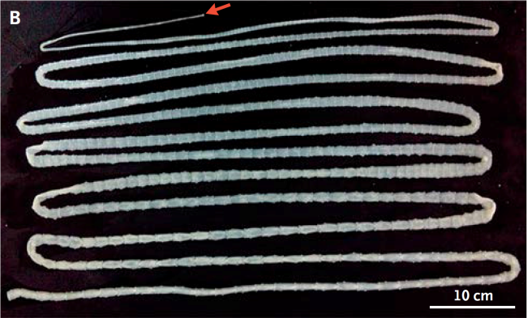
The Good: the inflammatory response against infection
Fig 1-2. Sherris Medical Microbiology, 6e; www.iflscience.com

Slide 9
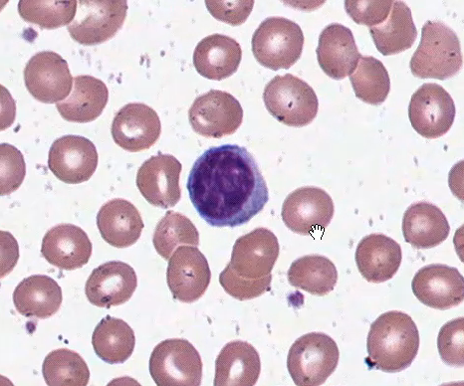
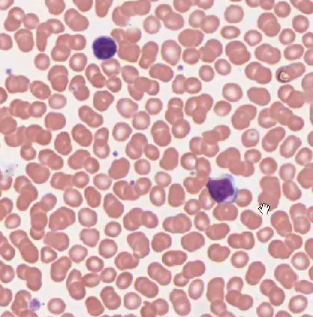
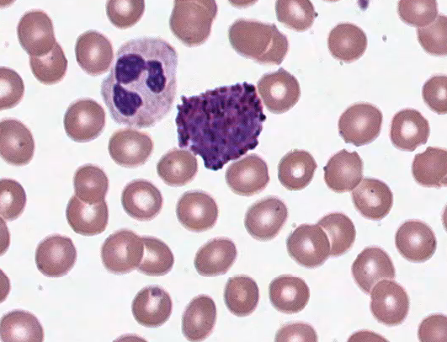
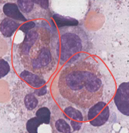
The Good: the players in the inflammatory response against infection
Lymphocytes-slower response but highly specific to particular pathogens
Monocyte/Macrophage-quickly enters site of infection; eats pathogens/dead cells; initiates healing response
The Granulocytes-
Release pre-packaged substances that kill pathogens
Neutrophils
Basophils
Eosinophils

Slide 10
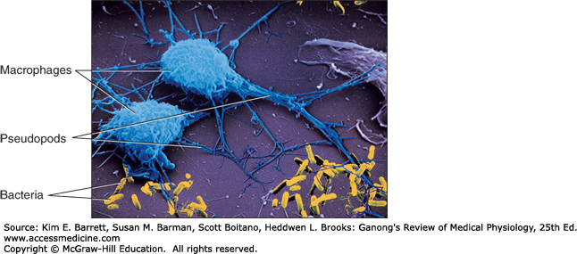
The Good: Initial events in response to an infection

Slide 11
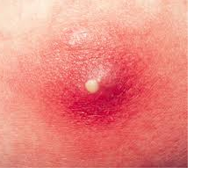
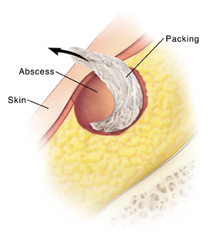
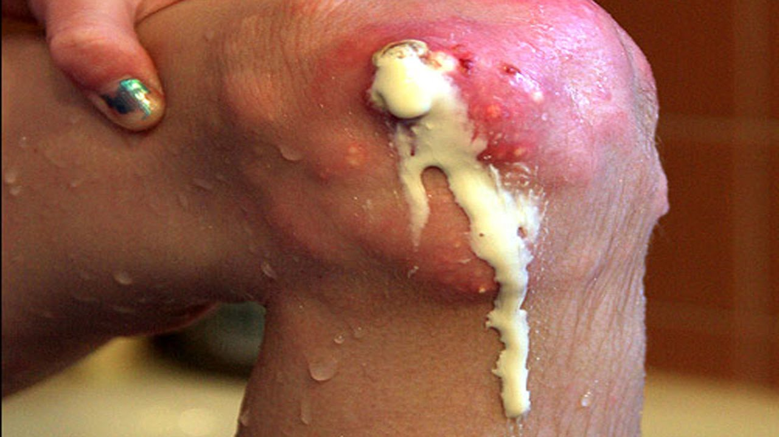
The Ugly: Pus = accumulation of white blood cells

Slide 12
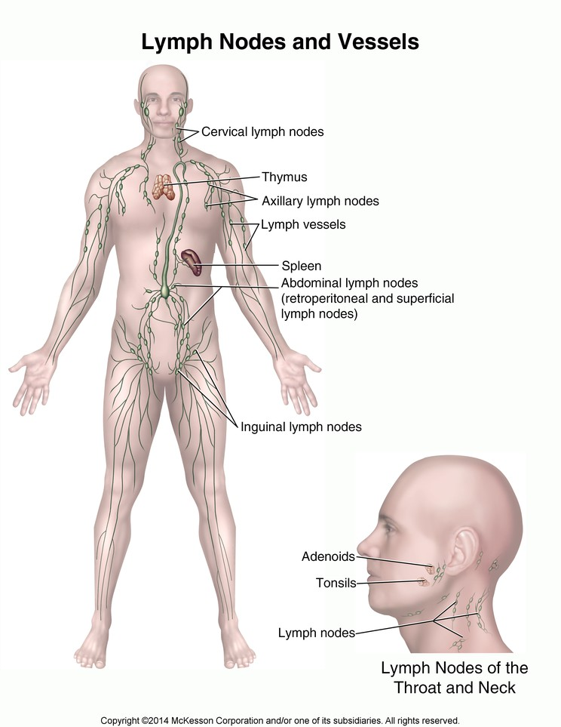
The Good: Later events in response to an infection include activation of lymphocytes highly specific to pathogen

Slide 13
The Bad: Inappropriate immune responses
Autoimmune disease – immune response to a component of normal tissue
Allergic disease – immune response to something that is harmless (food, pollen)

Slide 14
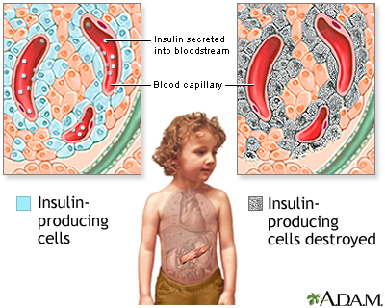
Autoimmunity: Type 1 Diabetes

Slide 15
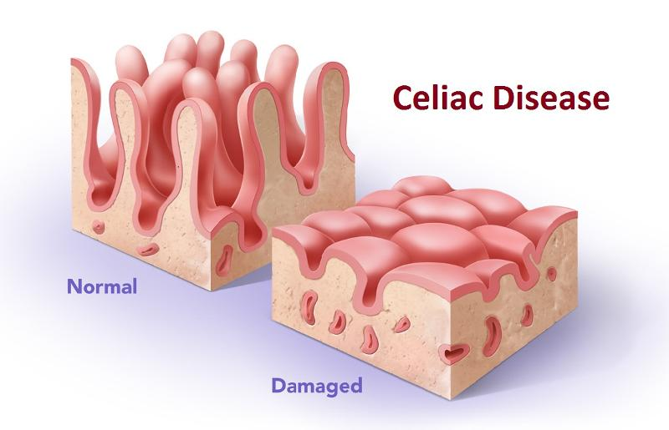
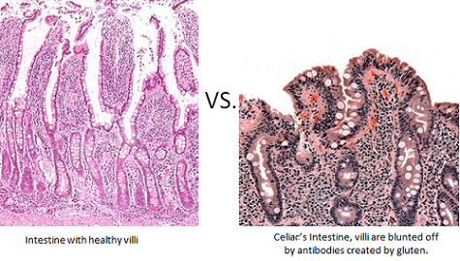
Autoimmunity: Celiac Disease
-inappropriate development of antibodies against gliadin (a component of gluten)
Abdominal pain, inability to absorb nutrients well -> anemia & osteoporosis,
diarrhea, bloating, fatigue, neurological symptoms

Slide 16
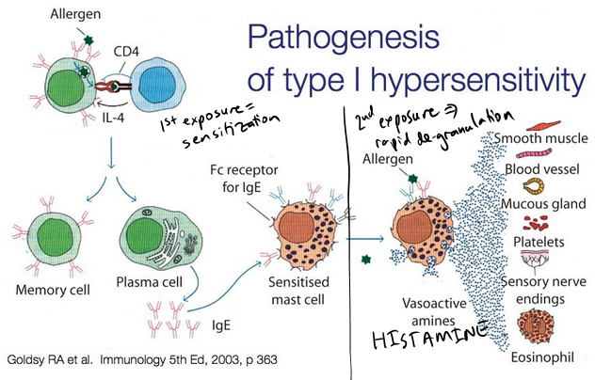
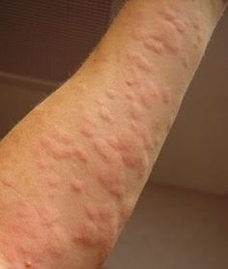
The Bad: Allergic Reactions

Slide 17
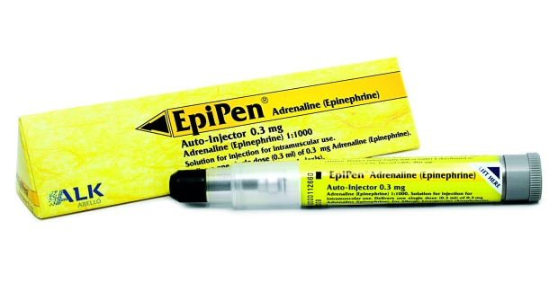
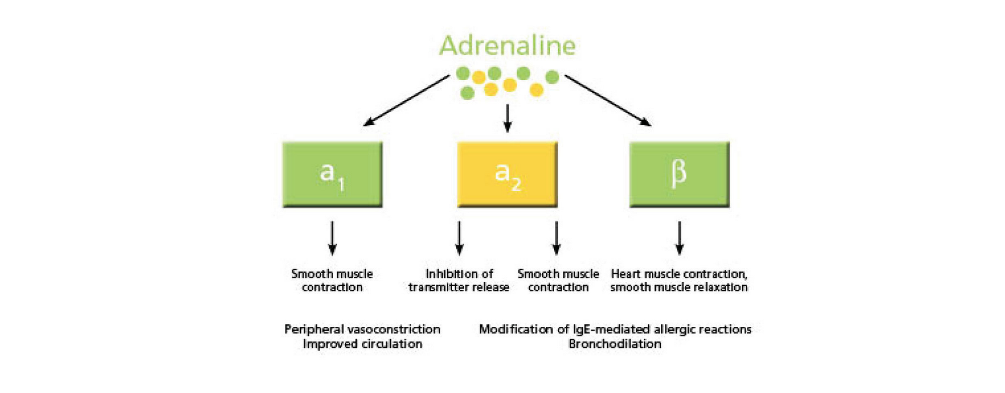
The Bad: Allergic Reactions

Slide 18
Inflammation is sometimes good, sometimes bad, always a little ugly!
Autoimmunity
Allergies
Excessive pain & swelling
Increased susceptibility to infections
Poor wound healing
Questions?

Slide 20
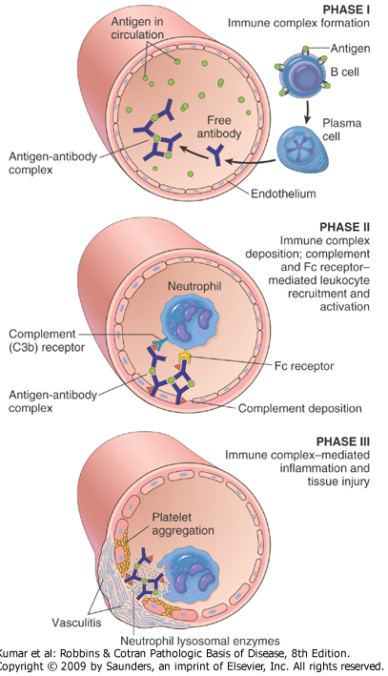
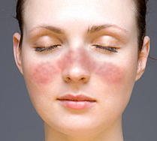
Autoimmunity: Lupus (Systemic Lupus Erythematosus)
May have rash (worse with sunlight exposure), arthritis, chest/lung pain due to inflammation in lubricating sac surrounding lungs or heart, seizures, psychosis, kidney damage

