Slide 1
Perspectives on Gun Violence and Mass Killings

Slide 3
GUN VIOLENCE ARCHIVE2014 TOLL OF GUN VIOLENCE
Total Number of Incidents 51,762
Number of Deaths¹ 12,569
Number of Injuries¹ 23,020
Number of Children (age 0-11) Killed/Injured¹ 628
Number of Teens (age 12-17) Killed/Injured¹ 2,373
Mass Shooting² 281
Officer Involved Incident² 3,214
Home Invasion² 2,606
Defensive Use² 1,585
Accidental Shooting² 1,601
Gun violence incidents collected/validated from 1200+ sources daily – source links on each incident report.
1: Actual number of deaths and injuries 2: Number of INCIDENTS reported and verified
Numbers on this table reflect a subset of all information collected and will not add to 100% of incidents.
www.gunviolencearchive.org www.facebook.com/gunviolencearchive
Data Validated: November 25, 2015

Slide 4
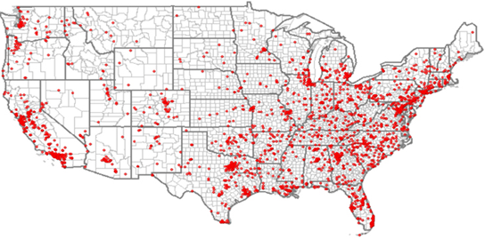

Slide 5
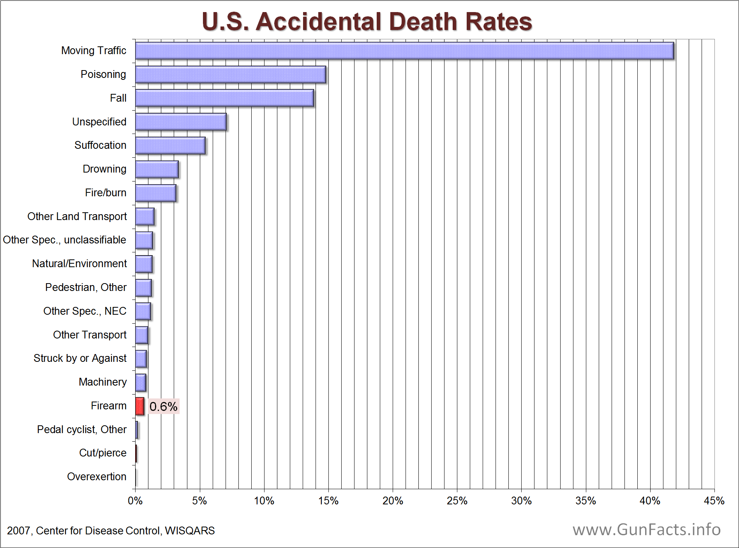

Slide 6
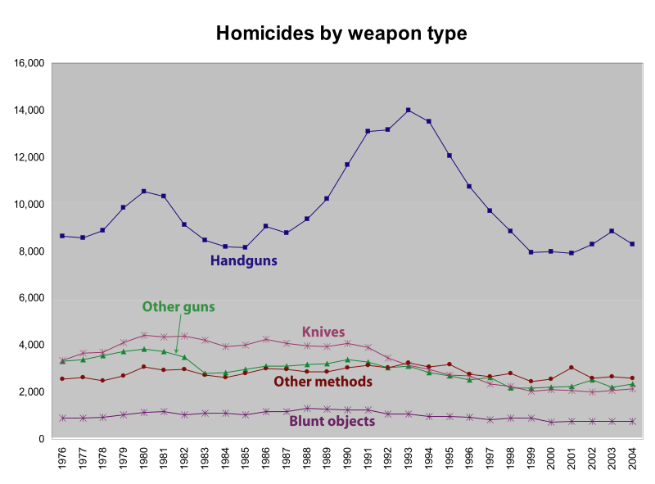

Slide 7
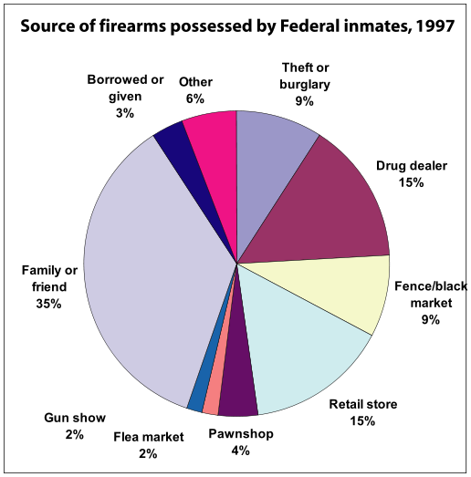

Slide 8
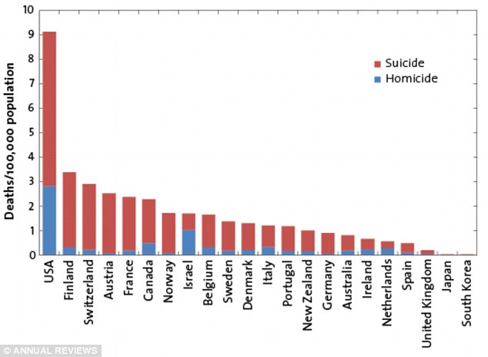

Slide 9
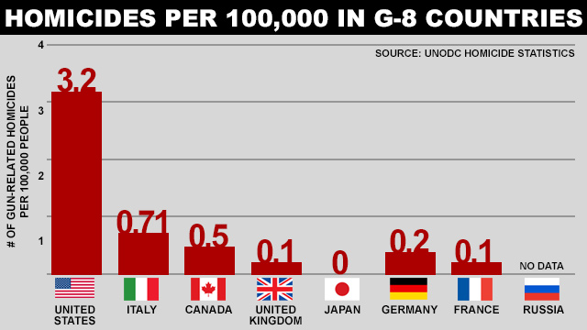

Slide 10
RUNNING AMOK
"Running amok" is used to refer to the behavior of someone who, in the grip of strong emotion, obtains a weapon and begins attacking people indiscriminately, often with multiple fatalities.^{[13]} An episode of amok may be triggered by a period of depression or highly aggressive behavior. The slang terms going postal or going ballistic are similar in scope. Police describe such an event as a killing spree. If the individual is seeking death an alternate method is often "suicide by cop".
Amok is often described as a culture-bound (or culture-specific) syndrome,^{[14][15]} which is a psychological condition whose manifestation is strongly shaped by cultural factors. Other reported culture-bound syndromes are latah and koro. Amok is also sometimes considered one of the subcategories of dissociative disorders (cross-cultural variant).

Slide 11
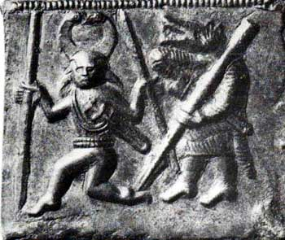
Berserkers

Slide 12
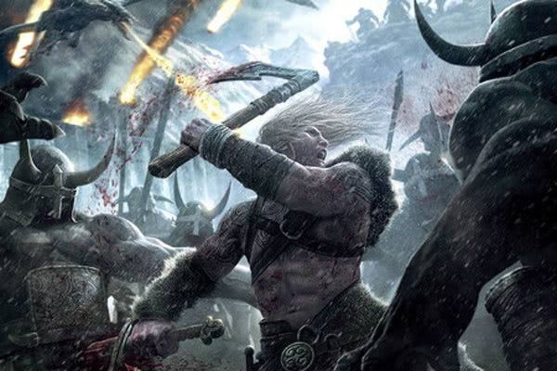

Slide 13
Clinical aspects
Underlying problem (e.g. paranoia, anger, etc.)
Access to weapons
Opportunity (proximity)
Isolation
Few interpersonal relations (esp. with women)
Prone to fantasy (esp. video games)
Stress/in general, but precipitating factors, such as job loss, school failure, etc.

Slide 14
Additional factors
Weird (different)
Crazy
Mean

Slide 15
MEAN
WEIRD
CRAZY

Slide 16
WEIRD
MEAN
CRAZY

Slide 17
Models
Mental illness (individual)—National Rifle Association
Historic context—record of gun violence, etc in slavery, extermination, genocide
Role of fantasy (violent video games, TV)
Community intervention

Slide 18
J Appl Psychol. 2015 Jun 29. [Epub ahead of print]
Catching Rudeness Is Like Catching a Cold: The Contagion Effects of Low-Intensity Negative Behaviors.
Foulk T, Woolum A, Erez A.
Abstract
In this article we offer a new perspective to the study of negative behavioral contagion in organizations. In 3 studies, we investigate the contagion effect of rudeness and the cognitive mechanism that explains this effect. Study 1 results show that low-intensity negative behaviors like rudeness can be contagious, and that this contagion effect can occur based on single episodes, that anybody can be a carrier, and that this contagion effect has second-order consequences for future interaction partners. In Studies 2 and 3 we explore in the laboratory the cognitive mechanism that

Slide 23
“I say we had best look our times searchingly in the face, like a physician diagnosing some deep disease.”– Walt Whitman, Democratic Vistas, 1871

Slide 25
