Slide 1
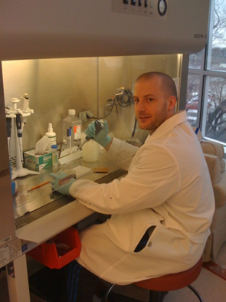
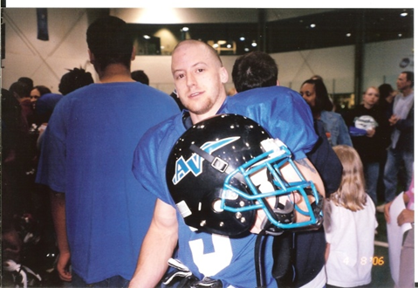
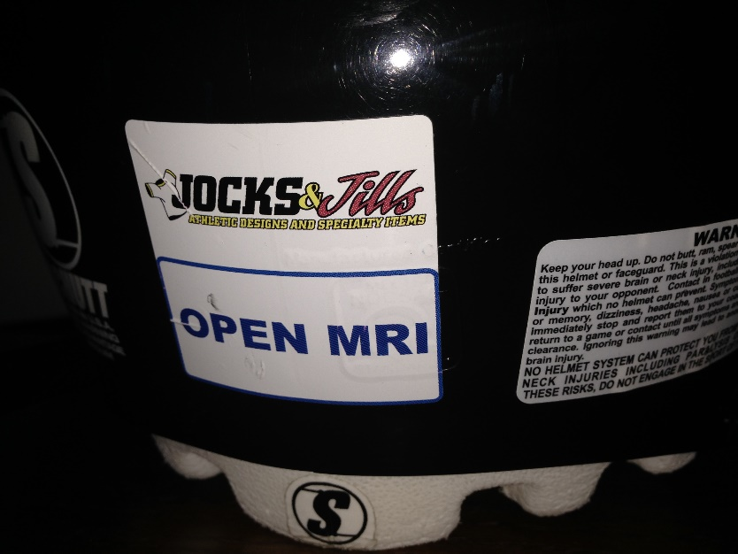
From The Field To The Lab: Perspectives On Head Injury From A Former Football Player And Current Scientist: Part One
Presented by:
Jordan Taylor, Ph.D. (Candidate), M.Ed., CSCS
Department of Physical Therapy & Rehabilitation Science
University of Kansas Medical Center

Slide 2
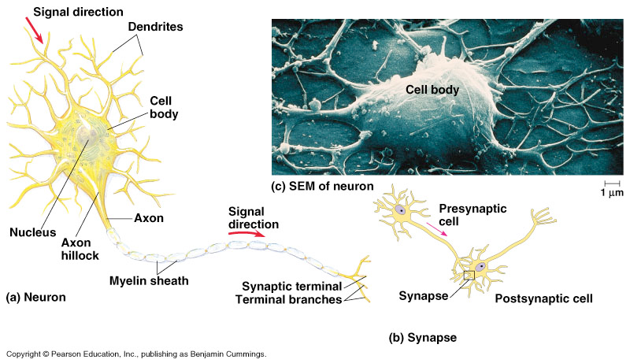
Cells of the Nervous System
Neurons send and receive information (e.g., electrical, mechanical, and chemical signals)
Campbell Biology 7th Ed.

Slide 3
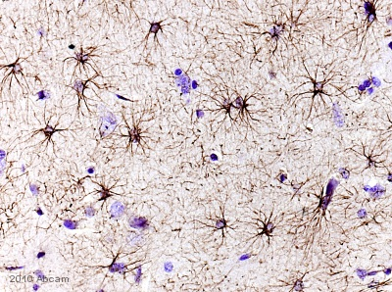
Cells of the Nervous System
Glial Cells = Several Types:
1. Astrocytes = most abundant type, anchor neurons to blood supply.
- Regulate external chemical environment by clearing neurotransmitters from the synaptic space
- Part of the blood-brain barrier (BBB)
2. Oligodendrocytes = cells that surround axons in the CNS
- provide myelin sheath for CNS axons
3. Schwann cells = cells that surround axons in the PNS
- provide myelin sheath for PNS axons
GFAP stain showing astrocytes
www.abcam.com

Slide 4
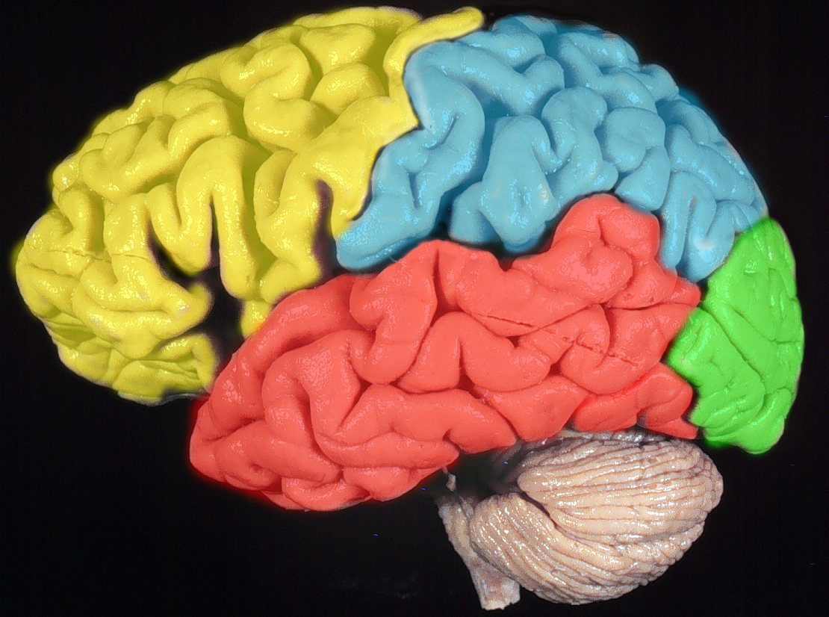
The Human Brain
Brain Lobe Functions:
Frontal Lobe = personality, planning, speech, motor commands
Parietal Lobe = attention, perception of touch, taste, reading
Occipital Lobe = Visual Analysis
Temporal Lobe = recognition, hearing, smell
Limbic Lobe = emotional behavior, learning, memory, regulation of autonomic nervous system

Slide 5
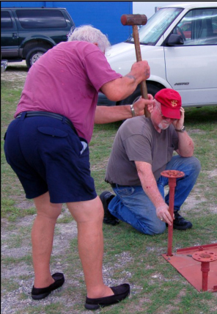
What is a Concussion?
It is what results when someone does EXACTLY what you say:
“When I nod my head, you hit it.”

Slide 6
Defining A Concussion
“A concussion (or mild traumatic brain injury) is a complex pathophysiological process affecting the brain, induced by traumatic biomechanical forces secondary to direct or indirect forces to the head. Disturbance of brain function is related to neurometabolic dysfunction, rather than structural brain injury, and is typically associated with normal structural imaging findings (CT Scan, MRI). Concussion may or may not involve a loss of consciousness. Concussion results in a constellation of physical, cognitive, emotional, and sleep related symptoms. Recovery is a sequential process and symptoms may last from several minutes to days, weeks, months, or even longer in some cases.”
CDC Physicians Toolkit; Collins et al., 2006

Slide 7
Defining A Concussion
So – did that 100-word definition help you understand concussions?

Slide 8
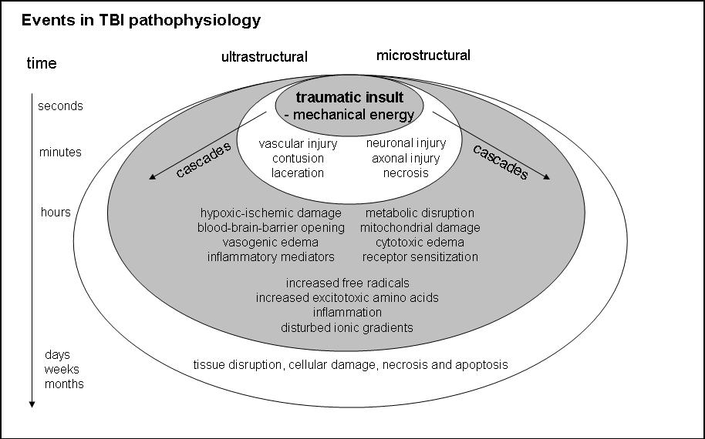
Concussion Pathophysiology
Primary Injury – Results from mechanical forces acting on the brain
Secondary Injury – Resulting bio-molecular and physiological changes that follow
- Widespread destruction of neurons, axons, and glial cells is dependent upon proximity and/or connectivity of affected tissues relative to primary injury site(s)

Slide 9
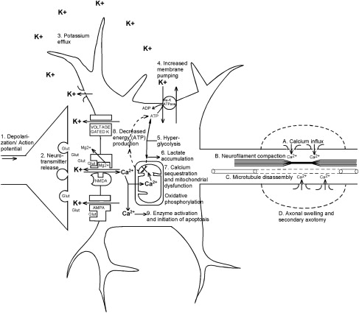
Neurometabolic Cascade of Concussion
Giza CC, Hovda DA. The neurometabolic cascade of concussion. J Athl Train 2001;36(3):230.)
Notes:
<number>

Slide 10
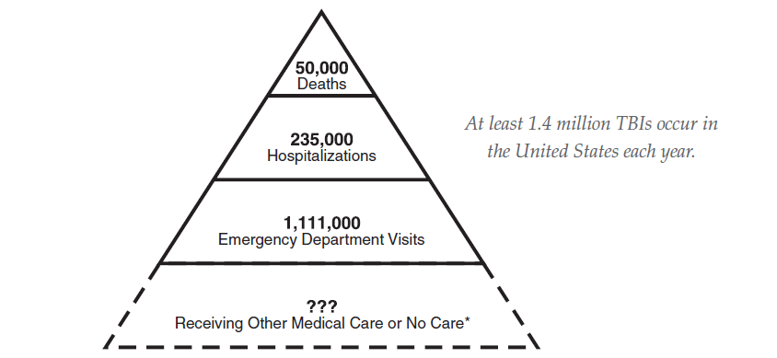
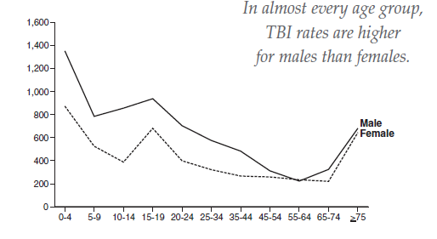
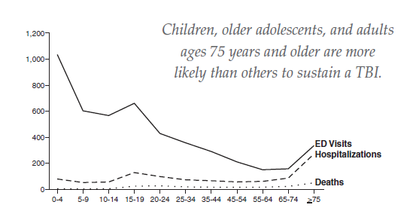
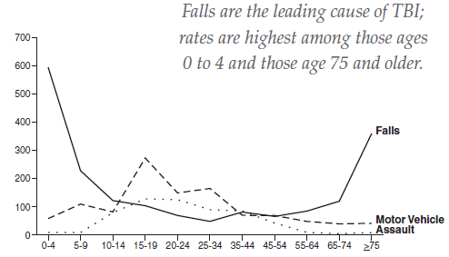
Source: CDC

Slide 11
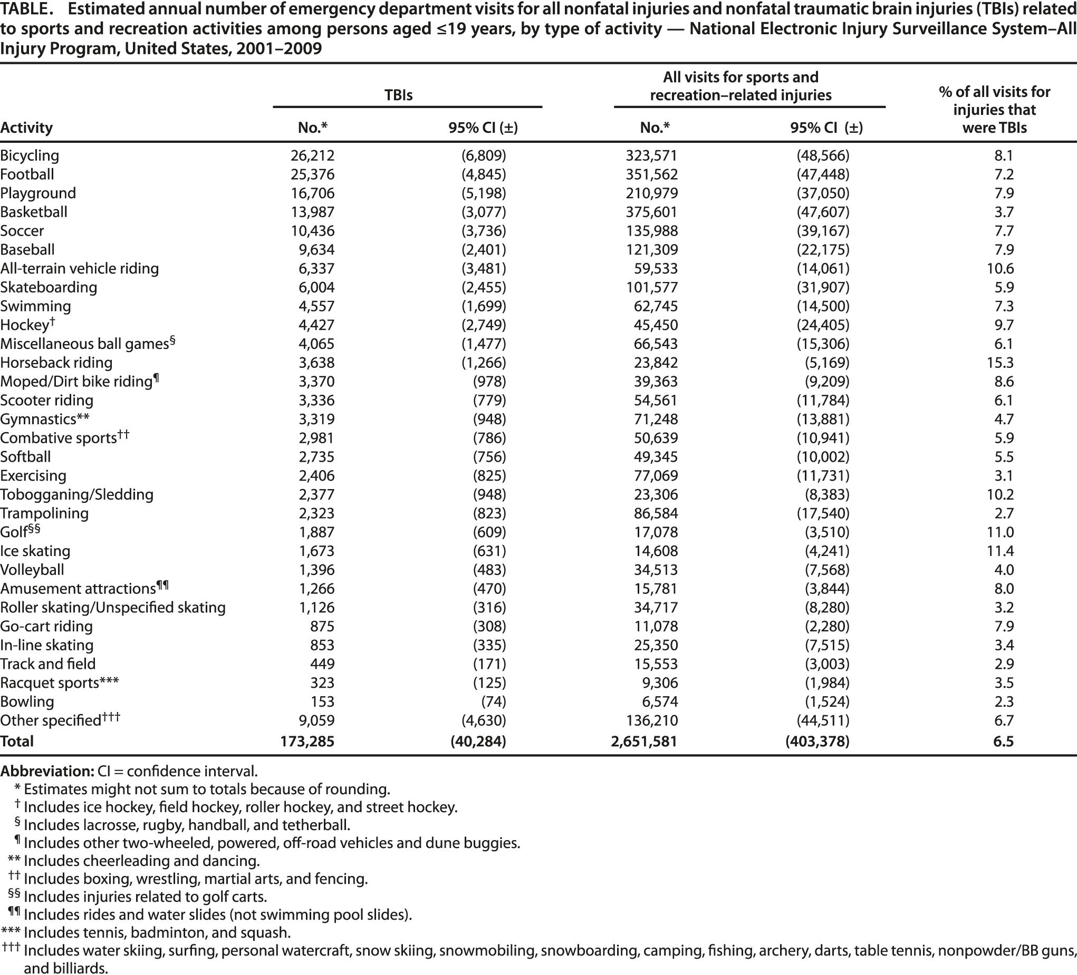
Incidence of Sports Related Head Injuries
Gilchrist J., et al. Nonfatal sports and recreation related traumatic brain injuries among children and adolescents treated in emergency departments in the United States, 2001-2009. MMWR 2011: 60(39);1337-1342.

Slide 12
Concussion Signs & Symptoms
Confusion
Appears dazed or stunned
Answers questions slowly
Feeling sluggish, hazy, foggy
Concentration or memory problems (amnesia)
Is confused about position assignment
Forgets plays
Is unsure of game, score, or opponent
Can’t recall events prior to incident
Can’t recall events after incident
Loses consciousness (even briefly) or appears groggy
Headache or “pressure” in head
Nausea or vomiting
Balance problems or dizziness
Sensitivity to light or noise
Double or blurry vision
Moves clumsily
Shows changes in behavior or personality
Does not “feel right”
Sleep disturbances – sleeps too much, or sleeps too little

Slide 13
Symptom Presentation Timeline
When will symptoms typically emerge?
Immediate – amnesia, loss of consciousness, balance
Delayed – all other symptoms! (sleep disturbance, behavior change)
Most symptoms will not be evident for 48 hours; many do not appear for days or weeks
Common early symptoms
Headache, nausea, dizziness, lack of awareness or orientation to surroundings
Metabolic changes
Alterations in intracellular/extracellular glutamate, potassium, and calcium (e.g., neural signaling)
Decrease in cerebral blood flow (e.g., oxygen, glucose)
Cellular dysfunction due to mismatch in supply and demand; increased vulnerability to second insult

Slide 14
Second Impact Syndrome
Involves:
An athlete having post-concussive symptoms after a head injury
Return-to-play/practice too soon and then a second head injury
Edema, swelling, herniation, possibly death
Acute, on-field presentation:
Pulmonary edema
Unconsciousness
Previous and recent concussion
Because the brain is recovering when injured a 2nd time, it is more vulnerable to a less severe blow
Is rare relative to overall concussion rate; documentation is emerging in medical and sports literatures

Slide 15
Post-Concussion Syndrome
Post-concussion syndrome diagnosis may be made when symptoms resulting from a concussion last for more than three months
Cause unknown
Occurs in 30-80% of mild TBI cases
Subjective symptoms often persist after cognitive scores return to normal
Persistent symptoms seldom attributed to injury incident
Linked to reduction in glucose and changes in cerebral blood flow for up to 3 years
Related consideration – “hidden” TBI
Common after blast-TBI; co-occurs with PTSD

Slide 16
Post-Concussion Syndrome Symptoms
Physical:
Headache (most common symptom)
Dizziness (2nd most common)
Sensitivity to light or noise
Fatigue
Insomnia, sleepiness
Cognitive
Memory problems, esp. short-term memory
Reduced attention & concentration
Language problems (word-finding, etc.)
Emotional/behavioral changes
Reduced frustration tolerance
Depression
Anxiety
Change in personality
Poor judgment
Reduced social inhibition
Increased impulsivity
Labile emotions or mood swings
Reduced ability to tolerate stress or alcohol
Symptoms persist for 3-6 months in many people, sometimes longer
Symptoms may occur immediately, or spontaneously appear weeks or months after the injury
Misdiagnosis is common

Slide 17
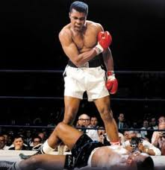
Chronic Traumatic Encephalopathy
Progressive neurological deterioration found in individuals who have sustained multiple concussions
dementia pugilistica (1928); punch-drunk syndrome
Development of symptoms over a long latent period (avg. 12-16 years)
Associated with:
Memory disturbances
Behavioral and personality changes
Speech and gait abnormalities
Parkinsonian-like symptoms
Brain changes:
Atrophy of cerebral hemispheres, medial temporal lobe, thalamus, mammillary bodies, & brainstem
Enlarged ventricles
Tau-immunoreactive neurofibrillary tangles (also found in patients with Alzheimer’s disease)
www.aworldofboxing.com

Slide 18
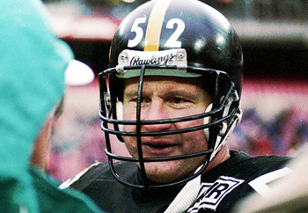
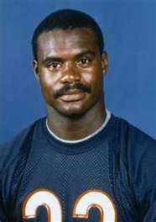
Chronic Traumatic Encephalopathy
Boston University School of Medicine - Center for the Study of Traumatic Encephalopathy (CSTE) is examining the effect of repetitive brain trauma in athletes
Postmortem brain tissue studies have been conducted for many athletes in a variety of sports (NFL, MLB, NHL, WWE)

Slide 19
Chronic Traumatic Encephalopathy
17-year-old Nathan Stiles of Spring Hill, KS: Straight-A student, football Player, homecoming king
Died in 2010 of second-impact syndrome following a game during his senior year of high school
Brain examined by Dr. Ann Mckee at Boston University School of Medicine (CSTE)
Quote from Dr. Ann McKee; “You expect a pristine brain. I saw a brain that was riddled with tau proteins. I was stunned at how similar that brain was to boxers who lived into their 70’s.”
Nathan is the youngest documented case of chronic traumatic encephalopathy

Slide 20
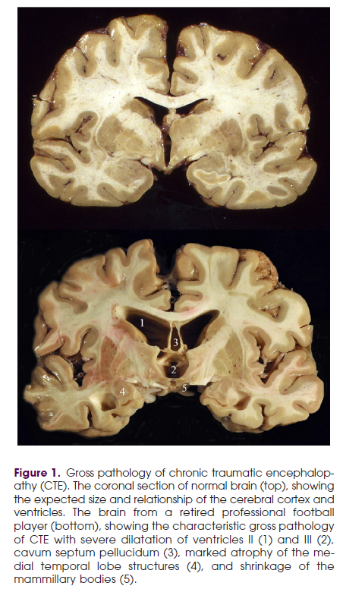
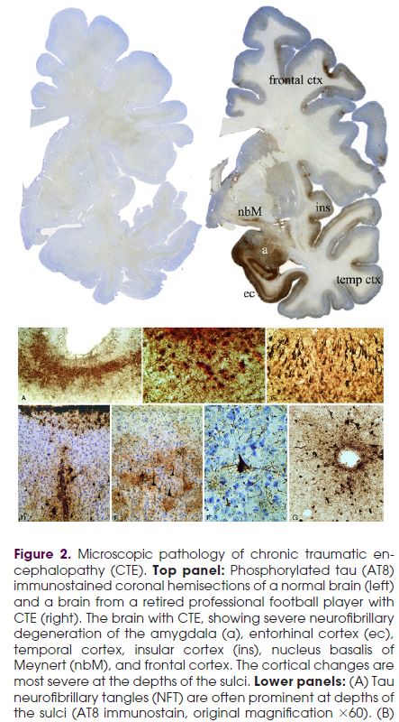
Stern et al., 2011

Slide 21
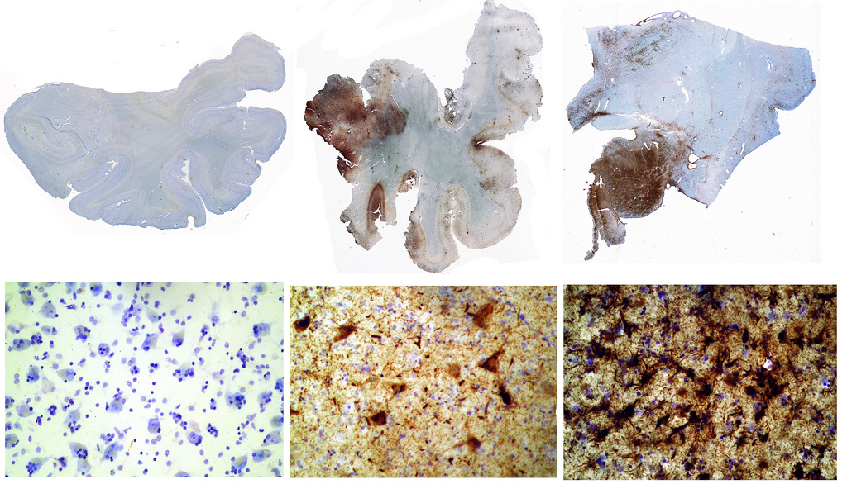
Tau protein
Normal brain of a 65 year -old
Brain of ex-NFL linebacker John Grimsley (suffered 8 concussions – died at age 45)
Brain of 73 year –old boxer

Slide 22
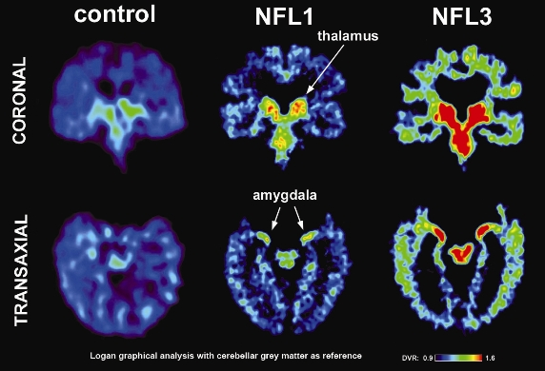
Chronic Traumatic Encephalopathy
Currently, CTE can only be definitively diagnosed by examination of brain tissue postmortem
PET scanning using [18F]FDDNP is being investigated in research studies as a tool for diagnosing CTE in vivo
- [18F]FDDNP is a newly developed injectable radiopharmaceutical tracer
- Binds to both tau protein and beta-amyloid in brain
- Elevated [18F]FDDNP uptake has been associated with cognitive symptoms due to normal aging, mild cognitive impairment, and dementia
2013 study of 5 former NFL players conducted by researchers at UCLA
- PET scans with [18F]FDDNP
- 1st study to confirm presence of tau protein in the brain of living humans
- tau was present in areas of the brain responsible for memory and emotional regulation
- Distribution of tau in this study was consistent with findings from brains of players diagnosed with CTE postmortem
- 3 of the players had impaired cognitive function, 1 had dementia, and 1 exhibited normal cognitive function
Small, G.W., et al. PET scanning of brain tau in retired national football league players: preliminary findings. American Journal of Geriatric Psychiatry. 2013 Feb; 21(2):138-44. doi: 10.1016/j.jagp.2012.11.019. Epub 2013 Jan 22.
Notes:
<number>

Slide 23
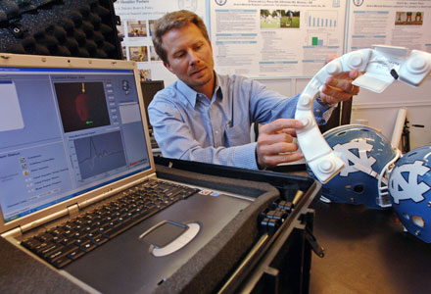
Helmet Studies
Hypothetical example of g-force?
Car hits wall @ 25mph head-on without slowing
Comes to rest in 300ms (no crumple zones)
If you were not wearing a seat belt, the force of your head hitting the windshield would be approx. 100 gs
University of North Carolina
G-force measurements with in-helmet accelerometers
Data suggests in an average football season, a lineman could be struck in the head 1000+ times.
For a 10-year NFL player, that’s approx. 18,000 hits (H.S., College, NFL)…
Complex contributing factors
Acceleration force not prime factor
Force vector
Surface struck
Recent impact history (cumulative exposure)
Career impact history?
Dr. Kevin Guskiewicz, UNC
2011 MacArthur award recipient
(was trainer for Pittsburgh Steelers in early 1990s)
Guskiewicz & Mihalik., 2011
Notes:
Take the experience of a young defensive lineman for the University of North Carolina football team, who suffered two concussions during the 2004 season. His case is one of a number studied by Kevin Guskiewicz, who runs the university’s Sports Concussion Research Program. For the past five seasons, Guskiewicz and his team have tracked every one of the football team’s practices and games using a system called HITS, in which six sensors are placed inside the helmet of every player on the field, measuring the force and location of every blow he receives to the head. Using the HITS data, Guskiewicz was able to reconstruct precisely what happened each time the player was injured.
“The first concussion was during preseason. The team was doing two-a-days,” he said, referring to the habit of practicing in both the morning and the evening in the preseason. “It was August 9th, 9:55 A.M. He has an 80-g hit to the front of his head. About ten minutes later, he has a 98-g acceleration to the front of his head.” To put those numbers in perspective, Guskiewicz explained, if you drove your car into a wall at twenty-five miles per hour and you weren’t wearing your seat belt, the force of your head hitting the windshield would be around 100 gs: in effect, the player had two car accidents that morning. He survived both without incident. “In the evening session, he experiences this 64-g hit to the same spot, the front of the head. Still not reporting anything. And then this happens.” On his laptop, Guskiewicz ran the video from the practice session. It was a simple drill: the lineman squaring off against an offensive player who wore the number 76. The other player ran toward the lineman and brushed past him, while delivering a glancing blow to the defender’s helmet. “Seventy-six does a little quick elbow. It’s 63 gs, the lowest of the four, but he sustains a concussion.”
“The second injury was nine weeks later,” Guskiewicz continued. “He’s now recovered from the initial injury. It’s a game out in Utah. In warmups, he takes a 76-g blow to the front of his head. Then, on the very first play of the game, on kickoff, he gets popped in the earhole. It’s a 102-g impact. He’s part of the wedge.” He pointed to the screen, where the player was blocking on a kickoff: “Right here.” The player stumbled toward the sideline. “His symptoms were significantly worse than the first injury.” Two days later, during an evaluation in Guskiewicz’s clinic, he had to have a towel put over his head because he couldn’t stand the light. He also had difficulty staying awake. He was sidelined for sixteen days.
But what sidelined the U.N.C. player, the first time around, was an accidental and seemingly innocuous elbow, and none of the blows he suffered that day would have been flagged by a referee as illegal. Most important, though, is what Guskiewicz found when he reviewed all the data for the lineman on that first day in training camp. He didn’t just suffer those four big blows. He was hit in the head thirty-one times that day. What seems to have caused his concussion, in other words, was his cumulative exposure. And why was the second concussion—in the game at Utah—so much more serious than the first? It’s not because that hit to the side of the head was especially dramatic; it was that it came after the 76-g blow in warmup, which, in turn, followed the concussion in August, which was itself the consequence of the thirty prior hits that day, and the hits the day before that, and the day before that, and on and on, perhaps back to his high-school playing days. The HITS data suggest that, in an average football season, a lineman could get struck in the head a thousand times, which means that a ten-year N.F.L. veteran, when you bring in his college and high-school playing days, could well have been hit in the head eighteen thousand times: that’s thousands of jarring blows that shake the brain from front to back and side to side, stretching and weakening and tearing the connections among nerve cells, and making the brain increasingly vulnerable to long-term damage. People with C.T.E., Cantu says, “aren’t necessarily people with a high, recognized concussion history. But they are individuals who collided heads on every play—repetitively doing this, year after year, under levels that were tolerable for them to continue to play.” Read more http://www.newyorker.com/reporting/2009/10/19/091019fa_fact_gladwell#ixzz1EzD8vN8N
<number>

