Slide 1
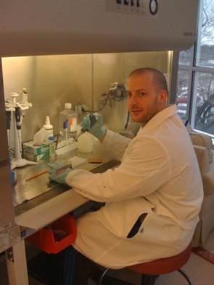
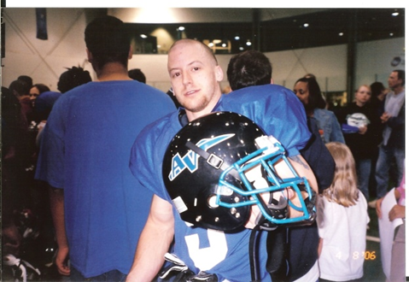
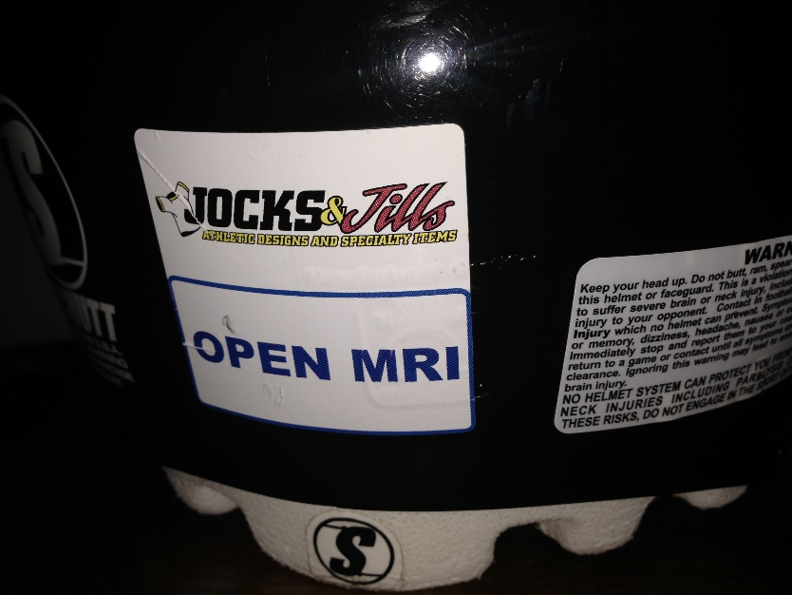
From The Field To The Lab: Perspectives On Head Injury From A Former Football Player And Current Scientist: Part Two
Presented by:
Jordan Taylor, Ph.D. (Candidate), M.Ed., CSCS
Department of Physical Therapy & Rehabilitation Science
University of Kansas Medical Center

Slide 2
Detecting Brain Injury
Longitudinal study of high school football players
  tested in Aug, Oct, Dec (N=21; 48 games/practices; 15,264 collisions ≥ 14.4g)
  HIT system (helmet accelerometers) data
  ImPACT neurocognitive testing
  fMRI
Three outcome groups (N=11 with no missing data)
  No symptoms and no change in ImPACT scores (n=4)
  Symptoms present with impaired ImPACT scores (n=4)
  No symptoms, but impaired ImPACT scores & altered brain activity (n=4)
  Visual working memory
  Dorsolateral prefrontal cortex
  Correlated with higher numbers of hits to top-front of head
Unlikely to undergo medical evaluation, so will continue sports & also may experience post-concussive symptoms
Talavage TM, Nauman E, Breedlove EL, Yoruk U, Dye AE, Morigaki K, Feuer H, Leverenz LJ.
Functionally-Detected Cognitive Impairment in High School Football Players Without Clinically-Diagnosed Concussion. J Neurotrauma, 2010 Oct 1. PMID: 20883154

Slide 3
Adult vs. Adolescent Brain
Recent media coverage of sports-related concussions is of retired professional football players
Adolescent brains are more likely to have:
  Diffuse injury to brain tissues
  Prolonged brain swelling
  Slower recovery
  Neurological deficits following re-injury
  Greater potential for lingering problems with learning, memory, judgment, and social behavior
  Challenges related to other high school activities – academic, social, etc.
Keep in mind that an “adult” pattern of brain connections doesn’t mature until 18-24 years of age
Collins, 2010

Slide 4
Severity vs. Number
Blows to the head
  All are serious!
  That includes “dings” and “having your bell rung”
  < 10% of concussions occur with loss of consciousness
Repeated hits may lead to:
  Slowed thought processes, memory problems, behavior changes
  Long-term effects may include depression or suicide
We don’t know how hard, how often, or for how long before repetitive injuries become a problem
Most (~80%) of concussed athletes will be fully recovered within 3 weeks
Weir et al., 2009

Slide 5
Male vs. Female
Sex appears to affect rates & outcome
Females are:
  twice as likely to sustain a concussion
  also are more likely to report sleep disturbances and headaches
  more likely to have post-concussive syndrome at one, three, and six months post-injury
  less likely to be in school one year after injury
Lincoln, et al., 2011

Slide 6
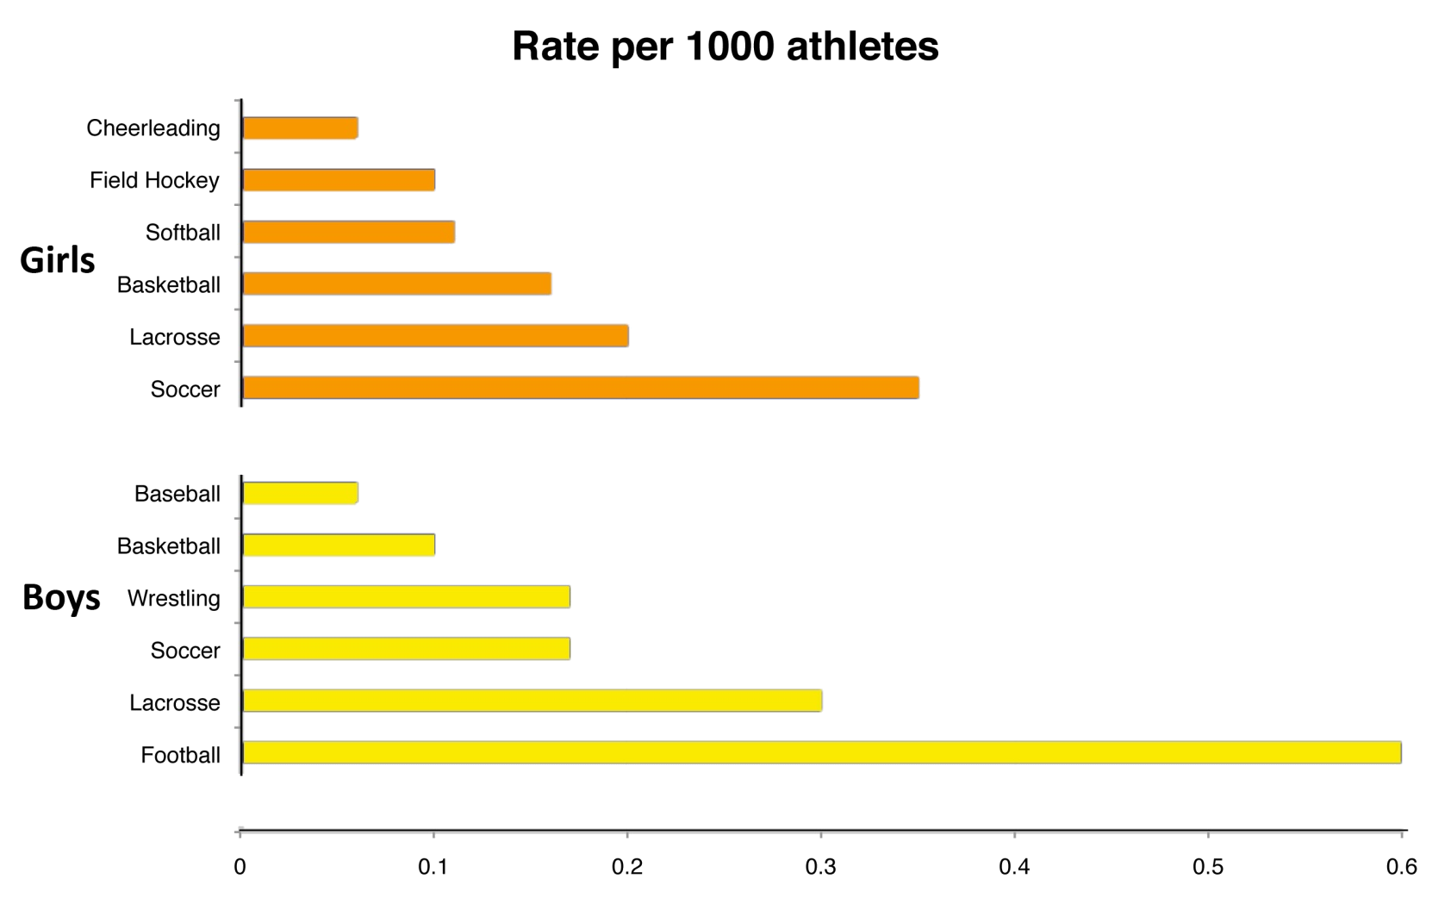
High School Sports Concussions
60% higher rate than boys
180% higher rate than boys
Are rates for girls really higher, or are girls more likely to report brain injuries?
Girls also appear to require a longer recovery than boys. Same issues?

Slide 7
High School Sports Concussions
              • from 1996-1999; rate is likely to be higher now due to changes in the sport
              • only sport where more injuries occur in practices than in competitions
              • highest risk sport when calculated as individual participant risk
              • A cheerleader has a 67% chance of experiencing a concussion

Slide 8
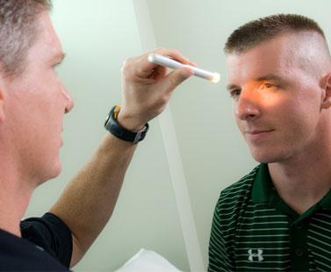
Diagnosis
How does a doctor diagnose a concussion?
  Symptom reporting
  Athlete
  Parent
  Coach or trainer
  → Other players!
  Physical Signs (balance!)
  Behavioral Changes
  Cognitive Impairment
  Sleep Disturbances
Neuroimaging?
  Functional MRI (fMRI; activity)
  Diffusion Tensor Imaging (DTI; axonal connections)
  Susceptibility-weighted imaging (SWI/BOLD; blood flow)

Slide 9
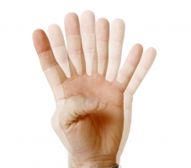
Concussion Management: Physical
Recognition of signs and symptoms
Loss of consciousness or amnesia do not always occur with concussion
Under reporting
  65% of football players do not report
  > 50% of hockey players do not report
Why not?
  They want to continue playing
  Don’t want to let team/coach/parents down
  Don’t understand the consequences of continued play
  Don’t recognize/don’t show signs or symptoms

Slide 10
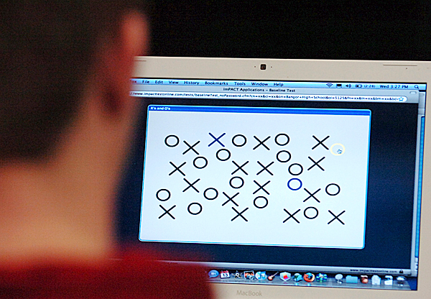
Concussion Management: Cognition
Assessment of cognitive function
“Person, Place, and Time” no longer is sufficient
Neurocognitive exams:
  - To determine recovery & return-to-play/practice
  - Baseline (for later comparison)
  - Sideline evaluation
  - “Catch” those people who are under-reporting symptoms

Slide 11
Neurocognitive Tests
“Tools” that assist doctors with making difficult return-to-play decisions
Computerized Testing:
Concussion Resolution Index-
- Tests memory and reaction time
- Administered & interpreted by a licensed medical professional
- 25 minutes to complete exam
ImPACT (Immediate Post-Concussion Assessment and Cognitive Testing)-
  - Most widely used (H.S., collegiate, professional) computer-based testing program
  - Tests attention span, memory, problem solving, processing speed, and reaction time
  - Approx $2/test ($8 post-injury)
  - Can administer multiple tests at the same time
  - Administered by any trained individual (coach, school nurse, athletic trainer, team doctor)
  - Interpreting results requires training (per ImPACT Applications, Inc.), and results should be reviewed by a doctor

Slide 12
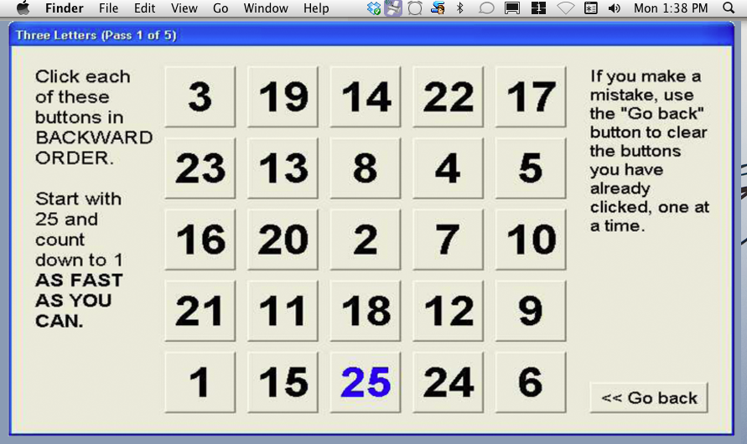
ImPACT Testing

Slide 13
Neurocognitive Tests
Interview Assessment:
Axon Sports
- Measures processing speed, attention, learning, and memory
- Features 2 tests: Baseline and Post-Injury
- Each test features 4 tasks that use playing cards
- Test may be administered by anyone, but results must be interpreted by a licensed medical professional
SCAT3 (Sport Concussion Assessment Tool 2)
- Free test; 20 minutes of 1-on-1 time to administer
- Tester training and consistency is critical for valid results
- Standardized results don’t presently exist

Slide 16
Exciting Technological Advancements for Concussion Assessment
Capacity Sports (CEO; Chase Curtiss) in conjunction with researchers at Wichita State University and University of Kansas Medical Center:
Utilizing Smartphone technology as a biomedical device for concussion assessment
- Use iPhone, iPod touch, iPad, and android to measure balance, reaction time, working memory, and memory retention
- Profile is created for each athlete
- Baseline and Post-concussion measurements
- Tests can be conducted in 5-7 minutes
- Data can be view by team athletic trainer, coach, and/or doctor affiliated with the school
- Data for all devices throughout the country is uploaded to a database in Tulsa, OK
- The uploaded national data can be organized and viewed for many variables (Sport, position, gender, age, etc.)
- Currently being used in USD 259 schools (Wichita, KS area)
- “Concussion Manager” currently not available in the App Store

Slide 17
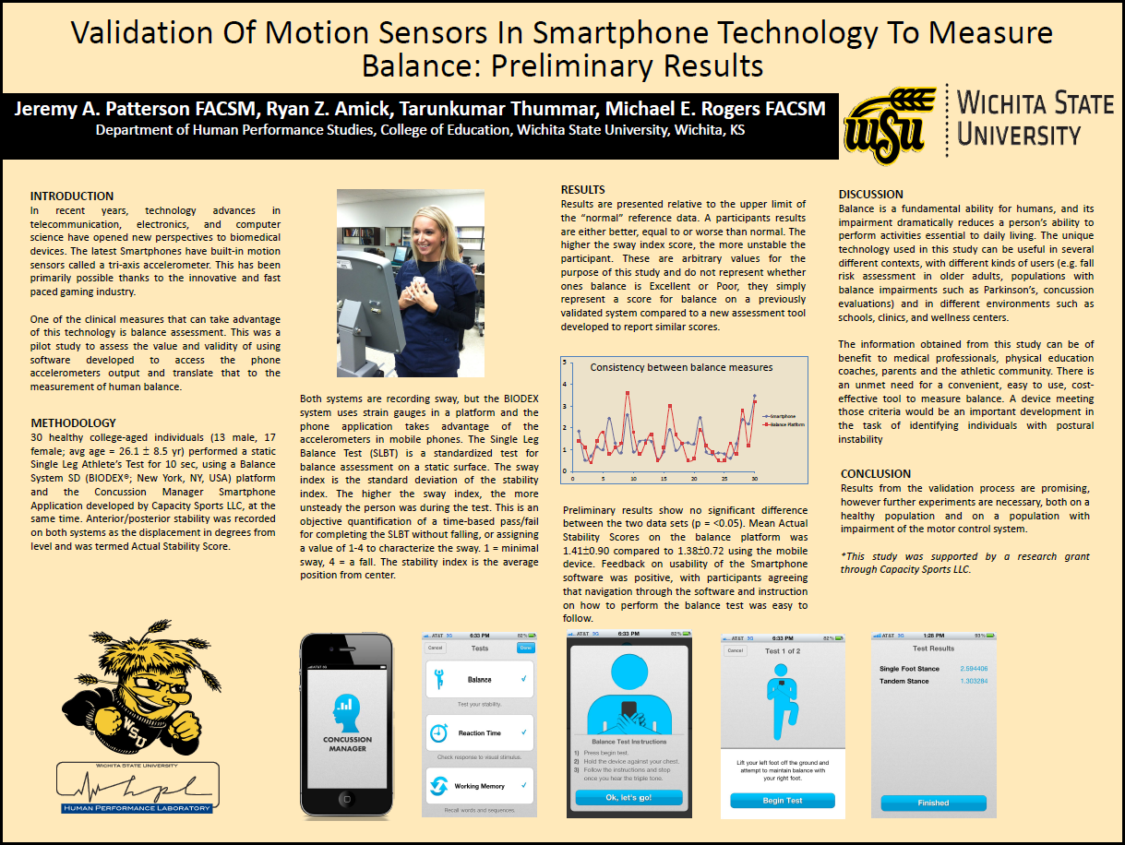

Slide 18
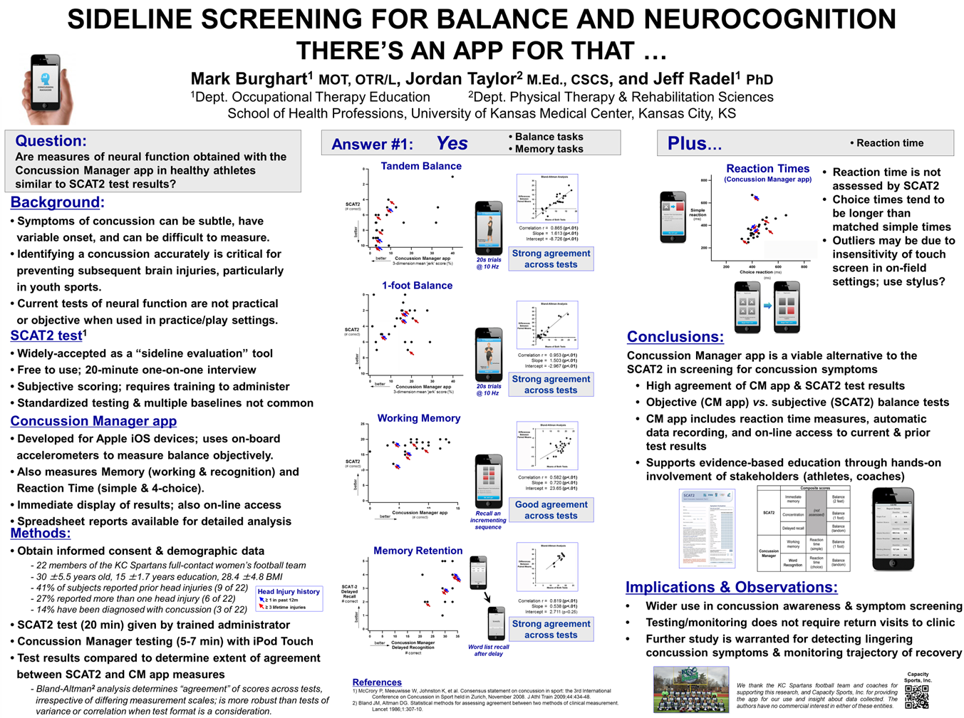

Slide 19
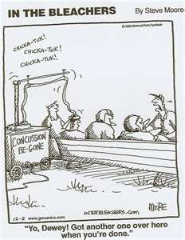
Return-To-Play Guidelines
No post-concussion symptoms!
Graduated return-to-practice, then return-to-play
  Physical and cognitive stepwise approach
  Each step over 24 hours
  If symptoms appear at next step, take one step back
Final clearance by licensed medical personnel
  Is a law in Kansas & Missouri

Slide 20
Steps To A Safe Return
Step 1. No Activity
→ Complete physical and cognitive rest
→ Stay home from school, job?
→ No homework, texting, videogames, reading…
Step 2. Light aerobic exercise; OK’ed by physician
Step 3. Sport-specific exercise; running, no pads
Step 4. Non-contact training drills, weights
Step 5. Full contact practice
Step 6. Return to play; must be cleared by physician
McCrory et al., 2009

Slide 21
Points of Influence
• watch for potential head injuries
• wear protective gear properly
• use caution in risky drills & limit full contact practices to no more than 1-2x/week
• sit out & report players with symptoms
• listen to players’ locker room chatter
• no driving if symptoms suspected!
• hydration & adequate conditioning
conditioning (neck strengthening)
• cross-training
• agility training
• communication among coaches
• report head injuries
Pre-season
Practices
Games
Post-season
• conditioning
• education
- players
- AD/coaches/trainers
- referees
- parents
- teachers
• concussion waiver
• baseline testing
• concussion history
• recondition protective gear
• trainers attending games
• “spotters” to identify potential head injuries
• players monitoring teammates for signs
• sideline overly-aggressive players
• support referee decisions
• model/encourage good sportsmanship

Slide 22
Medical Personnel
Injured Athlete Action Plan
Off the field
  stay current with mTBI literature
On the field
  Check ABC’s
  Initial disposition (emergency transport vs. sideline evaluation)
  Focused neurological assessment
  Cervical Spine
  Mental status
  Neurological deficit
  Detailed history, physical exam, cognitive exam
  Signs and symptoms of current condition including number and severity of previous concussions and when they took place
  Assess…
… re-assess…
... and re-assess AGAIN!

Slide 23
Furthermore
Any evidence of deterioration, no matter how mild the injury, justifies immediate transport to a Trauma Center or Emergency Department for evaluation
  Subdural hematomas tend to present with no initial signs, but then a rapid deterioration occurs
  Consider trauma activation?
Re-assess any player who may have sustained a head injury at the end of the game, before they leave the field
Watch for signs/symptoms in any players

Slide 24
Injured Athlete Algorithm
Complains of signs or symptoms
Not complaining of signs or symptoms
Use side-line test (SCAT3,
concussion manager app., etc.)
Athlete should not return to play, should be assessed medically, should not be left alone, and should not drive a motor vehicle
Fails test
Passes test
??
Follow return-to-play policy:
Step 1. No Activity
Step 2. Light aerobic exercise
Step 3. Sport-specific exercise; running, no pads
Step 4. Non-contact training drills, weights
Step 5. Full contact practice
Step 6. Clearance by licensed medical personnel
Athlete may return to play

Slide 25
National Federation of High Schools (NFHS)
Concussion Policy:
Any player who shows signs, symptoms or behaviors associated with concussion must be removed from the game and shall not return until cleared by a health care professional trained in concussion management
Officials must remove the player who shows signs of concussion, including “loss of consciousness, headache, dizziness, confusion, balance problems, etc”
“Given that the vast majority of concussions do not include a loss of consciousness, but that athletes often show obvious evidence of concussion, the NFHS Sports Medicine Advisory Committee strongly believes that officials must continue to be empowered to remove these athletes from play, thus protecting them from further injury”
All State Associations follow NFHS rules

Slide 26

Save our Sports
10 Point Plan for Safer Sports
Encourage mandatory brain trauma education for coaches, athletic trainers, parents and athletes
Develop better methods of concussion detection and diagnosis
Develop better methods of concussion management
Reevaluate how the game is practiced
Reevaluate protective equipment
Reevaluate techniques of play
Reevaluate the rules
Reevaluate rule enforcement and the role of referees
Reconsider the culture of the game
Consider minimum medical resources

Slide 27
Education Resources
Boston University Center for the Study of Traumatic Encephalopathy
- http://www.bu.edu/cste/
Sports Legacy Institute
- http://www.sportslegacy.org
Centers for Disease Control & Prevention - “Heads Up” program
- http://www.cdc.gov/concussion/HeadsUp/Training/HeadsUpConcussion.html
- http://www.preventingconcussions.org (free continuing education course)
National Federation of State High School Associations
- http://www.nfhslearn.com/electiveDetail.aspx?courseID=15000 (free on-line course)
ImPACT training workshops
- In-person
- http://impacttest.com/training/workshops (fee-based on-line courses)
NCAA video (is well-suited for educating student athletes)
- http://s3.amazonaws.com/ncaa/web_video/health_and_safety/concussion/concussion.html

Slide 28
Thank You’s & Contacts for More Information
Jordan Taylor, Ph.D. (candidate), M.Ed., CSCS
University of Kansas Medical Center
jtaylor@kumc.edu
785-215-4556 or 913-588-2732
Nancy Berman, Ph.D.
University of Kansas Medical Center
nberman@kumc.edu
913-588-2712
Jeff Radel, Ph.D.
University of Kansas Medical Center
jradel@kumc.edu
913-588-7195
Jeremy Patterson, Ph.D.
Wichita State University
jeremy.patterson@wichita.edu
316-978-5440
Chase Curtiss, M.Ed.
CEO of Capacity Sports
chase@capacitysports.com
918-728-1688
Chi-ming Huang, Ph.D.
University of Missouri Kansas City
HuangC@umkc.edu
816-235-2582

