Slide 1
CONNECTING THE DOTS: THE POLITICS & ECONOMICS OF INEQUALITY
Presentation by Ester Holzendorf & Dave Kingsley
Community of Reason
August 10, 2014
Notes:
<number>

Slide 2
Topic for today
Connecting the dots between crime, poor education, substandard housing, malnutrition, unsafe and underserved neighborhoods, unemployment, poverty and poor health
How plutocratic parasites control the political process and destroy lives: (1) Unlimited and corrupt expenditure of money on campaigns (2) Fiscal and monetary policy which redistributes wealth from lower income strata to wealthy few (3) Disassembling government power to protect working class (4) Deregulation of financial sector, which allows for predatory lending (5) Privatizing government functions and commoditizing citizens

Slide 3
UNDERLYING POLITICAL & ECONOMIC CAUSES
So-called “neoliberal capitalism”
Mythical free market: free market free for all & law of the jungle
Corporate control over political process through unbridled expenditures, and amoral political behaviors driven by highest bidders
Monetary & fiscal policy designed to benefit the corporate elites, financial services industry, & wealthiest Americans

Slide 4
What the Media Wants You to Believe
Deficiency in the victims
More and better education will solve violence, housing, health, and employment problems
Success is due to hard work and intelligence,
Economics are driven by natural laws and that down cycles with high unemployment are inevitable

Slide 5
What we believe
Poverty and blighted neighborhoods are caused by monetary, fiscal, and other government policy
Individuals stuck in poor neighborhoods with all of the attendant problems of that ecology are victims of macroeconomics not a natural deficiency.
People living in poor neighborhoods are at the highest risk of becoming victimized by corporate super-predators

Slide 6
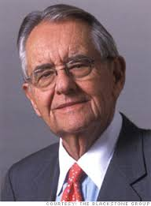
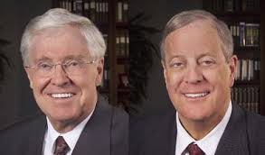
Example of plutocratic parasite
Peter G. Petersen
Koch Brothers

Slide 7
Plutocracy & Parasite: Definitions
Plutocracy: 1: government by the wealthy, 2: a controlling class of rich men.*
Parasite: 1: one frequenting the tables of the rich and earning welcome by flattery: sycophant 2: an organism living in or on another organism in parasitism, 3: something that resembles a biological parasite in dependence on something else for existence or support without making a useful or adequate return.* *Webster’s New Collegiate Dictionary (1981). Springfield, Massachusetts: G. & C. Merriam.

Slide 8
Plutocratic Parasite: Our Definition
An individual, corporation or institution allied with plutocratic power who or which exist in a parasitic relationship with the lower income strata of society.
Plutocratic parasites engage in a wide range of predatory behaviors for the purpose of enriching themselves at the expense of vulnerable lower income individuals & neighborhoods.
In Kansas City, plutocratic parasites are manifested through government subsidies in the form of TIF projects, subprime lending in the form of housing, auto, and payday lending, regressive taxation, prison-industrial complex, abandoned & blighted neighborhoods, poverty-level wages, and control of the political process through venal behavior & corrupt spending.

Slide 9
Economic Devastation of Eastside KCMO
Estimated 7,000 to 10,000 abandoned properties
Unknown number of absentee owners
Homes in most distressed neighborhoods repeatedly flipped by out of neighborhood investors
Loss of equity and assets of current homeowners – many of whom are elderly
Poorest people concentrated in Eastside neighborhoods

Slide 10
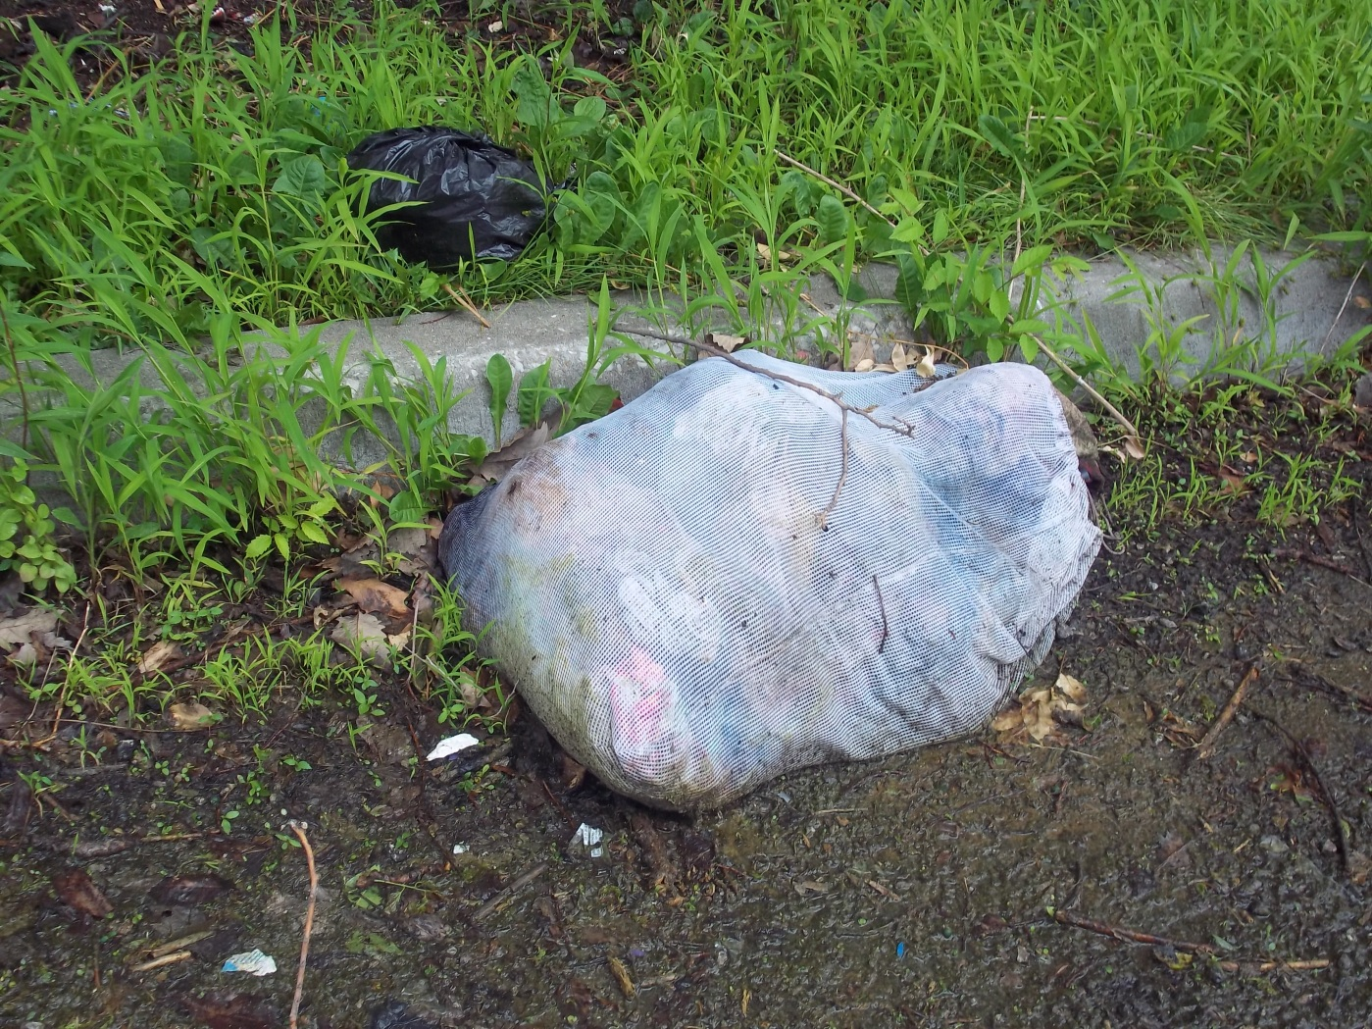
Plutocratic governance doesn’t care about poor neighborhoods

Slide 11
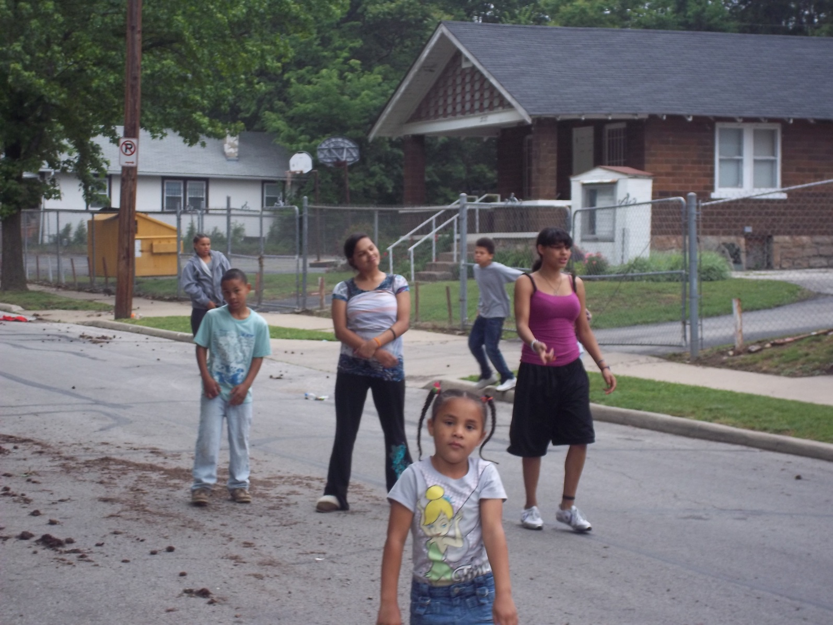
Where children play in a blighted neighborhood

Slide 12
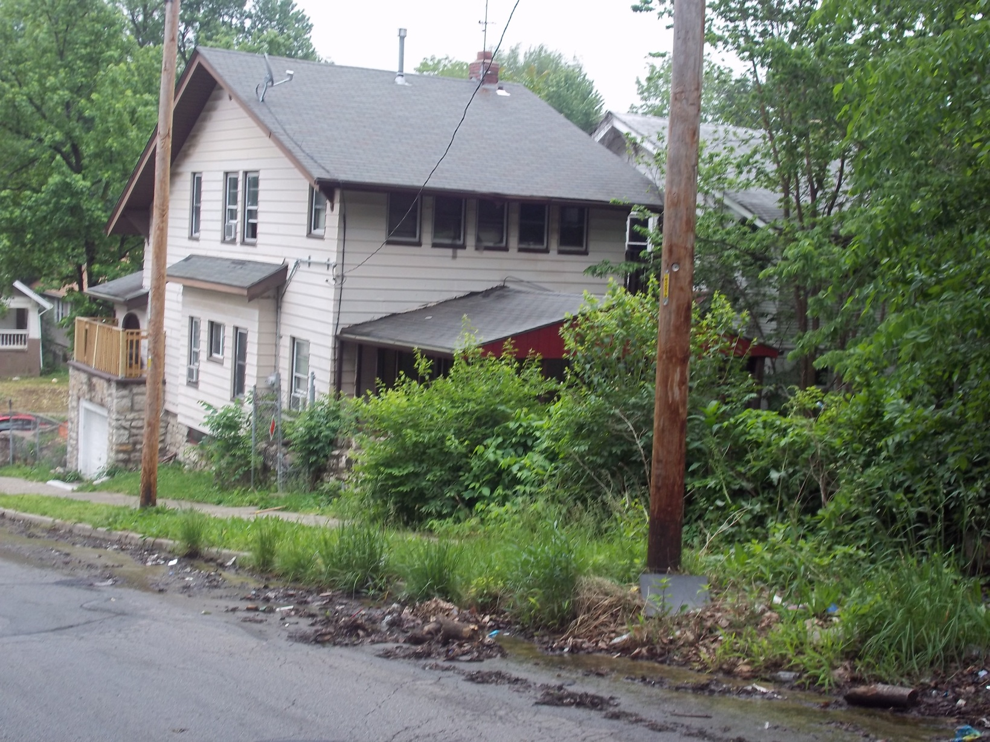
What children live next to in a blighted neighborhood

Slide 13
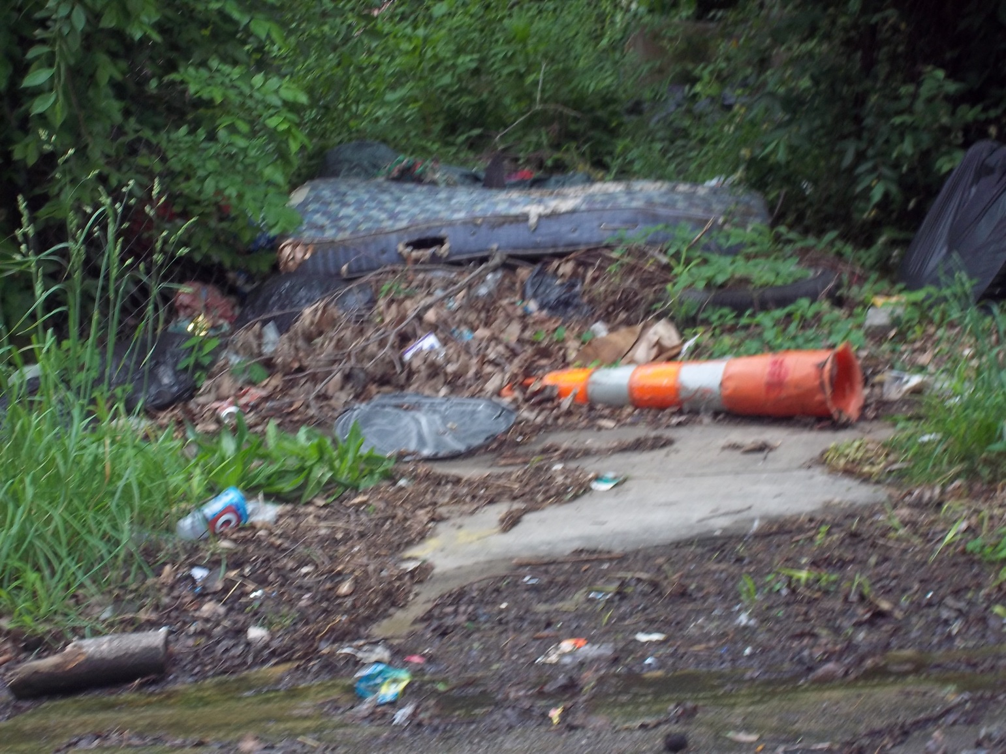
In the children’s backyard

Slide 14
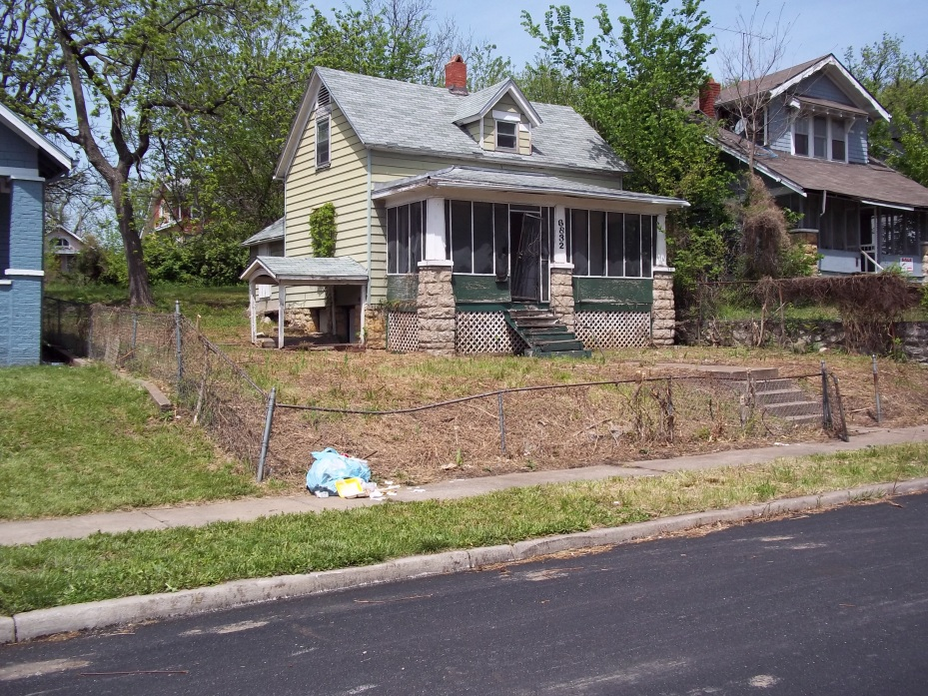
3832 Chestnut: The Federal Government Abandoned This House

Slide 15
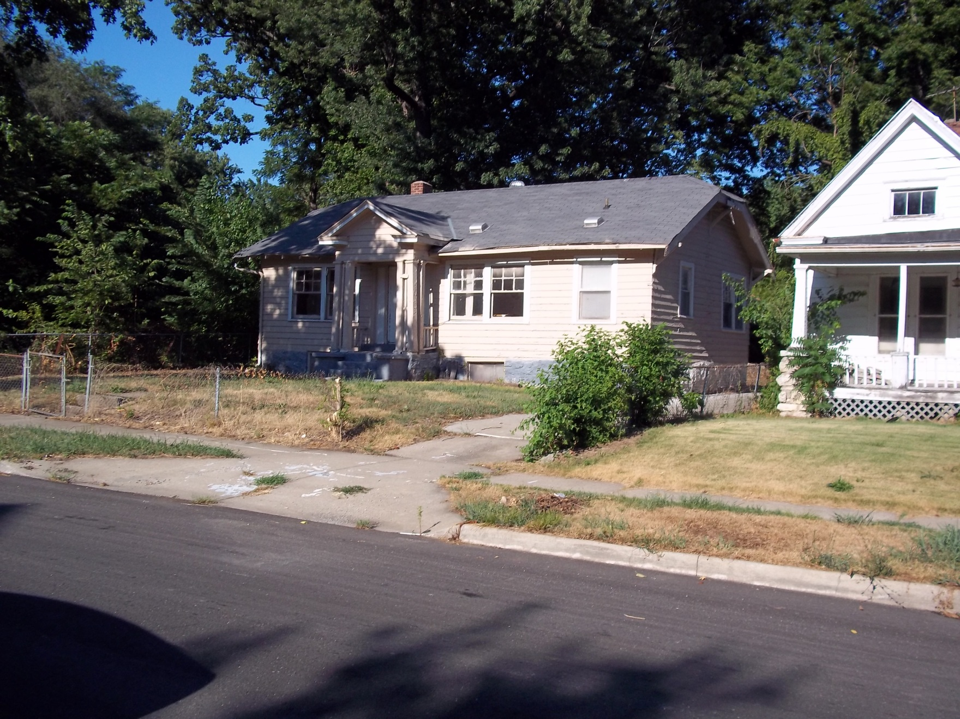
Owned by the City

Slide 16
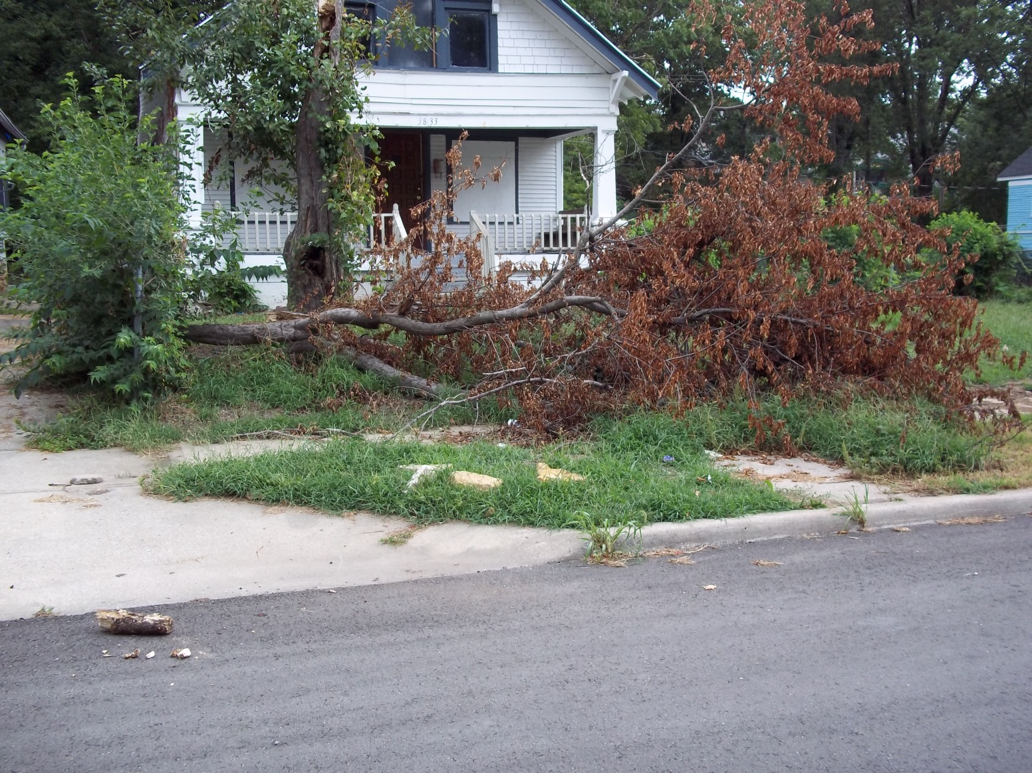
Owned by the City
Notes:
<number>

Slide 17
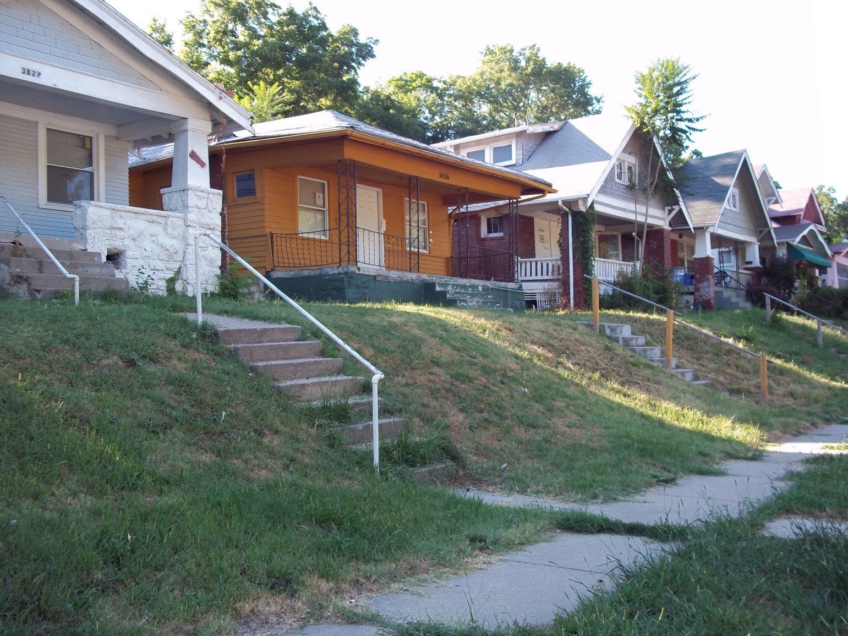
Drug/Prostitution House: owned by investors

Slide 18
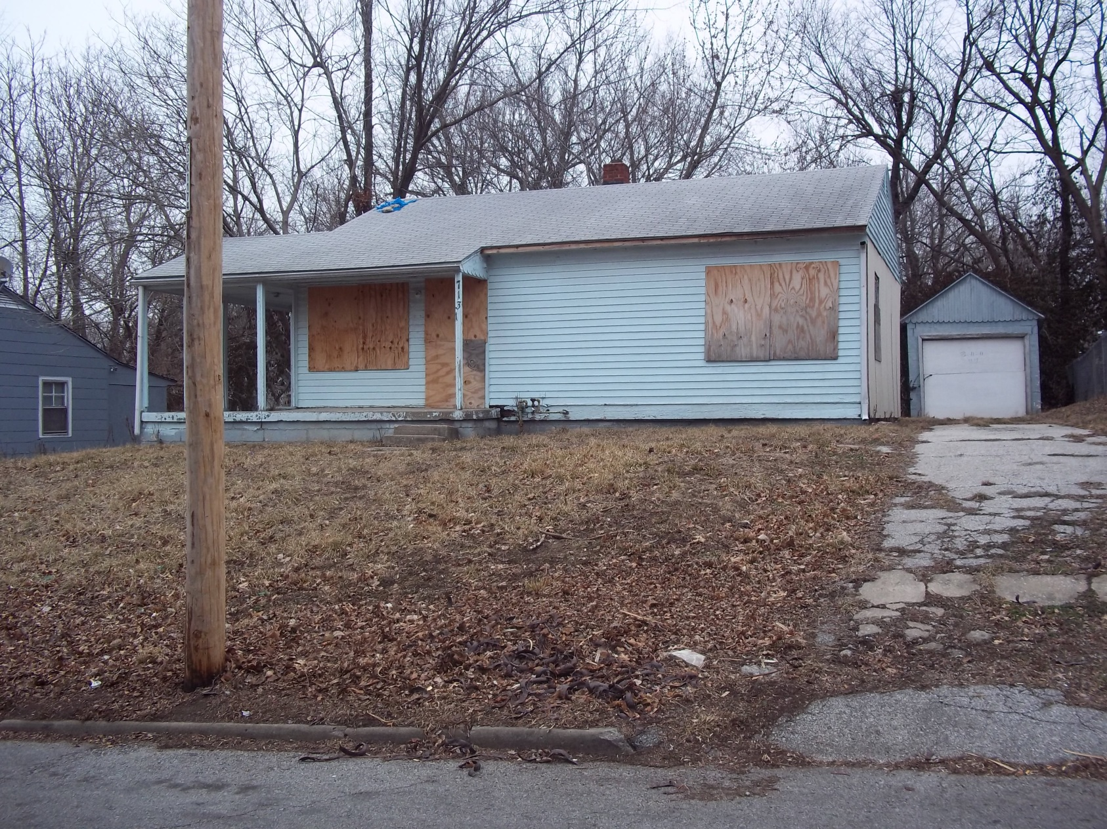
Next Door

