Slide 1
The Bible
A Crash Course in 8 Sessions
Session 1
Background – Part 1

Slide 2
Oscar Wilde’s View of the Bible
The Book of Life begins with a man and a woman in a garden. It ends with Revelations.
--Oscar Wilde, A Woman of No Importance

Slide 3
Mark Twain’s View of the Bible
Re the Bible: “It is full of interest. It has noble poetry in it; and some clever fables; and some blood-drenched history; and some good morals; a wealth of obscenity; and upwards of a thousand lies.”
--Mark Twain

Slide 4
What is the Bible?
The Bible is a collection of ancient writings, or books, in a number of different genres.
Ancient world views
Biblical versus Greek literature
Monotheism, social justice, and humility
Anthropomorphic views of God

Slide 5
What is the Bible saying?
Some would argue that the Bible is the story of God’s revelation to Israel and to humans.
Others would argue that the Bible is the story of Israel’s response to the call of God.
Still others would argue that the Bible is the story of Israel’s response to the concept, or idea, of God.

Slide 6
Bible Problems
Inspiration – Is the Bible divinely inspired and if so, in what way? Does it really matter?
Canonicity – What writings should be in the Bible?
Texts – How close are the existing manuscripts of the Bible to the original texts? And does this really matter?
Languages – Can the words of the Bible be fully understood today and accurately translated?
Interpretation – How do we interpret the words and ideas in the Bible?
Historicity – Is the Bible historically accurate? Does this really matter?

Slide 7
Two Kinds of Critical Study
Higher Criticism – Examines the Biblical texts
as literature by using historiographic,
literary, and linguistic tools
Lower Criticism – Efforts to discover and
reconstruct Biblical texts based on existing
manuscripts

Slide 8
Tools Used By Biblical Scholars
Textual criticism – Tries to determine which ancient manuscripts are closest to the original
Literary criticism
> Form criticism – How were literary units, or
genres, used?
> Source criticism – Tries to identify sources used
to create a text
> Redaction criticism – Tries to uncover the work
of the final editors of a text
History of Religions criticism – Looks at the religion of ancient Israel in relation to other ancient religions
Archeology

Slide 9
Some Views of Inspiration
The Church has traditionally held that the writings in the Bible are in some way inspired by God.
This is based on two NT verses: 2 Timothy 3:16-17 and 2 Peter 1:19-21.
Are the words of scripture, or the human writers of scripture, inspired? Or both?

Slide 10
Arguments for Inspiration
The historical statements in the Bible are supported by other evidence and by archaeology.
The Bible is consistent and free of contradictions.
The Biblical text has been faithfully transmitted.
Are these arguments valid?

Slide 11
Views of Human Inspiration
The human writers were the instruments through whom God has spoken.
The human writers were the persons through whom God dictated the words of scripture.
The human writers were the messengers of God; they themselves chose the words used to convey the messages of God.
The Bible writers were not divinely inspired.

Slide 12
Views of Verbal Inspiration
The words, and perhaps even the letters of the words, were dictated by God to the Bible writers.
God did not dictate the words of scripture, but insured that the Bible writers did not error in what they wrote.
Only some parts of the Bible were inspired by God, whereas other parts are from the human writers alone.
Although not directly inspired, the Bible demonstrates the divine ability to use scripture.
The Bible is not necessarily inspired at all because the messages of the Bible can stand on their own.

Slide 13
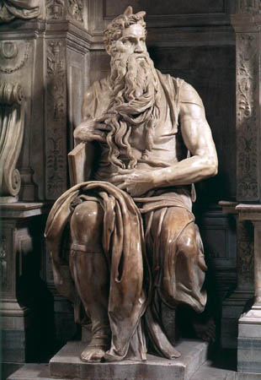
The Hebrew Canon (TaNaKh)
Law (Torah) Genesis Exodus Leviticus Numbers Deuteronomy | Prophets (Nevi’im) Joshua Judges Samuel Kings Isaiah Jeremiah Ezekiel The Minor Prophets: Hosea, Joel, Amos, Obadiah, Jonah, Micah, Nahum, Habakkuk, Zephaniah, Haggai, Zechariah, Malachi | Writings (Kethuv’im) Psalms Job Proverbs The Five Scrolls (Megilloth) Song of Solomon Ruth Lamentations Ecclesiastes (Qoheleth) Esther Daniel Ezra-Nehemiah Chronicles

Slide 14
Rabbinic Canon Criteria
The book had to be written in the lingua
sacra (Hebrew).
The book had to have been purportedly
written no later than the time of Ezra
(c. 400 BCE).
The book had to be consistent with the
beliefs of the rabbis.

Slide 15
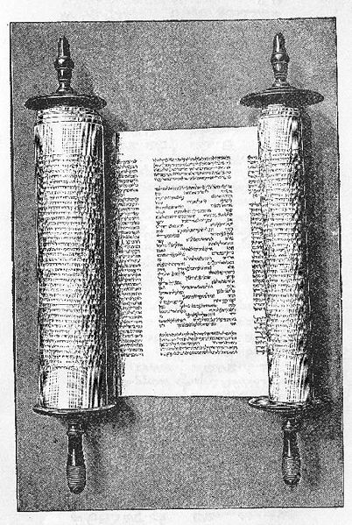
Canons of the Jewish Sects
Sadducees – Torah only
Samaritans – Torah only
Pharisees – Tanakh + Mishna (Oral Law)
Essenes – Tanakh + other books?
Karaites – Tanakh only

Slide 16
The Greek Canon (Septuagint)
Historical Books Genesis Exodus Leviticus Numbers Deuteronomy Joshua Judges Ruth 1-2 Samuel 1-2 Kings 1-2 Chronicles Ezra Nehemiah Esther (with additions) Tobit Judith 1-2 Maccabees 1-2 Esdras* 3 Maccabees* 4 Maccabees* (as an appendix) | Poetic Books Job Psalms Proverbs Ecclesiastes (Qoheleth) Song of Songs Eccesiasticus (Sirach) Wisdom of Solomon Prayer of Manasseh* | Prophetic Books Isaiah Jeremiah Lamentations Ezekiel Daniel (with additions) Hosea Joel Amos Obadiah Jonah Micah Nahum Habakkuk Zephaniah Haggai Zechariah Malachi Baruch 1-2 Enoch*

Slide 17
Summary of the Canons
Jews: Tanakh + Mishna
Protestants: Tanakh + New Testament
Roman Catholics/Orthodox: Tanakh +
Apocrypha + New Testament

Slide 18
Biblical Languages
Tanakh (OT) – Hebrew (parts of Ezra and
Daniel are in Aramaic).
Apocrypha – Tobit – Aramaic (Greek)
Judith – Aramaic (Greek)
1 Macc – Hebrew (Greek)
2 Macc – Greek
Sirach – Hebrew (Greek)
Wisdom – Greek
Baruch – Hebrew? (Greek)
New Testament - Greek

Slide 19
Canaanitic Languages
Canaanitic | Ammonite
 | Edomite
 | Moabite
 | Amarna
 | Phoenician | Standard | Littoral
 |  |  | Punic
 |  | Byblian
 | Hebrew | Northern | Mishnaic
 |  | Southern | Medieval
 |  |  | Modern

Slide 20
Hebrew
Hebrew uses a consonantal script.
Markers for vowels, called vocalization,
were not added until the 8th century CE.
Aramaic replaced Hebrew as the common
language of the Jews in the 5th and 4th
centuries BCE.
Other Semitic languages include Akkadian
(Eastern), Arabic (Southern) and the
languages of Ethiopia (Ge’ez and Amharic).

Slide 21
Aramaic Languages
Ugaritic | Ugaritic
Aramaic | Old Aramaic
 | Imperial Aramaic | Syriac
 |  | Late Eastern | Babylonian
 |  |  | Mandaic
 | Middle Aramaic | Late Western | Galilean
 |  |  | Samaritan
 |  |  | Judean
 |  |  | Ma’loula

Slide 22
Aramaic
The language of Aram (Syria) became widespread in the ANE because it was one of the first alphabetic languages.
It is also a consonantal language and it was the common language of Galilee and Judea at the time of Jesus.
The Hebrew alphabet is taken from Aramaic.

Slide 23
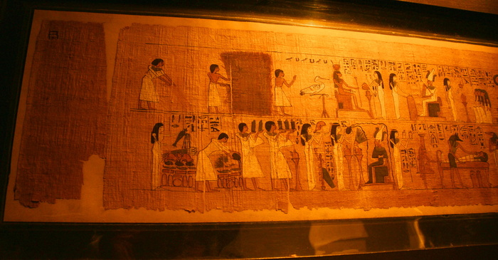
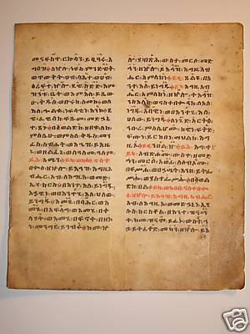
Writing Materials
Surfaces:
Papyrus
Animal Skins (Parchment, Vellum,
and Leather)
Paper
Ink:
Carbon Black
Metallic-based
Formats:
Scrolls (up to the 8th cent. CE for Jews)
Codices (1st cent. CE for Christians)

Slide 24
Four Stages of Text Transmission
Initial, oral stage – divergent oral traditions
Written transmission of texts now lost
Completely written traditions replace the oral ones – some texts are still extant from as early as 250 BCE
Textual standardization – 1 CE to 200 CE

Slide 25
When the Tanakh Was Written
10th c. BCE – J Tradition
9th c. BCE – E Tradition
8th c. BCE – Royal Annals, Proto-Isaiah (1-35), Hosea,
Amos, Micah
7th c. BCE – Zephaniah, Nahum, Habakkuk, Obadiah,
Deuteronomy
6th c. BCE – Deuteronomic History (Deuteronomy+Joshua+
Judges+Samuel+Kings), Jeremiah, Ezekiel,
Isaiah (40-66), Lamentations, P Tradition, Haggai,
Proto-Zechariah (1-8), Job
5th c. BCE – Genesis+Exodus+Leviticus+Numbers+Deut (Torah),
Malachi
4th c. BCE - Final framework for the Prophets, Joel?, Jonah,
Deutero-Zechariah (9-14), Ezra-Nehemiah, Chronicles,
Ruth, Song of Songs, Proverbs, Ecclesiastes
2nd c. BCE – Most of Apocrypha, Final Psalms, Daniel, Esther?

Slide 26
Who Wrote the Tanakh?
Anonymous – Genesis through Job, some Psalms, some Proverbs, Isaiah 36-66, Daniel 1-6, Jonah, Zechariah 9-14, narrative framework for the Prophets, Tobit, Judith, 1 Maccabees, 2 Maccabees
Eunonymous – Some Psalms?, some
Proverbs, Isaiah 1-35, Jeremiah, Ezekiel,
Hosea, Joel?, Amos, Obadiah, Micah,
Nahum, Habakkuk, Zephaniah, Haggai,
Zechariah 1-8, Malachi, Sirach
Pseudonymous – Some Psalms?, some
Proverbs?, Ecclesiastes, Song of Solomon,
Daniel 7-12, Baruch, Wisdom of Solomon

Slide 27
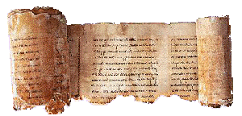
Hebrew Manuscripts
Dead Sea Scrolls (250 BCE – 135 CE)
Masoretic Texts (MT):
Cairo Prophets (895 CE/1890’s)
Aleppo Codex (930 CE)
Leningrad Codex (1009 CE/1839)
Samaritan Pentateuch (12th c. CE)

Slide 28
Subsequent MT Manuscripts
These date from the 11th to the 15th centuries CE.
Shephardic (Spain)
Ashkenazi (Germany)
Italian
Yemenite

Slide 29
Printed Texts - Hebrew
Soncino (1488) – Shephardic texts
Rabbinic Bible (1517)
Rabbinic Bible (1525) – Jacob ben Hayyim
(Textus Receptus) – Shephardic texts
Ginsberg (1926) – ben Hayyim text
Snaith (1928) – Shephardic and Yemenite
Biblia Hebraica (1937) – Kittel and Kahle
Based on Leningrad Codex

Slide 30
Ancient Translations
Aramaic – Targums (OT only)
Greek – Septuagint (OT only)
Latin – Vulgate (OT and NT)
Syriac – Peshitta (OT and NT)

Slide 31
Aramaic Translations or Targums
Babylonian Targums
Targum Onqelos to the Pentateuch
Targum Jonathan to the Prophets
Palestinian Targums
Targum Yerushalmi to the Pentateuch
(Codex Neofiti 1 in the Vatican)
Pseudo-Jonathan to the Pentateuch

Slide 32
Greek Translations
Pre-Christian papyri (2nd c. BCE-100 CE)
Origen’s Hexapla (3rd c. CE)
Codex Vaticanus (mid-4th c. CE)
Codex Sinaiticus (mid-4th c. CE)
Codex Alexandrinus (5th c. CE)
Codex Marchalianus (6th c. CE)
Miniscule manuscripts (9th – 15th c. CE)

Slide 33
Latin Translations
Old Latin
Vulgate – Codex Amiatinus (8th c., Florence)
Codex Gigas (13th c., Stockholm)

Slide 34
Syriac Translations
Old Syriac (no OT MSS survive)
Peshitta
Add. 14,425 (Torah less Leviticus) (5th c. CE,
British Library)
Biblioteca Ambrosiana (all of the OT, 6/7th c.
CE, Milan)
Syr 341 (all of the OT, 8th c. CE, Paris)

Slide 35
Summary
1. Most of the Tanakh, as we now it today, was written, or redacted,
between 600 BCE and 200 BCE.
2. There are two periods from which Hebrew manuscripts survive.
1) From 250 BCE up to 135 CE; and
2) From 895 CE up to 1450 CE.
There are virtually NO Hebrew manuscripts from 135 CE until 895 CE.
3. The Hebrew text was essentially stabilized, or standardized, by
Rabbi Akiva around 100 CE. Before 100 CE, there were many
variant readings.
4. The first printed translations of the Tanakh were based on
Shephardic manuscripts dated in the 13th and 14th centuries.
Roman Catholic translations of the OT were based on the Latin
Vulgate manuscripts from the same period.
5. Modern translations of the Tanakh, whether Jewish, Protestant, or Roman
Catholic, are based on the Leningrad Codex, which dates from 1009 CE,
and the Aleppo Codex, which dates from 930 CE.
6. Many scholars believe that some of the readings from the Greek Septuagint
represent an older, and perhaps more authentic, text than the Hebrew text.

Slide 36
The Bible in English - Protestant
Wyclif – 1380’s (NT and later OT) (Handwritten)
Tyndale – NT (1525)
Coverdale –1535 in Germany
Thomas Matthew – 1537 in Antwerp
The Great Bible – 1539
Geneva Bible – 1560
Bishop’s Bible – 1560’s (last in 1602)
King James (or Authorized) - 1611

Slide 37
The Bible in English – Revisions of the AV (or KJV)
Revised Version (RV) – 1881-85
American Standard Version (ASB) – 1901
Revised Standard Version (RSV) – 1946/1952
New American Standard Bible (NASB) – 1960-71
The Living Bible – 1971 (paraphrastic)
New King James Version (NKJV) – 1979-82
New Revised Standard Version (NRSV) - 1989

Slide 38
The Bible in English – Other Modern Protestant Translations
Moffat – 1913-1926
An American Translation (“Chicago” or “Goodspeed” Bible) – 1923-35
Phillips New Testament – 1958
New English Bible (NEB) – 1961-70
Today’s English Version (TEV) (“Good News Bible”) – 1966-79
New International Version (NIV) – 1973-78

Slide 39
The Bible in English – Roman Catholic
Douay-Rheims (NT – 1582; OT – 1609/10)
Challoner (1749-52)
Confraternity Revision – 1941
Knox Bible – 1944-50
Westminster Version – 1945-49
New American Bible (NAB) – 1952-70
Jerusalem Bible - 1966

Slide 40
The Bible in English – Jewish
Torah (1785)
Lesser (1854)
Jewish Publication Society (JPS) – 1917
New JPS Bible - 1985

Slide 41
Interpretation - General
How do we determine the intended genre of a particular Biblical passage?
What is the context of the passage?
Can there be more than one context? Does the context of the reader have validity in interpreting a passage?
Have the Bible writers themselves used valid methods of interpretation?

Slide 42
Study of Interpretation
Hermeneutics – the principles of interpretation
Exegesis – the application of those principles

Slide 43
Biblical Genres
Historical narrative
Nonhistorical narrative (myth, legend)
Parables
Poetry and hymns
Proverbs
Laws
Prophecies
Apocalytic visions
Genealogies

Slide 44
Types of Interpretation
Literal sense – derives meaning from the historical context
Allegorical sense – derives meaning from the words of scripture
Typical sense – derives meaning from the things and events of scripture
Sensus plenior – “full sense”
Notes:
ll

Slide 45
Geography of Palestine

Slide 46
Regions of Palestine
Coastal Plain – Plain of Sharon
Hill Country – Judean hills and the hills of Samaria
Rift Valley – Sea of Galilee, the Jordan River, and the Dead Sea
Transjordanian Plateau – Bashan, Gilead, Ammon, Moab, Edom

Slide 47
The Coastal Plains
The Coastal Plains consists of three smaller plains:
The Plain of Acre
The Valley of Jezreel (or Esdraelon)
The Plain of Sharon

Slide 48
The Hill Country
The Hill Country consists of five regions:
The Galilean Hills
The Hill Country of Samaria
The Judean Hills
The Shephelah
The Negev

Slide 49
The Rift or Jordan Valley
The Rift or Jordan Valley has seven divisions:
The Bekaa Valley in modern Lebanon
Lake Huleh
The Sea of Galilee
The Jordan Valley
The Dead Sea
The Arabah
The Gulf of Aqaba

Slide 50
The Transjordanian Region
The Transjordanian Region has four regions:
Bashan
Gilead and Ammon
The Plateau of Moab
Mt Seir (Edom)

Slide 51
Climate
The Coastal Plains – 21 inches of rain per year with January lows in the upper 40’s and August highs in the upper 80’s
The Hill Country – 25 or more inches of rain in the north to 2 inches or less in the south – Jerusalem averages mid-80’s in August and low 40’s in January
The Rift Valley – Less than 10 inches per year with highs near 100 in the summer
The Transjordanian Region – Rainfall of 10 to 15 inches per year – Around 90 for a high in summer and upper 30’s for a low in January

Slide 52
Flora (Trees) in Ancient Times
Acacia – A hard wood
Box - Very hard, durable wood
Cedar of Lebanon – Durable, fragrant wood
Crown of thorns - Evergreen with edible fruit
Cypress – Wood was used for many items
Greek juniper – Wood useful and berries used medicinally
Oak – Hard used for construction and ship building
Pine – Two varieties, it is drought resistant
Poplar – Not widely used
Tamarisk – Short (20 ft) deciduous tree
Willow – Used for small objects and boats

Slide 53
Fauna in Ancient Times
Bear – Survived in Palestine until the 20th century
Camel – Domesticated around 1200 BCE
Deer - Two species – source of wild game
Dog - Used as watch dogs
Fox – Still commonly found
Gazelle – Source of wild game
Leopard – Survived in Palestine until early 20th century
Lion – Became extinct in Palestine in ancient times
Wolf – Survived in Galilee until 20th century
Others – Hares, rodents, etc

