Slide 1
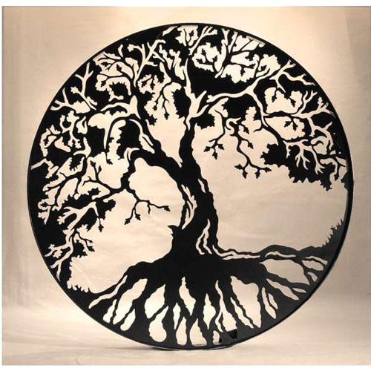
TENTH ANNUAL DARWIN DAY TODD KELSO MEMORIAL
Eliseo Fernández
Linda Hall Library of Science and Technology
How the Tree of Life Became a Tangled Web: Changes in Evolutionary Theory

Slide 2
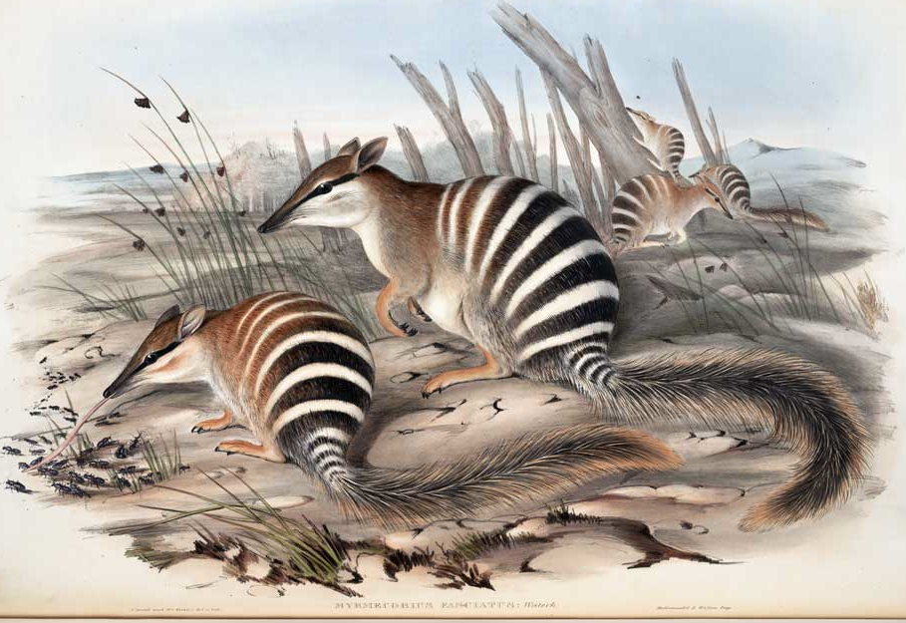
This presentation summarizes highlights of two original papers. Full versions are available at the Linda Hall Library web page: https://webmail.lindahall.org /services/reference/papers/fernandez/Tree_of_life.pdf http://www.lindahall.org/services/reference/papers/fernandez/juntofinal.pdf

Slide 3
NEO-DARWINISM
The overly restrictive denotation of the term “evolution” advocated by Neo-Darwinism was the orthodox stance on biological evolution throughout most of the past century. Evolution was conceived as an aimless process (no direction) resulting from the widespread occurrence of chance genetic variations and the continuous culling of less fitted organisms through an almost exclusive mechanism: natural selection. It is important to note that Darwin had rejected both of these positions.

Slide 4
ON NATURAL SELECTION
In the last edition of the Origin (1872): As my conclusions have lately been much misrepresented, and it has been stated that I attribute the modification of species exclusively to natural selection, I may be permitted to remark that in the first edition of this work, and subsequently, I placed in a most conspicuous position—namely at the close of the Introduction—the following words: "I am convinced that natural selection has been the main but not the exclusive means of modification." This has been of no avail. Great is the power of steady misrepresentation.

Slide 5
DIRECTIONALITY
With respect to directionality Darwin thought that evolution is progressive. In Chapter 10 of the first edition of the Origin he states: the more recent forms [of organisms] must, on my theory, be higher than the more ancient; for each new species is formed by having had some advantage in the struggle for life over other and preceding forms. (Darwin 1859, 336-37).

Slide 6
RECENT CHALLENGES
In recent decades this narrow conception has been undermined by its inability to account for new discoveries and trends in biology, such as the place of self-organization and energetics in the emergence and maintenance of life, and the roles of evolvability, epigenetic inheritance, symbiogenesis, and horizontal gene transfer in evolution. As a result there have risen many and heterogeneous attempts to revise or extend the neo-Darwinian synthesis or to replace it by other altogether different explanatory schemes. Here we will focus on some few developments related to the role of analogical thinking.

Slide 7
METAPHORS AND ANALOGIES
Analogical thinking has an essential and indispensable role in the discovery, consolidation and promotion of new ideas and patterns of reasoning.
Darwin and analogical thinking
Darwin was an exceptional thinker. Besides his extraordinary powers of observation, one is struck by his capacity for bringing together a variety of apparently unrelated examples through a marvelous knack for exploiting recondite analogies and metaphors. Here we concentrate on a very important analogy: the tree of life.

Slide 8
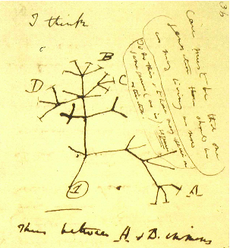
DARWIN’S ORIGINAL TREE IN NOTEBOOK B

Slide 9
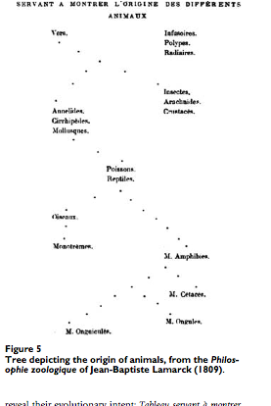
LAMARCK’S TREE

Slide 10
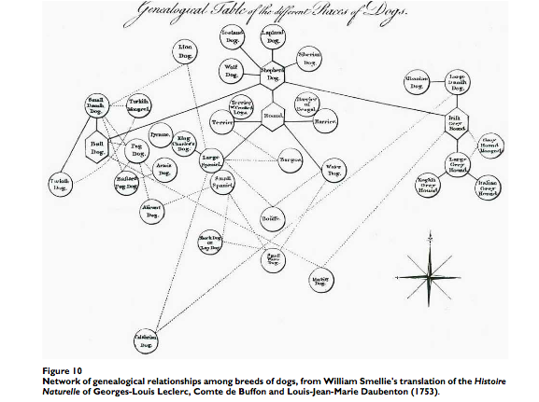
TREES OF GENEALOGY

Slide 11
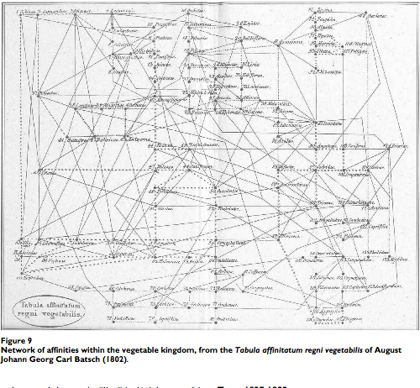
TREES OF TAXONOMY

Slide 12
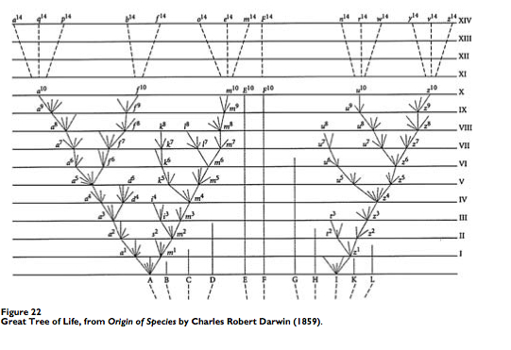
THE TREE DIAGRAM IN THE ORIGIN

Slide 13
DIAGRAMS
Diagrams ignore the “pictorial” aspects emphasized by other analogical devices to show instead relations that bind highly schematized elements, represented as featureless dots (nodes).
I think the heuristic power of Darwin’s tree rises from the fusion of two previously distinct and longstanding interpretations of the diagram: the tree of genealogy and the classificatory tree of taxonomy.
This synthesizing capacity is a special case of a more general feature that partly accounts for the heuristic fertility of analogical devices: they bring forth previously unsuspected similarities between hitherto unrelated ideas.

Slide 14
METAPHORS EVOLVE
Darwin found an improvement to the tree of life in his depiction of the “coral of life.” He was concerned that fossil species were not represented in the tree. In Notebook B [Transmutation of species (1837-1838)] p.25, he wrote: “The tree of life should perhaps be called the coral of life, base of branches dead; so that passages cannot be seen.” A tree is alive from its roots to the tips of its leaves, but corals grow on top of their calcified dead branches, which represent past lineages that no longer exist.

Slide 15
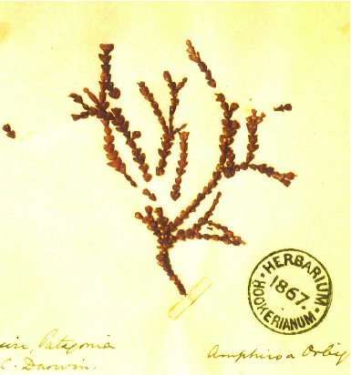
CORAL OF LIFE WITH MISSING BRANCHES

Slide 16
CONFUTATIONAL METAPHORS
According to Robert Boyd scientific metaphors are of two kinds: theory constitutive (or constructive) and pedagogical (or exegetical).
Theory-constructive: introduce new conceptions; cannot be readily paraphrased.
Pedagogical: are instruments of persuasion and illustration that can be easily eliminated in favor of literal renditions.
Some attacks against Neo-Darwinism deploy a type of metaphor difficult to adjudicate to either side of this dichotomy: I call them confutational metaphors. They are related to confutational thought experiments e.g. Newton’s rotating bucket or Galileo’s gedanken experiments with falling bodies. Their purpose is not so much the introduction of new ideas but the demise of well-established ones, by revealing internal inconsistencies or contradictions with well-entrenched beliefs.

Slide 17
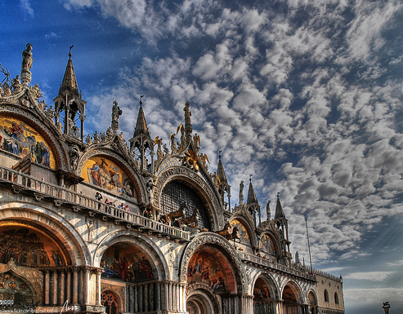
A VERY INFLUENTIAL CONFUTATIONAL METHAPHOR
“The Spandrels of San Marco and the Panglossian Paradigm:
A Critique of the Adaptationist Programme” (Gould and Lewontin 1979)

Slide 18
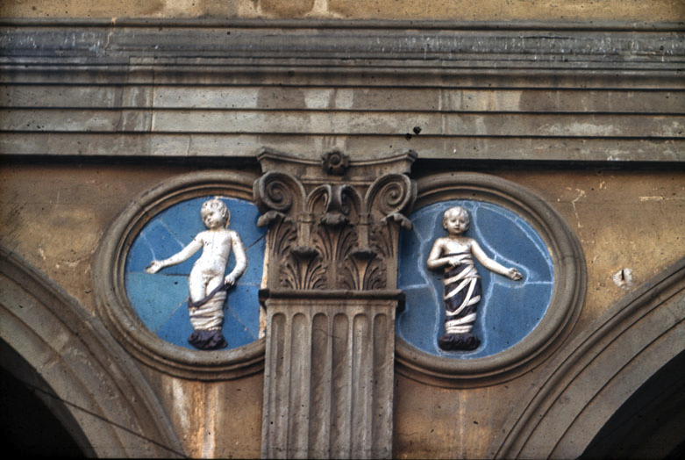
SPANDRELS

Slide 19
EVOLUTIONARY SPANDRELS
In Renaissance architecture “spandrels” were curved masonry structures used for supporting a dome and were necessitated by structural constraints alien to the esthetical demands of the design.
By analogy, Gould and Lewontin used this term to designate phenotypic traits due to structural constraints in the bauplan of an organism, and not a result of evolutionary adaptations.
In their polemic against what they called “the Adaptationist Program,” they showed that many phenotypic features previously thought of as adaptations were in fact evolutionary spandrels.

Slide 20
FROM THE CORAL OF LIFE TO THE TANGLED WEB OF LIFE
Through rapid advances in molecular biology it has been possible to reconstruct early segments of the tree of life.
In the 1970’s Carl Woese and other researchers reconfigured the universal phylogenetic tree as a diagram starting from three principal branches, called domains: Bacteria, Archaea, and Eucarya.
The first two include the unicellular organisms usually called Prokaryotes. Eucarya, having complex cells with a separate nucleus and several organelles, include all of the major branches of multicellular organisms, such as plants, fungi and animals.
Notes:
<number>

Slide 21
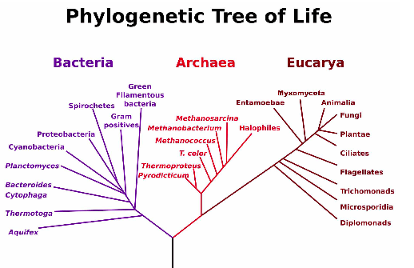
PHYLOGENETIC TREE OF LIFE

Slide 22
THE TREE OF LIFE IS BASED ON THE TRADITIONAL CONCEPTION OF “SPECIES”
The lowest rank in the taxonomic hierarchy, the species, was traditionally defined as a group of organisms capable of interbreeding to produce fertile descendants.
Several mechanisms explain speciation, i.e. the production of new species. In the most common, allopatric speciation, new species rise as a consequence of geographic separation (e.g., birds migrating to different islands).
Separate ecosystems impose different selection pressures on the individuals, resulting in genotypic and phenotypic variations.
After many generations the organisms become reproductively isolated and members of separate enclaves can no longer interbreed and interchange genes.

Slide 23
HORIZONTAL GENE TRANSFER (HGT)
During the last two decades the application of new methodologies has increasingly revealed the high frequency and widespread occurrence of horizontal (lateral) gene transfer (HGT) between distantly related organisms. HGT occurs most frequently among prokaryotes, but it also shows up among some eukaryotic lineages.
The lateral transfer of genes between parallel branches has literally short-circuited the whole scheme of the tree of life, which is based on the traditional view of species as rising exclusively through vertical (generational) gene transfer. HGT has rendered questionable the tree’s future, either as a constructive or as a pedagogical metaphor.
All the same, this image has been so useful and remains associated with so many ideas in the history and philosophy of biology, that practitioners are naturally very reluctant to dismiss it or radically alter it.

Slide 24
A BIOLOGICAL ANALOGUE OF CAPITALISM
In his seminal article “A new biology for a new century,” Carl Woese speculates about a pre-Darwinian era best described in the words of Freeman Dyson (Dyson 2004):
Evolution was a communal affair, the whole community advancing in metabolic and reproductive efficiency as the genes of the most efficient cells were shared. Evolution could be rapid, as new chemical devices could be evolved simultaneously by cells of different kinds working in parallel and then reassembled in a single cell by horizontal gene transfer. But then, one evil day, a cell resembling a primitive bacterium happened to find itself one jump ahead of its neighbors in efficiency. That cell, anticipating Bill Gates by three billion years, separated itself from the community and refused to share. Its offspring became the first species of bacteria—and the first species of any kind—reserving their intellectual property for their own private use.

Slide 25
PATTERN PLURALISM
Some biologists think the metaphor can be saved through integration into a variety of more comprehensive relational schemes or diagrams.
Doolittle and Bapteste 2007:
Pattern pluralism (the recognition that different evolutionary models and representations of relationships will be appropriate, and true, for different taxa or at different scales or for different purposes) is an attractive alternative to the quixotic pursuit of a single true TOL [tree of life].
Valas and Bourne 2010:
The tree of life is alive, but not well. Construction of the tree of cells has been viewed as the end goal of the study of evolution, where in reality we need to consider it more of a starting point. We propose a duality where we must consider variation of genetic material in terms of networks and selection of cellular function in terms of trees. Otherwise one gets lost in the woods of neutral evolution.
Notes:
<number>

Slide 26
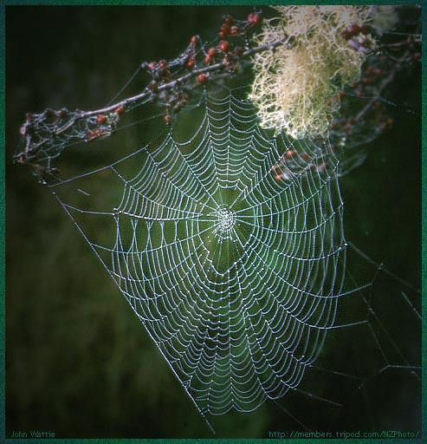
THE TREE AS A BRANCH OF A WEB
Biologists now tend to view the tree as a structure discernible as part of a wider and non-arborescent relational network, variously referred to as the web, the mosaic, the thicket, and even the forest of life ( Puigbo et al. 2009).

Slide 27
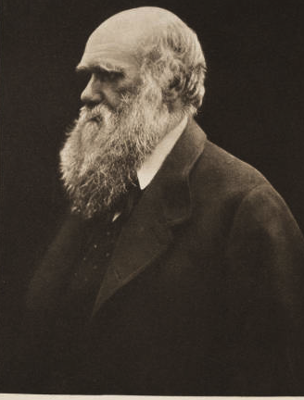
THE FUTURE IS BRILLIANT
Evolutionary theory keeps evolving. Whether the image of the tree of life is retained, transformed or abandoned, it seems certain that the study of the historical trajectory of this and many other metaphors will usher in further lessons in the nature of analogical thought and its role in the creation of cognitive novelty.
Notes:
<number>

Slide 28
Selected Bibliography

