Slide 1
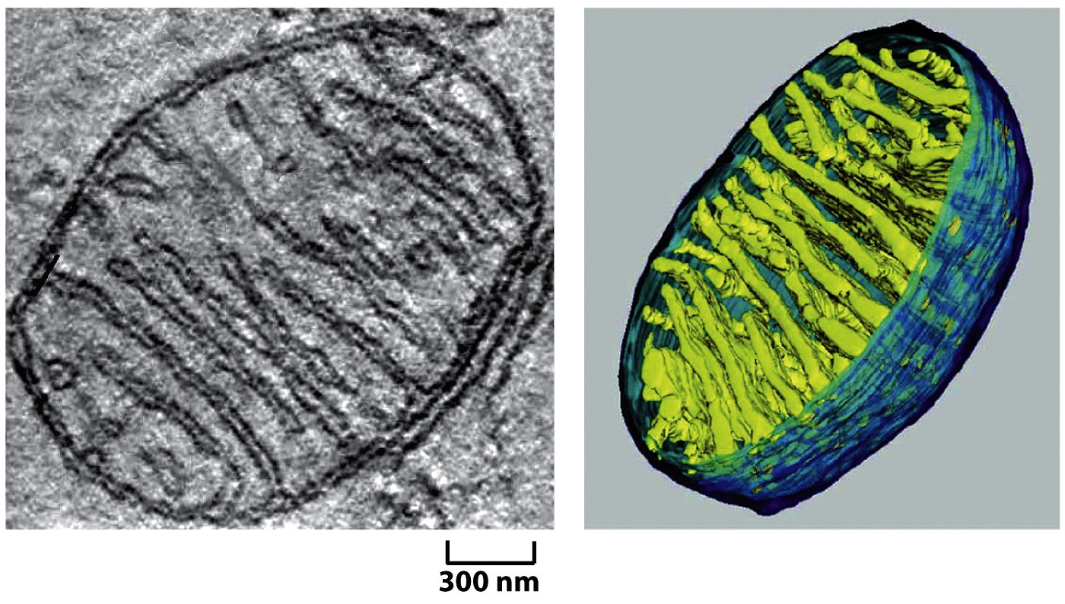
Mitochondrial Genetics
Russell Swerdlow, MD

Slide 2
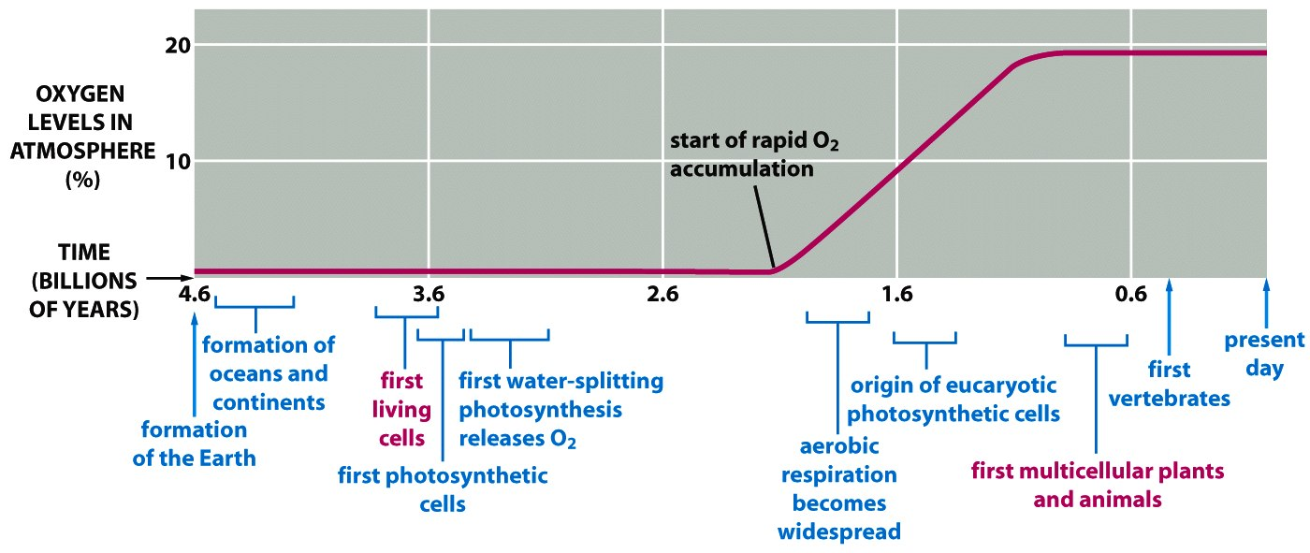
Photosynthetic Organisms Create Oxygen Atmosphere
-Once O2 starts getting made, it reacts with ferrous iron (Fe2+) in oceans. This goes on for almost 1 billion years. Finally, Fe2+ is consumed by about 2 billion years ago and O2 levels start rising. Supported by geologic evidence (ferric oxides in sedimentary rocks).
Figure 14-71 Molecular Biology of the Cell (© Garland Science 2008)

Slide 3
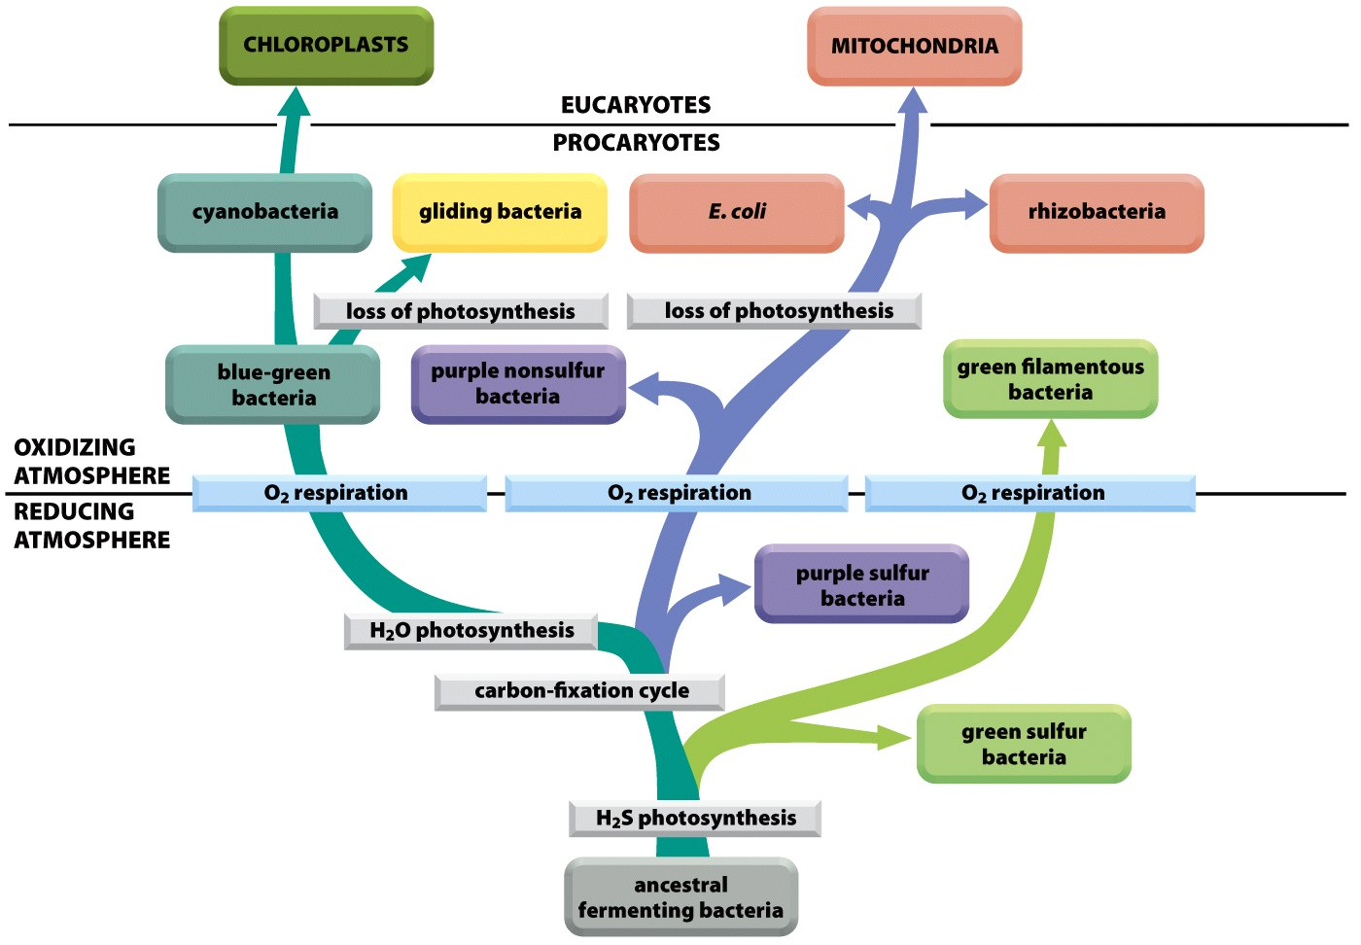
Genesis of Mitochondria and Chloroplasts
Figure 14-72 Molecular Biology of the Cell (© Garland Science 2008)

Slide 4
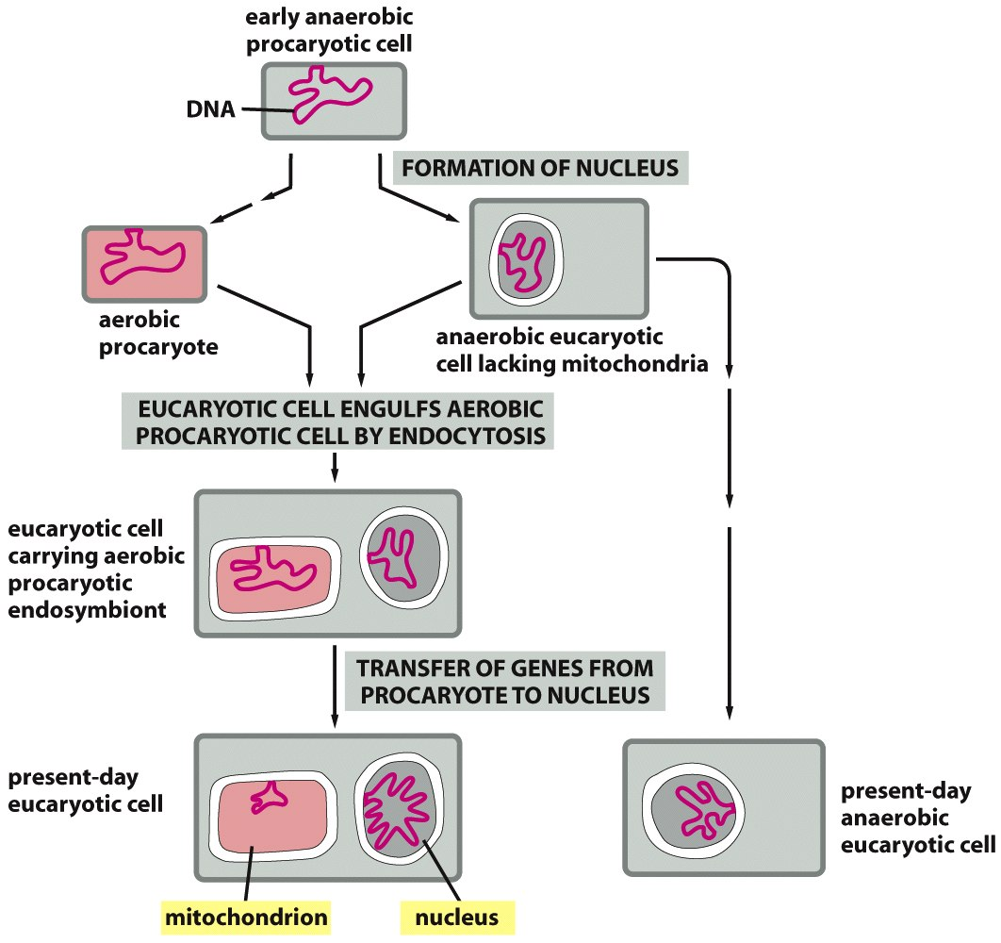
Endosymbiont Hypothesis
Figure 14-58 Molecular Biology of the Cell (© Garland Science 2008)

Slide 5
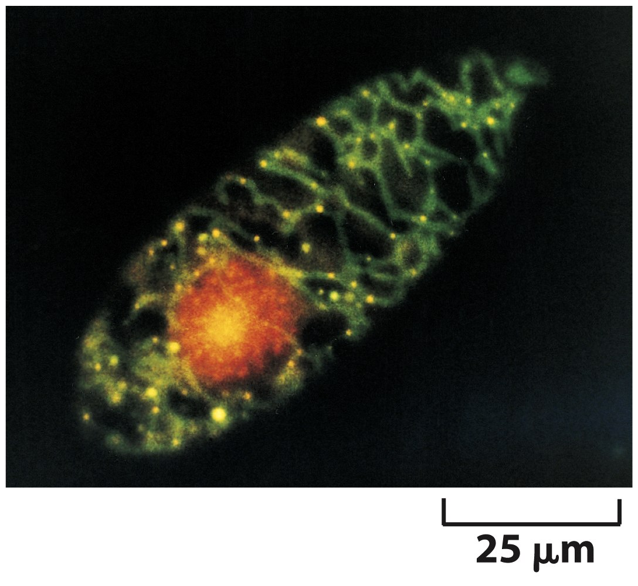
Human mtDNA
Originally called rho DNA
Multiple copies per cell
Nucleoids
Associated with membranes
nucleoids
Figure 14-52 Molecular Biology of the Cell (© Garland Science 2008)

Slide 6
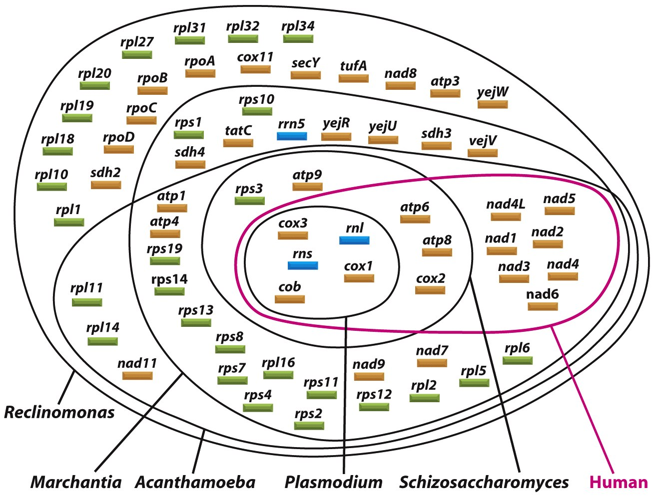
Compaction of the mtDNA
Figure 14-59 Molecular Biology of the Cell (© Garland Science 2008)

Slide 7
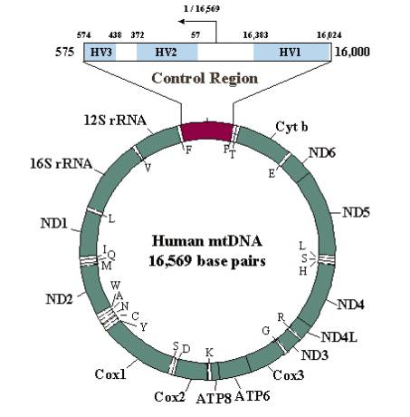
Introns Lost During Evolution

Slide 8
Codon Assignments
Table 14-3 Molecular Biology of the Cell (© Garland Science 2008)

Slide 9
mtDNA Pseudogenes

Slide 10
mtDNA Transcription
Transcription: H-strand transcription starts at the HSP and proceeds counterclockwise. L-strand transcription starts at the LSP and proceeds clockwise.
Light strand
Terminated and full length transcripts built from heavy strand
Heavy strand
Transcript built from light strand

Slide 11
mtDNA Translation
mtDNA and plastid translation resembles bacterial translation
Ribosomes
Antibiotic sensitivity
N-formyl methionine

Slide 12
mtDNA Replication
Replication: Requires RNA primers synthesized downstream from LSP. The nascent H-strand forms from the L-strand template commencing at OH and proceeding clockwise, first displacing the parental H-strand to form a bubble. Two-thirds of the nascent H-form is formed before nascent L-strand synthesis can start at OL. As a newly exposed single-stranded template sequence in the H-strand forms a hairpin to constitute, OL, H-strand replication (into a nascent L strand) commences in the opposite direction (counter clockwise. The double stranded mtDNA molecule is formed by removal of the RNA primers, gap-filling, introduction of superhelical turns, and closure of the circle.
Light strand
Heavy strand
Triple stranded DNA

Slide 13
Maternal Inheritance
100,000 copies of mtDNA
Stem Cell
Father
Mother
meiosis
sperm
ovum
All mito genes are maternal

Slide 14
Mitotic Segregation
Zygote
Germ Line
Other
Tissues
Nervous
System

Slide 15
Mitotic Segregation
Zygote
Germ Line
Other
Tissues
Nervous
System

Slide 16
Heteroplasmy and Threshold
Mother
Healthy
Non-carrier
Healthy
carrier
Healthy
carrier
Healthy
carrier
sick

Slide 17
Aging Theory
Rate of Living Hypothesis
Higher metabolic rate animals often with shorter life spans
Free Radical Theory of Aging
Mitochondrial Theory of Aging
Mitochondrial DNA Somatic Mutation
Deletion mutations
Point mutations
Increased mutations a/w decreased ETC activity
In aging, represent cause or consequence?

Slide 18
mtDNA Mutations Drive Aging Phenotype
Trifunovic et al (2004). Premature ageing in mice expressing defective
mitochondrial DNA polymerase. Nature 429, 417 – 423.

Slide 19
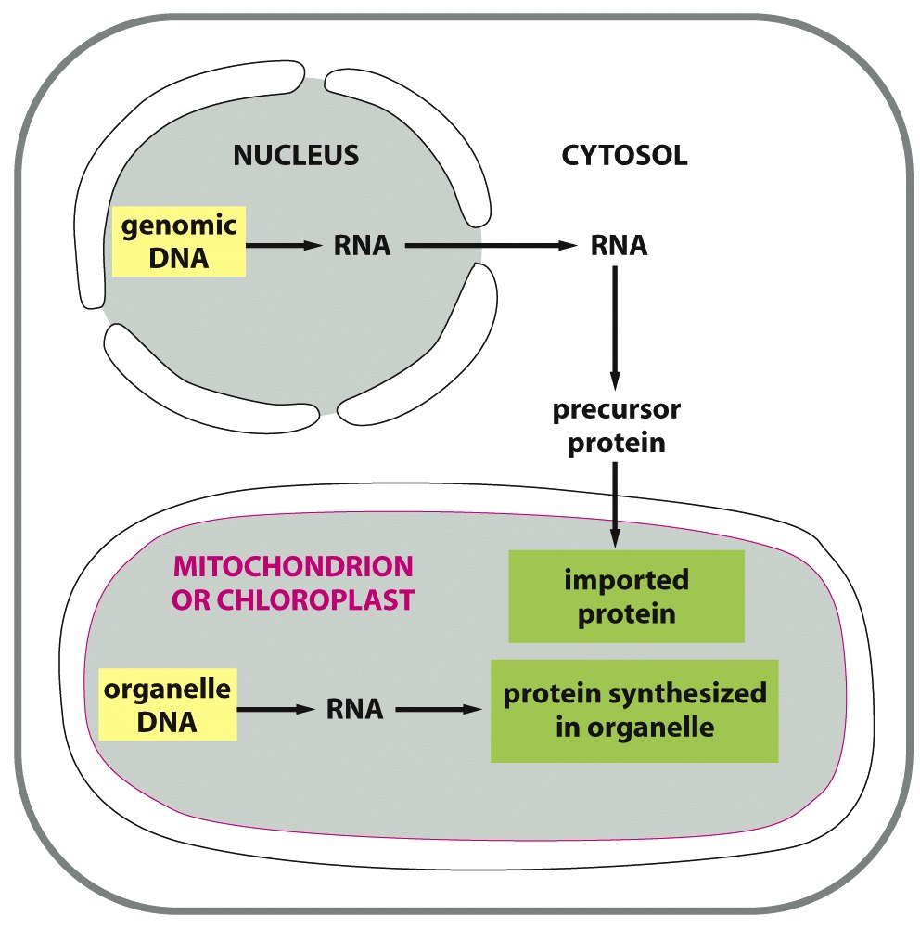
Proteasomes From Two Genomes
Figure 14-53 Molecular Biology of the Cell (© Garland Science 2008)

Slide 20
mtDNA Coding Genes
Complex I “ND” genes
7 mtDNA+39 nDNA genes
Complex III Cyt B gene
1 mtDNA+10 nDNA genes
Complex IV “CO” genes
3 mtDNA+10 nDNA genes
Complex V “ATP Synthase” genes
2 mtDNA+12nDNA genes

Slide 21
Tracking Migrations: mtDNA Haplogroups

Slide 22
Mutation-containing
mtDNA
Wild-type
mtDNA
Heteroplasmic
Stem Cell/
Oogonium
Diploid nucleus
Oocytes
with
different
mtDNA
ratios
Haploid nucleus
Sperm
Mitotic segregation scenario 1
Mitotic segregation scenario 2
Zygote
Nervous System
(above disease
threshold)
Oogonia
(low risk of
transmission)
Nervous System
(below disease
threshold)
Oogonia
(high risk of
transmission)

Slide 23
mtDNA: Practical Applications
Genealogy
Forensics
Affects lifestyle?
Associations with disease risk and longevity?

