Slide 1
Science and Faith: Conflict, Contrast, or Convergence?
Community of Reason KC
August 4, 2013
Leroy Seat

Slide 2
An abiding interest, concern
Major seminary (graduate school) professor was Eric C. Rust, an Englishman who studied science before becoming a theologian.
One of his major books is Science and Faith (1967).
A Festschrift for him is titled Science, Faith, and Revelation: An Approach to Christian Philosophy (1979), including a chapter by LKS.

Slide 3
My field of expertise
I know little about science; nothing I say this afternoon will be about science as such.
My education and lifelong study has been in the field of Christian theology and philosophy (including the philosophy of science).
Theology is primarily fides quaerens intellectum (faith seeking understanding).
Philosophy is not about answering questions but rather about questioning answers.

Slide 4
My quest for intellectual honesty
Currently I am working on a book (which I may never finish) provisionally titled Christian Faith and Intellectual Honesty.
Both terms are of great significance to me, and it is imperative (for me) that they always be linked.
One of the main appeals of “freethinkers” is their interest in “intellectual honesty,” not just believing what is traditional or comforting.

Slide 5
Three highly influential thinkers
Blaise Pascal (1623-62), French scientist/religious philosopher; main work: Pensées (1669, 1958).
Søren Kierkegaard (1813-55), Danish theologian/ philosopher, “father” of Christian existentialism, and a critic of the state church of his day. (See Kierkegaard's Attack Upon “Christendom” 1854-1855, 1968.)
Michael Polanyi (1891-1976), Hungarian scientist/ philosopher; author of Personal Knowledge: Towards a Post-Critical Philosophy (1958, 1974).

Slide 6
Pascal’s Words
"The heart has its reasons which reason knows not of."
“There are two kinds of people one can call reasonable; those who serve God with all their heart because they know Him, and those who seek Him with all their heart because they do not know Him” (194).

Slide 7
Kierkegaard’s Words
“Truth is subjectivity” (Concluding Unscientific Postscript).
“. . . Demonstrating God’s existence . . . . is accom-plished not by proofs but by worship” (Philosophical Fragments).

Slide 8
Polanyi’s Words
“Comprehension is neither an arbitrary act nor a passive experience, but a responsible act claiming universal validity. Such knowing is indeed objective in the sense of establishing contact with a hidden reality; a contact that is defined as the condition for anticipating an indeterminate range of yet unknown (and perhaps yet inconceivable) true implications. It seems reasonable to describe this fusion of the personal and the objective as Personal Knowledge.”

Slide 9
Recently, another teacher
John F. Haught (b. 1942) is professor emeritus at Georgetown University.
A long-time theology professor at Georgetown, he established the Georgetown Center for the Study of Science and Religion and was its Director for many years.

Slide 10
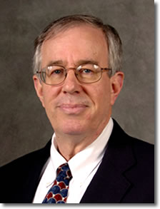
John F. Haught (b. 1942)

Slide 11
Some of Dr. Haught’s books
God After Darwin (2000; 2nd ed., 2008)
Deeper than Darwin (2003)
Is Nature Enough? Meaning and Truth in the Age of Science (2006)
God and the New Atheism (2008)
Science and Faith: A New Introduction (2012)

Slide 12
Main topics in Science and Faith
Is science compatible with religious faith?
Doesn’t science rule out the existence of a personal God?
After Darwin, can anyone honestly believe in divine providence?
Do miracles really happen?
Was the universe created or did it “just happen”?
Isn’t life reducible to chemistry?
Is your mind anything more than your brain?

Slide 13
Main topics in Science and Faith (2)
Can’t science now explain morality, and can’t we be good without God?
Are human beings special in the vast universe?
Is there life after death?
Does the universe have a purpose?
And what, if anything, would it mean theologically if we eventually discover extraterrestrial life and intelligence?

Slide 14
Three possible positions
Conflict – Popularized by Andrew Dickson White in A History of the Warfare of Science and Religion in Christendom .
Contrast – Roots go back at least to Albrecht Ritschl (1822-89): science is about facts, religion is about values.
Convergence – Haught’s emphasis.

Slide 15
The Conflict Paradigm
Basically demands a choice: either science or faith.
This is the position of most Christian fundamentalists.
This is the position of “the new atheists,” who are “secular” fundamentalists.

Slide 16
Andrew D. White and His Book
White (1832-1918) was the co-founder and first president of Cornell U.
In1869 White gave a lecture on "The Battle-Fields of Science,” and this grew into two volumes completed in 1896.
The first chapter is “From Creation to Evolution.”

Slide 17
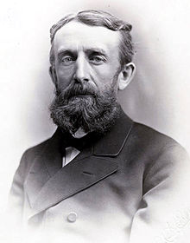
Andrew White in 1885

Slide 18
Where was the real conflict?
While he was Professor of Christian Theology at the University of Nottingham, Alan Richardson (1905-75) wrote The Bible in the Age of Science (1961).
I have often quoted a statement made in the first chapter of that book:

Slide 19
Richardson’s statement
“The struggle of the new scientists [in the 16th century] against the old order was not a struggle of ‘science’ against ‘religion’ but the revolt of the new scientific philosophy against the old Aristotelian pseudo-scientific philosophy” (p. 16).

Slide 20
(Parenthetical consideration)
“Grayling’s Explanation”
A. C. Grayling (b. 1949) is a leader in the new atheism movement and the author of many books, including The Good Book (2012) and The God Argument: The Case Against Religion and for Humanism (2013).
“Freeing the Mind” is the third chapter in Toward the Light of Liberty (2007)
Grayling advocates freeing the mind from religion and for science – but he repeatedly refers to Aristotle (see pp. 79, 82, 84, 93).

Slide 21
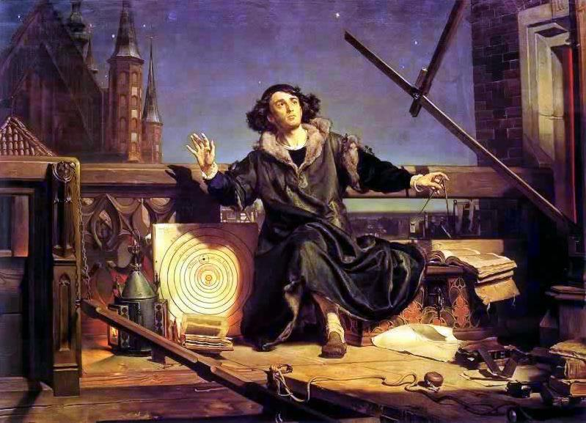
Astronomer Copernicus:
“Conversation with God” (Matejko, 1873)

Slide 22
Examples of Agnostic Thinkers Holding the Conflict Paradigm
Thomas Paine (1737-1809)
Robert Ingersoll (1833-99)
Christopher Hitchens (1949-2011)
Richard Dawkins (b. 1941)
Sam Harris (b. 1967)

Slide 23
The Conflict Paradigm in Thomas Paine
Paine was the author of The Age of Reason (1793-4).
He is sometimes called America’s first “freethinker.”
Only six people attended his funeral; ostracized because of his ridiculing of Christianity.

Slide 24
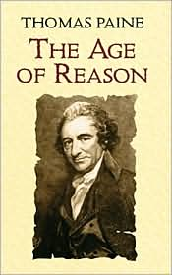

Slide 25
The Conflict Paradigm in Thomas Paine (2)
Paine was not an atheist—but neither was he a theist.
He was a deist, and many of this nations founding fathers were influenced by deism.
Paine’s main criticism was of tradi-tional Christianity and the Bible.

Slide 26
The Conflict Paradigm in Robert Ingersoll
Ingersoll (1833-99) was one of the most popular public speakers and the most prominent agnostic in the 19th century.
He was greatly criticized by conservative Christians who called him “Injuresoul.”
He is the subject of a new book by Susan Jacoby: The Great Agnostic: Robert Ingersoll and American Freethought (2013)

Slide 27
A central emphasis of Robert Ingersoll
According to Jacoby, Ingersoll “preached the gospel of science as the major source of human progress and religious superstition as its enemy” (p. 79).
(But among other things, science has led to the atomic bombs, massive pollution, and global warming that threatens the human race.)

Slide 28
Ingersoll’s vision for the future
Jacoby quotes Ingersoll’s vision for the future:
“I see a world without the beggar’s outstretched palm, the miser’s stony stare, the piteous wail of want, the pallid face of crime, the livid lips of lies, the cruel eyes of scorn. I see a race without disease of flesh or brain, shapely and fair, the married harmony of form and use, and as I look life lengthens, fear dies, joy deepens, love intensifies. The world is free” (168).

Slide 29
The conflict paradigm in Christopher Hitchens (1949-2011)
Hitchens’ best-known book is God is Not Great: How Religion Poisons Everything (2007).
“We do not rely solely upon science and reason . . . but we distrust anything that contradicts science or outrages reason.”

Slide 30
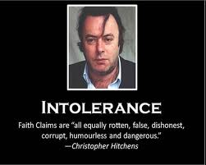

Slide 31
The conflict paradigm in Richard Dawkins (b. 1941)
Dawkins’ best-known book regarding atheism is The God Delusion (2006).
He contends that a supernatural creator almost certainly does not exist and that belief in a personal god qualifies as a delusion, which he defines as a persistent false belief held in the face of strong contradictory evidence.

Slide 32
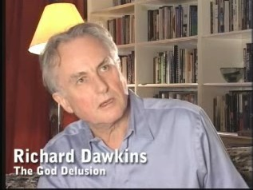

Slide 33
(Parenthetical consideration)
“Clifford’s Credo”
William K. Clifford (1845-77) essay “The Ethics of Belief” was first published in 1877.
In it is “Clifford’s Credo”: “It is wrong always, everywhere, and for anyone, to believe anything upon insufficient evidence."

Slide 34
(Parenthetical consideration)
“Clifford’s Credo”
William K. Clifford (1845-77) essay “The Ethics of Belief” was first published in 1877.
In it is “Clifford’s Credo”: “It is wrong always, everywhere, and for anyone, to believe anything upon insufficient evidence."

Slide 35
Questions about
“Clifford’s Credo”
What constitutes evidence; who determines what is, and is not, evidence?
How does one determine, or who determines, what is sufficient?
Is there sufficient [scientific] evidence that “Clifford’s Credo” is true? : “It is wrong always, everywhere, and for anyone, to believe anything upon insufficient evidence."

Slide 36
The conflict paradigm in Sam Harris (b. 1967)
Harris’ best-known book is The End of Faith: Religion, Terror, and the Future of Reason (2004).
He also wrote “There Is No God (And You Know It)” for the 10/6/05 issue of the Huffington Post.
Then on 1/2/06 he wrote “Science Must Destroy Religion” for the issue of the Huffington Post.

Slide 37
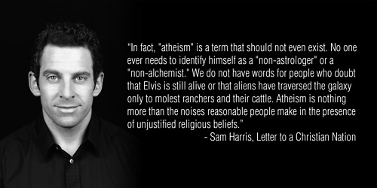

Slide 38
Rejecting the conflict paradigm held by Christians
Done to a certain extent in my book Fed Up with Fundamentalism (2007).
Few Christians other than fundamentalists think that one must choose either science or faith.
The conflict paradigm is outdated and superseded by a better understanding.

Slide 39
Yet, some conflicts remain
Scientific Naturalism
Nature is all there is and nature is enough (Rue).
Science provides all the knowledge we need.
There is no Creator of the physical world.
There is no life after physical death.
Christian Faith
Nature is not enough (Haught).
Science does not give all the knowledge we need.
All physical existence is due to a Creator.
There is a possibility of life after physical death.

Slide 40
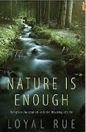
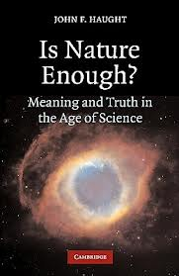
Loyal Rue (2011)
John Haught (2006)

Slide 41
The Contrast Paradigm
This position basically sees faith and science as co-existing peacefully in separate spheres of influence.
This is the position of most Christian moderates/liberals.
This is the position of many scientists.

Slide 42
Scientists who use the Contrast Paradigm
Some use of convergence, but mainly contrast.
John Polkinghorne (b. 1930); author of Science & Theology (1998); member of Society of Ordained Scientists (mainly Anglicans)
Francis Collins (b. 1950); Director of the NIH, author of The Language of God: A Scientist Presents Evidence for Belief (2006)
Alistair McGrath (b. 1953); author of Science and Religion (1998)

Slide 43
The Convergence Paradigm
Basically sees faith and science cooperating to understand the universe more completely.
As Haught writes, “Convergence tries to move beyond both conflict and contrast to a richer and more nuanced perspective, one that allows ample room for an ongoing conversation between science and faith.”

Slide 44
The Convergence Paradigm
Haught says that “convergence makes two main points.
“First, scientific discoveries can expand and enrich our sense of God.
“And second, faith’s sense of an inexhaustible meaning and truth underlying the universe provides a soft breeze that bears the sails of a scientific mind ever onward toward further discoveries.”

Slide 45
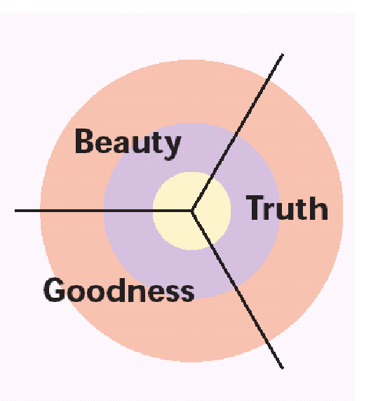
Musings on Truth, Goodness and Beauty

Slide 46

Three ancient Asian virtues:

Slide 47

Three ancient Asian virtues:

Slide 48
Truth
We humans should seek to live in accordance with that which is true and not by illusion, falsehood, or partial truth.
The quest for truth must be an ongoing, lifelong pursuit.
Trust the one who continues to seek truth; doubt the one who claims to have discovered truth fully.

Slide 49
Goodness
We humans should seek to live in accordance with that which is good, seeking that which is best for oneself, those who are nearby, and for the world as a whole.
Doing that which is good always enhances the quality of life for one’s self and for others.

Slide 50
Beauty
We humans should seek to live in appreciation of that which is beautiful and reject that which is ugly or degrading.
The appreciation of beauty includes the physical world which can be seen, heard, felt and tasted, but it also includes, perhaps primarily, the mental or “spiritual” world which is experienced by the mind or with the “heart.”

Slide 51
Truth, Goodness, Beauty and God
The quest for Truth, Goodness and Beauty are fully consistent with and aided by belief in God.
For a person of faith, Truth, Goodness and Beauty are understood as originating with God.
All manifestations of Truth, Goodness and Beauty in the world point toward God.

Slide 52
Truth, Goodness, Beauty and God
Understood correctly, God is perfect truth, infinite goodness and pure beauty.
Thus, the closer one is to God, the greater will be his/her apprehension of truth, implementation of goodness, and appreciation of beauty.

Slide 53
Truth, Goodness, Beauty and God
Conversely, the greater one’s apprehension of truth, implementation of good and appreciation of beauty, the closer he/she is to God—whether that relationship is recognized or acknowledged or not.
Thus, many skeptics/freethinkers/ agnostics/atheists are actually closer to God than many religious people.

Slide 54
Truth, Goodness, Beauty and Science
Science can and does help us gain knowledge about the physical world (the world of matter that can be quantified).
Such knowledge is by no means insignificant.
But science is of little help in the quest for Truth, Goodness or Beauty.

Slide 55
Truth, Goodness, Beauty and Faith
Truth, Goodness and Beauty are closely related to faith.
That is, religious faith can and often does lead to fuller apprehension of Truth, to deeper devotion to and realization of the Good for one’s self and especially for others, and to greater appreciation of Beauty.

Slide 56
Truth, Goodness, Beauty and Religion
This does not mean that all religion or all religious practices are necessarily beneficial in one’s quest for Truth, Goodness and Beauty.
Thus, it is important to see the difference between faith and religion—and this talk (and Haught’s book) is about science and faith, not science and religion.

Slide 57
Truth, Goodness, Beauty and Skepticism
Many of you have negative opinions about religion—for good reason.
Some of you have been hurt by religion and/or religious people.
Some of you have found some religious teachings to be untenable, even ignorant.

Slide 58
Truth, Goodness, Beauty and Skepticism
Bad experiences with some forms of religion and religious institutions have triggered negative responses, reactions that have led some (most?) of you to turn away from religion.
This has further resulted in many of you self-identifying as a skeptic/freethinker/ agnostic/atheist.

Slide 59
Truth, Goodness, Beauty and Skepticism
Rejection of religion or bad religious ideas and teachings has led many to place great emphasis reason and science.
Perhaps it is a quest for Truth, Goodness and Beauty that has led many to renounce religion and to become a skeptic/ freethinker/agnostic/atheist.

Slide 60
Truth, Goodness, Beauty & Science and Faith
In order to apprehend Truth, Goodness and Beauty fully, we need the convergence of science and faith.
There is no reason to choose one or the other.
Properly understood they can both be affirmed without conflict.

Slide 61
“Praise the Source of Faith and Learning” by Thomas H. Troeger (1987)
May our faith redeem the blunder
of believing that our thought
has displaced the grounds for wonder
which the ancient prophets taught.
May our learning curb the error
which unthinking faith can breed
lest we justify some terror
with an antiquated creed.

Slide 62
“Praise the Source of Faith and Learning” by Thomas H. Troeger (1987)
As two currents in a river
fight each other's undertow
till converging they deliver
one coherent steady flow,
Blend, O God, our faith and learning
till they carve a single course,
till they join as one, returning
praise and thanks to You, their Source.

Slide 63
Questions and Comments
Are Now Welcomed
Any question or comment is permissible.
There may be questions (especially about science) that I don’t know the answer to; if I don’t, I will say so.
Don’t hesitate to ask “hard” questions or to make critical comments (you don’t have to be “polite”).

Slide 64
Questions for Discussion
There has often been conflict between science and religion; there is far less conflict between science and faith. Why is this so? (What is the difference between religion and faith?)
There was a time when science was often attacked by religion. Now it seems to be more common for religious faith to be attacked by people in the name of science. Is this so, and if so, why?
Instead of conflict and criticism of the other side, can people affirming science and people affirming faith work together to rid the world of the many problems threatening the life and happiness of so many human beings?

