Slide 1
Nature of Human Nature
Part 1:
Motoring along on automatic pilot

Slide 2
Abstract
Psychology began as the science of consciousness, but Darwin’s theory focused the question, WHAT GOOD IS IT?
Motor theories of consciousness fashioned in the early 20th century removed consciousness from its central role in action
Modern neuroscience supports and expands on those early theories

Slide 3
Why this talk?
Kahneman’s Thinking, fast and slow (2011)
Other descriptions of the dichotomy
Cog Psych: automatic vs. controlled processes
elephant vs. rider (Haidt)
unconscious vs. conscious (Freud)

Slide 4
Why this talk?
These dichotomies are NOT Cartesian dualism
Refer not to a separation of mind & body
Rather a dichotomy of information processing, activities within mind
Different kinds of thinking, sensory-motor processes, perceptual processes
Material monism: brain enables mind (Gazzaniga)

Slide 5
Psychology?
The title: Nature of Human Nature
Definition: Psychology is the study of human nature by scientific means
Roughly equivalent to cognitive neuroscience
Relationship between brain activity and cognitive function (e.g., perception, memory, language, creativity, thinking, and so on)
Dichotomy between aware-unaware has a long history(for ψ)

Slide 6
Beginnings of the dichotomy
Darwin’s The expression of the Emotions in Man and Animal implied to many a duality of human nature:
If emotional expression in man descended from animals,
And given the precepts of evolution by descent,
then human nature “contains” a beast
Reason vs. Beast

Slide 7
The dichotomy
Last half of 19th century
England
Sir Francis Galton in an 1879 article in Brain painted the mind as a house set upon a
“complex system of drains and gas- and water-pipes…which are usually hidden out of sight, and (of) whose existence, so long as they acted well, we had never troubled ourselves.”

Slide 8
Beginnings of the dichotomy
Freud used an Iceberg as his metaphor to separate conscious processes (reality principle) from unconscious processes (pleasure principle)
And a massive unconscious it was

Slide 9
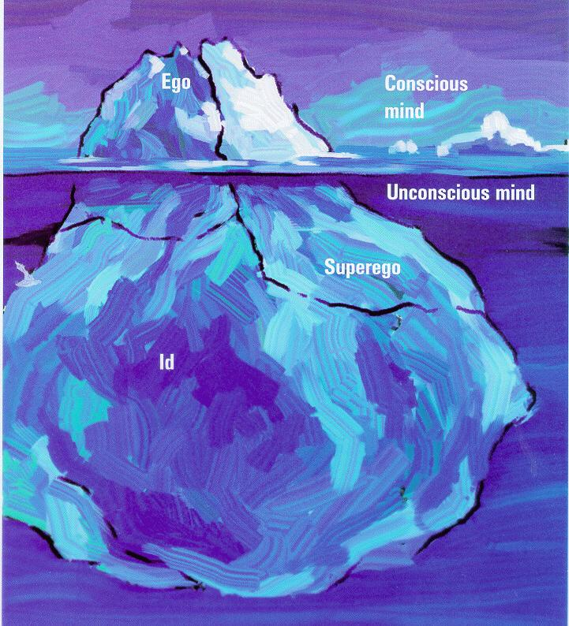

Slide 10
The dichotomy
From Cognitive Psychology (1970s)
Controlled vs. automatic processes
Controlled processes
Slow, aware, serial, under conscious control
Automatic processes
Fast, unaware, parallel, not controllable

Slide 11
The dichotomies
From Jonathan Haidt (I think)
Elephant and rider metaphor

Slide 12
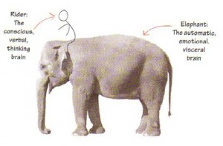

Slide 13
Fast Thinking
Slow Thinking

Slide 14
Fast Thinking
Slow Thinking
Controlled Processing
Automatic Processing

Slide 15
For how long has the dichotomy bothered psychologists?
Since it became American, especially

Slide 16
A Brief History of Psychology

Slide 17
Modern Psychology’s Early Years
Last decade 19th century in America, Wm James, John Dewy, H. Münsterberg, & others began to speculate about the influence of evolution on psychology
Darwin had put new concepts on the table
Variation in characteristics within a species
Adaptability to the environment
Survival (the struggle)

Slide 18
Modern Psychology’s Early Years
Darwinian theory
Variability in characteristics among members of a species
Morphological and behavioral
Differential tendency to survive as a function of the characteristics possessed
A mechanism by which characteristics can be transferred to offspring
Deferred to Lamarck

Slide 19
Modern Psychology’s Early Years
Environmental change places selection pressures on specific characteristics
Selects them out
Adaptations predict survival
Hence, over time, species change

Slide 20
Environment for psychology
Last half of 19th century
Germany
Psychophysics: measurement of mental dimensions (Fechner)
Heretofore thought impossible
Measurement of the speed of neural conduction (von Helmholtz)
Heretofore thought impossible;
Showed that an act of will is not instantaneous
Founding of Experimental Psychology (Wundt, 1879)
Attracted many American students

Slide 21
Environment for psychology
Last half of 19th century
America
Old Psychology: Scottish common sense psychology
A religious psychology
Students returned from Wundt’s lab to set up labs in America to practice the New Psychology
Experimental psychology
(a species change)

Slide 22
Environment for psychology
Last half of 19th century
America: much “new”
“the new education, the new ethics, the new woman, and the new psychology” (Leahey)
Old psychology belonged to clerics
New psychology belonged to scientists and professionals
APA founded in 1892

Slide 23
Environment for psychology
New political and social reform movement:
Progressivism
Reform, efficiency, progress were its values
John Dewey was its philosopher & prophet
Dewey’s progressive philosophy was centered around the concept of adaptation
Consciousness as an adaptation
Dewey was elected president of APA in 1899

Slide 24
Functionalism: America’s Psychology
Wm. James: Principles of Psychology (1890)
Set the foundation for psychology
For James, “consciousness arises in an individual when adaptation to new circumstances is imperative” (Leahey)
Dewey was strongly influenced by Principles

Slide 25
Functionalism: America’s Psychology
Dewey wrote a paper in 1896 that influenced the conception of America’s new psychology
The reflex arc concept in psychology
S → Idea → R, where idea = consciousness
Dewey argued: It’s artificial to analyze the components separately

Slide 26
Functionalism: America’s Psychology
Instead, they should be considered as “divisions of labor in an overall coordination of actions as the organism adjusts to its environment” (Leahey)
Example: snapping twig (= S)
For hiker it may not even enter consciousness
For solider awaiting contact with enemy it has much significance and fills his consciousness

Slide 27
Functionalism: America’s Psychology
It is the current behavior that gives a sensation its significance, or even determines if a stimulus becomes a sensation at all
Thus, presence of a stimulus does not determine consciousness, behavior does
Dewey, like Münsterberg, was proposing a motor theory of consciousness

Slide 28
Functionalism: America’s Psychology
Consider: James-Lange theory of emotion
Typical notion: S → emotion → R
James-Lange: S → R → emotion
It is not see bear, feel fear, run
Rather it is see bear, run, feel fear

Slide 29
Functionalism: America’s Psychology
consciousness
R
Current Behavior
S
Physiological Process
Motor Theory of Consciousness
“Our ideas are the product of our readiness to act…our actions shape our knowledge” (Münsterberg)
Our feeling of will is due, in large part, to our “incipient tendencies to behave” (Münsterberg)

Slide 30
Functionalism: America’s Psychology
So, Functionalists, fueled by evolution, asked
WHAT IS IT FOR?
Hence, what is the function of consciousness?
How does it help humans adapt & survive?
Recall, for James
consciousness arises in an individual when adaptation to new circumstances is imperative

Slide 31
Summary
America was “ripe” for psychology in the age of Darwin
So much was new, quickly changing
Needed a psychology that “did something, had pragmatic value”
Psychologists could use psychology to foster their progressive agenda, argued Dewey

Slide 32
Functionalism: America’s Psychology
How has the motor theory of consciousness stood up, survived, the sword of science?

Slide 33
“Paradigms” in Experimental Psychology
Functionalism (@1890 ff)
“What is it for?” Adaptive value
Behaviorism (@ 1920)
Eschewed mentalism entirely
Cognitivism (@1960)
Revived mentalism
Cognitive neuroscience (late 1970s)
Revives the relationship between brain & mind

Slide 34
Paradigmatic Assumptions
By mid 20th century, several paradigmatic assumptions are clear in American Psychology
Associationism (inherited via Empiricism, opposed to nativism, though not without challenge)
Atomism (opposed to holism, although Gestalt Psychology challenged that)
Mechanism (opposed to vitalism)
Evolution (opposed to creationism)

Slide 35
The Rise of Behaviorism
J. B. Watson was fed up with the “unscientific nature” of psychology
Due primarily to its focus on consciousness
Science, defined via Positivism
Description, Prediction, Control
Focus on observables (which consciousness is not)
Russians influenced Watson, especially:
Pavlov, classical conditioning
Bechterev (reflexology)

Slide 36
Behaviorist Manifesto
Psychology as the behaviorist views it is a purely objective branch of natural science. Its theoretical goal is the prediction and control of behavior. Introspection forms no essential part of its methods, nor is the scientific value of its data dependent on the readiness with which they lend themselves to interpretation in terms of consciousness. The behaviorist, in his efforts to get a unitary scheme of animal response, recognizes no dividing line between man and brute. The behavior of man, with all of its refinement and complexity, forms only a part of the behaviorist’s total scheme of investigation (J. B. Watson, 1913)

Slide 37
Methodology: Classical Conditioning
Second
Neutral Stimulus Paired with UCS several times
First
Innate functional unit (?), for example;
UCS → UCR
(food) → (salivation)
→ = “elicits”
NS
UCS → UCR
on
off
on
off
½ sec
NS
UCS

Slide 38
Classical Conditioning
Step 3
Remove the UCS
Present only the (previously) NS, now the CS, and get a CR
Result is Learning
CS
CR
An association is formed between a conditioned stimulus and a conditioned response

Slide 39
Learning = Conditioning
Watson famously said:
Give me a dozen healthy infants, well formed, and my own specified world to bring them up in and I’ll guarantee to take any one at random and train him to become any type of specialist I might select—doctor, lawyer, artist, merchant-chief and, yes, even beggar-man and thief, regardless of his talents, penchants, tendencies, abilities, vocations, and race of his ancestors (J. B. Watson, 1930)

Slide 40
Behaviorism is born
John B. Watson (1913) gave the behaviorist manifesto (in a speech at Columbia U)
Consciousness shall form no part
Behaviorism is based on observables
S → R (the atom of behavior)
It was to be a psychology that “did something”

Slide 41
Behaviorism of B. F. Skinner
(E): R → S
In an environment (E) – a discriminative stimulus – an organism’s behavior is determined by the consequences that follow
Consequences (roughly) = Reinforcement, Punishment
All is “observable”
Learning behavior is the focus
Consciousness plays no role in the language of psychology

Slide 42
Behaviorism
Watson’s & Skinner’s behaviorisms were called “radical behaviorism “ because they eschewed all talk of “mentalism”
Thus, human nature was described as:
An “automaton” whose behavior was determined by its reinforcement history
Personality is merely that corpus of behaviors shaped via reinforcement history
Behaviorists were radical blank slaters

Slide 43
(E): R → S
Determined by reinforcement history

Slide 44
Anomalies
Although they rid psychology of consciousness, behaviorism began to implode, contradictory findings
E.g., reinforcement is neither necessary nor sufficient to account for learning
Ethology
Organism’s nature (genetics) constrains what can be conditioned, learned
Does not fit the “no dividing line between man & brute”
Neuroscience was demonstrating that brains are not an undifferentiated mass, no to blank slate

Slide 45
Paradigm shift
Noam Chomsky
Review of Skinner’s Verbal Behavior (1959)
The review was more famous than the book
Showed forcefully that behaviorism (operant conditioning) could NOT explain language acquisition
Could not account for linguistic creativity, even in children
A watershed event

Slide 46
Cognitive Psychology
Many forms of behaviorism, 30s thru 50s
S → O → R, where O refers to “organism”
O took many forms
For Cognitive Psychology, O was like a digital computer
Humans were seen as limited capacity information processors

Slide 47
Cognitive Psychology
Attention is central
James wrote in Principles
Millions of items….are present to my senses which never properly enter my experience. Why? Because they have no interest for me. My experience is what I agree to attend to….Everyone knows what attention is. It is taking possession by the mind, in clear and vivid form, of one out of what seem several simultaneously possible objects or trains of thought….It implies withdrawal from some things in order to deal effectively with others.

Slide 48
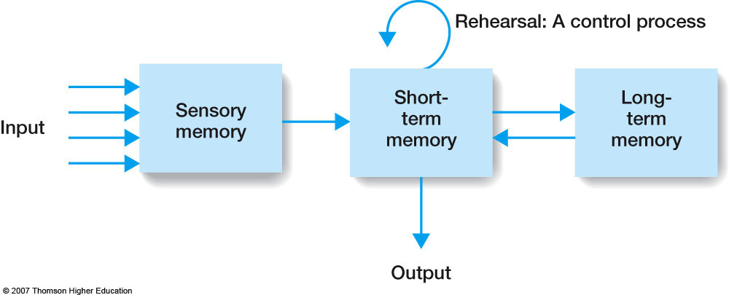
Caption: Flow diagram for Atkinson and Shiffrin’s (1968) model of memory. This model is called the modal model because of the huge influence it has had on memory research.
Notes:
Figure 11.1 Specialties in psychology. Percentages are approximate. The percentages shown here are based on membership in the American Psychological Association. The APA welcomes both scientists and practitioners. However, some psychological researchers belong to other organizations, such as the American Psychological Society. As a result, the percentage of clinical and counseling psychologists working in the United States may be a little lower than shown in chart a. Nevertheless, it is accurate to say that most psychologists specialize in applied areas and work in applied settings.

Slide 49
Attention
Notes:
Figure 11.1 Specialties in psychology. Percentages are approximate. The percentages shown here are based on membership in the American Psychological Association. The APA welcomes both scientists and practitioners. However, some psychological researchers belong to other organizations, such as the American Psychological Society. As a result, the percentage of clinical and counseling psychologists working in the United States may be a little lower than shown in chart a. Nevertheless, it is accurate to say that most psychologists specialize in applied areas and work in applied settings.

Slide 50
Selective Attention
Caption: Flow diagram of Broadbent’s filter model of attention.
Notes:
Figure 11.1 Specialties in psychology. Percentages are approximate. The percentages shown here are based on membership in the American Psychological Association. The APA welcomes both scientists and practitioners. However, some psychological researchers belong to other organizations, such as the American Psychological Society. As a result, the percentage of clinical and counseling psychologists working in the United States may be a little lower than shown in chart a. Nevertheless, it is accurate to say that most psychologists specialize in applied areas and work in applied settings.

Slide 51
Selective Attention
Donald Broadbent presented one of cognitive psychology’s first models
Testing (Cherry,1950s)
Cocktail party phenomena: Ability to pay attention to one message and ignore all others
Task: dichotic listening with shadowing

Slide 52
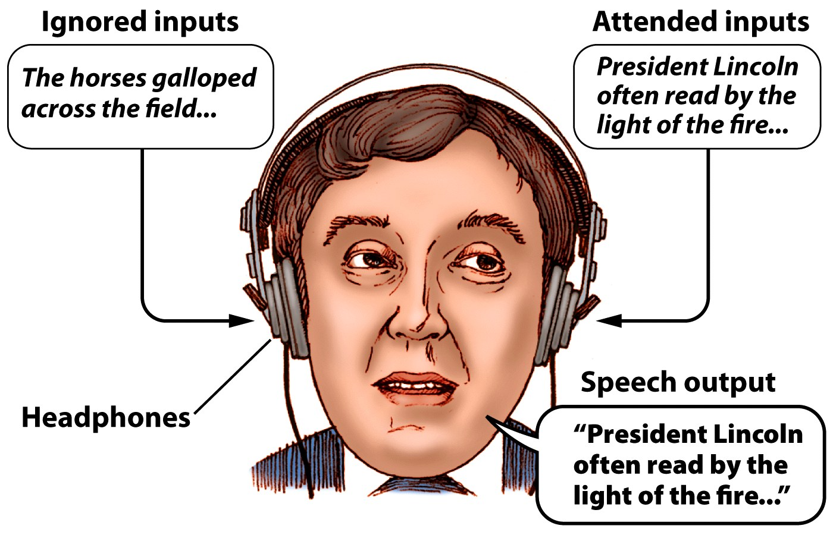
Notes:
﻿Figure 12.5 Cherry’s experimental setup for dichotic listening studies. He presented different auditory information (stories) to each ear of a subject. The subject was asked to “shadow” (immediately repeat) the auditory stimuli from one ear’s input (e.g., shadow the left-ear story and ignore the right-ear inputs).

Slide 53
Selective Attention
Following the shadowing procedure, subjects were asked about the other message
They could say nothing about it
Limited capacity information processers

Slide 54
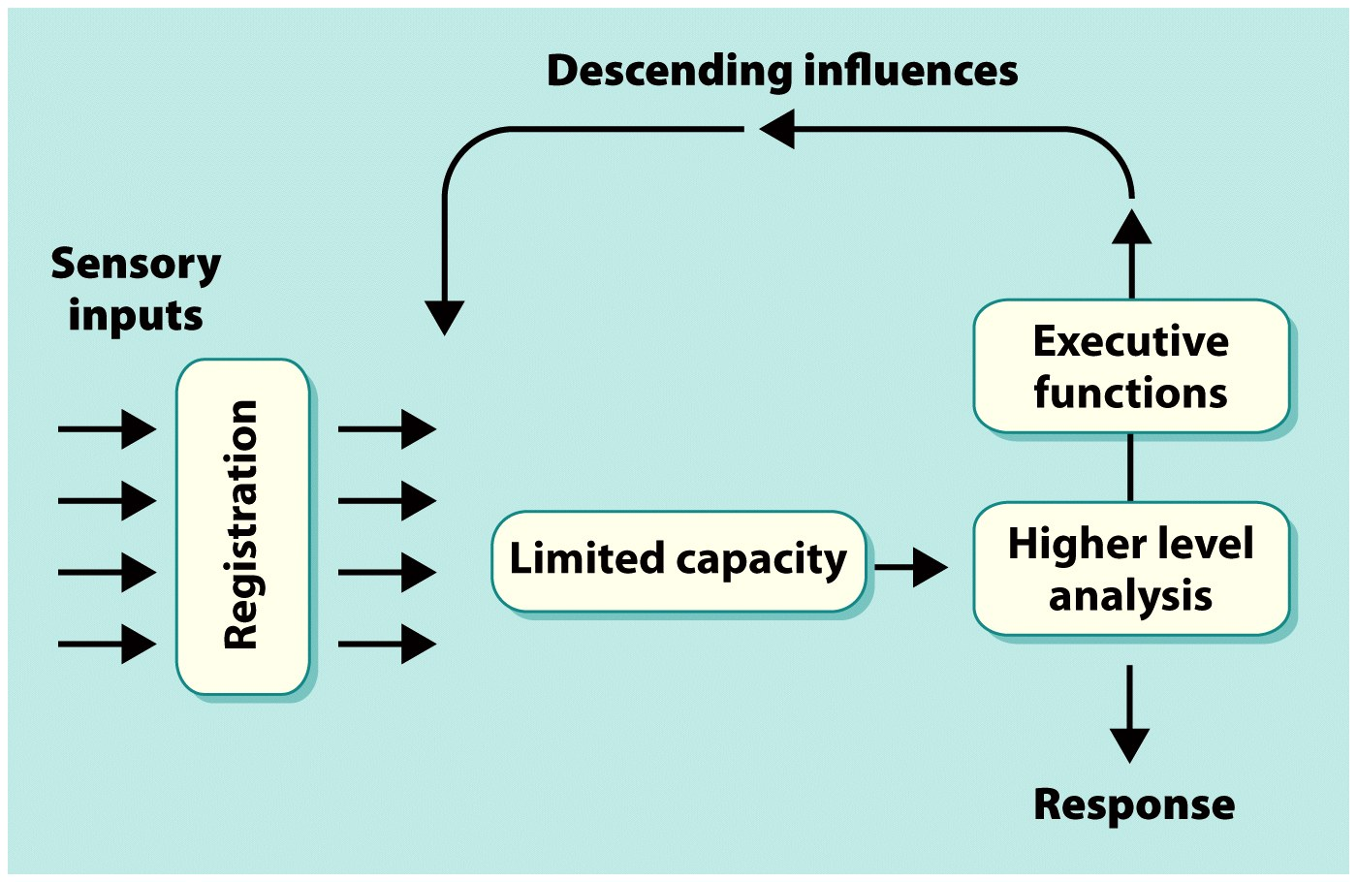
Notes:
﻿Figure 12.6 Broadbent’s model of selective attention. In this model, a gating mechanism determines what limited information is passed on for higher analysis. The gating mechanism shown here takes the form of descending influences on early neural processing, under the control of higher order executive processes.

Slide 55
Selective Attention
But what if your name is in the non-shadowed message?
Almost always heard

Slide 56
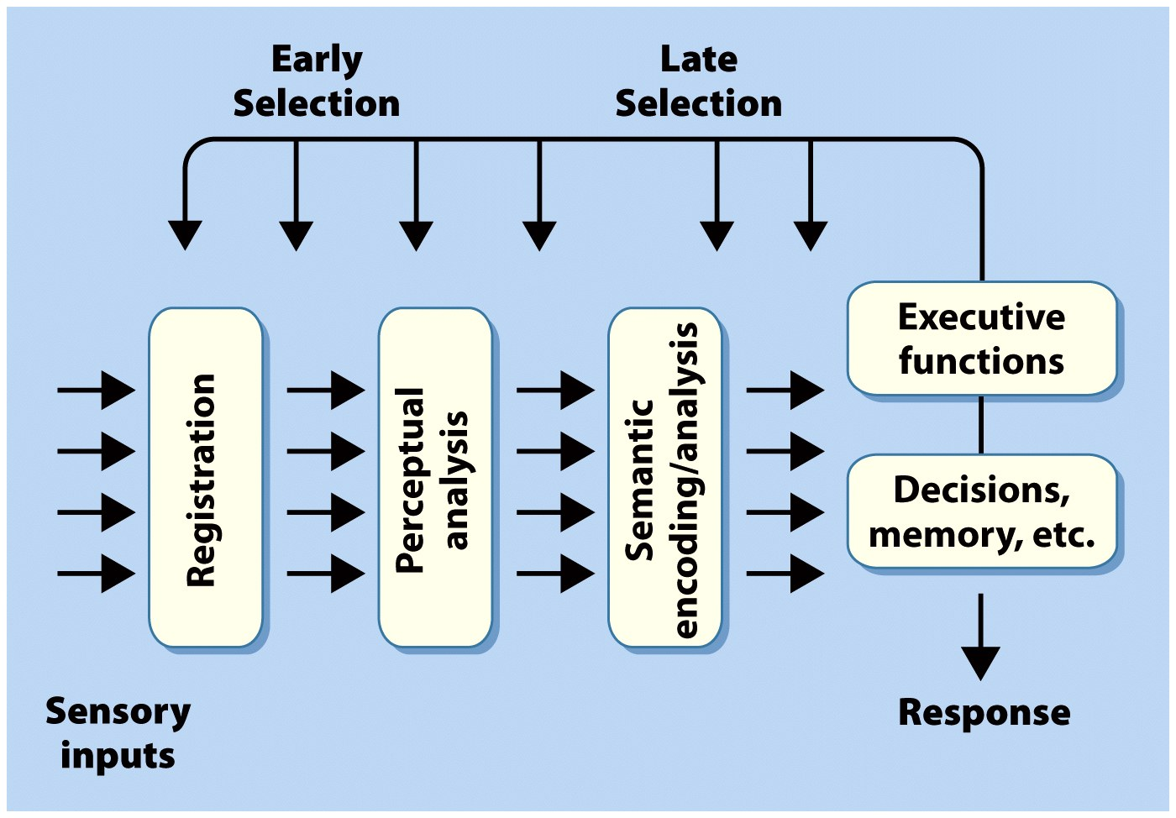
Notes:
﻿Figure 12.7 Early versus late selection of information processing. This conceptualization is concerned with the extent of processing that an input signal might attain before it can be selected or rejected by internal attentional mechanisms. Early-selection mechanisms of attention would influence the processing of sensory inputs prior to the completion of perceptual analyses. In contrast, late-selection mechanisms of attention would act only after the complete perceptual processing of the sensory inputs, at stages where the information had been recoded as a semantic or categorical representation (e.g., “chair”).

Slide 57
Cognitive Psychology
James: “everyone knows..”
Today: “no one knows…”
But it is clearly extremely important, and its effects have been demonstrated repeatedly from the physiological level to the behavioral level

Slide 58
Cognitive Psychology
What determines the focus of attention?
Control of attention
Endogenous control
James: “what I agree to attend to..”
Controlled top-down processes
by knowledge, expectation, context, task demands
Exogenous control
Attention capture

Slide 59
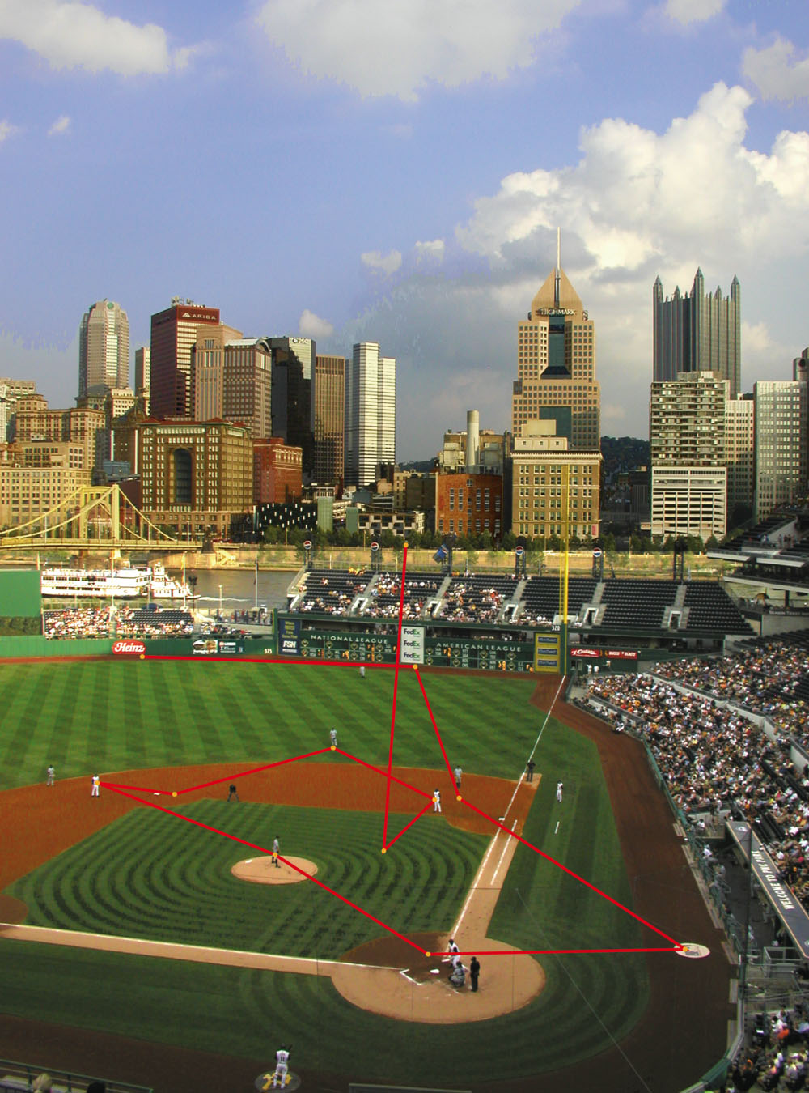
Fig. 6-CO, p. 132

Slide 60
Categories of Attention
Selective attention: “taking possession in clear & vivid form, of one out of what seem several… It implies withdrawal from some things in order to deal effectively with others”

Slide 61
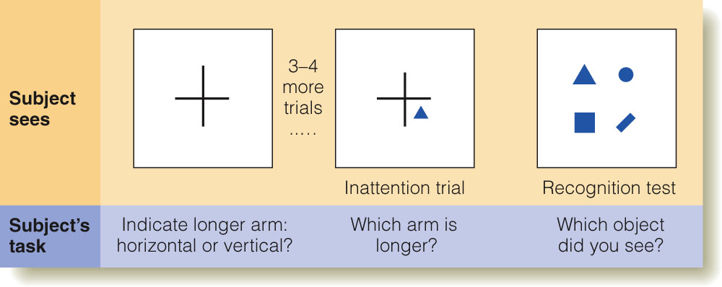
Inattentional Blindness
Figure 6.9 Inattentional blindness experiment. (a) Participants judge whether the horizontal or vertical arm is larger on each trial. (b) After a few trials, a geometrical object is flashed, along with the arms. (c) Then the participant is asked to pick which geometrical stimulus was presented.
Notes:
This slide can be used to talk about a second more controlled experimental procedure that shows inattentional blindness.

Slide 62
http://www.youtube.com/watch?v=vJG698U2Mvo

Slide 63
Updated Model of General Cognition
Via yours truly

Slide 64
Working Memory
response
Attentional control system
Long-Term Memory
Sensory Memory
(input processers)
input

Slide 65
Divided Attention
Divided attention: dividing attention between tasks
How about multitasking?
How many task can one do simultaneously?
An early model from D. Kahneman

Slide 66
From Kahneman
Limited attentional resources
Available Resources
Allocation Policy
Task Repertoire
T1 T2 T3 T4 T5 T6

Slide 67
Allocation of resources:
Different tasks require different types and amounts of processing resources
Automatic tasks
Controlled tasks
Processing resources needed
Very Few
Many

Slide 68
Characteristics of Task Processes
Automatic
Controlled
Processing resources needed
Very Few
Many
Fast
Parallel
Unaware
Cannot be controlled
Obligatory
Autonomous
Slow
Serial
Aware
Controlled
Selected
Dependent

Slide 69
Characteristics of Task Processes
Automatic
Controlled
Processing resources needed
Very Few
Many
Fast
Parallel
Unaware
Cannot be controlled
Obligatory
Autonomous
Slow
Serial
Aware
Controlled
Selected
Dependent

Slide 70
Allocation of resources required by tasks can change over time; a controlled task can become automatic
Automatic
Controlled
Processing resources needed
Fast
Parallel
Unaware
Cannot be controlled
Obligatory
Autonomous
Slow
Serial
Aware
Controlled
Selected
Dependent

Slide 71
The critical variable
Automatic
Practice
Controlled
Processing resources needed
Few
Many
Fast
Parallel
Unaware
Cannot be controlled
Obligatory
Autonomous
Slow
Serial
Aware
Controlled
Selected
Dependent

Slide 72
So, automatic pilot
How do we get about on automatic pilot?
Spatial mental map
expectation
Attention capture
Foveate the unexpected, and on movement
Update mental map, take corrective action

Slide 73
Cognitive Neuroscience
Cognitive Control
Working Memory

Slide 74
Working Memory
response
Executive Attention
Long-Term Memory
Sensory Memory
(input processers)
input

Slide 75
Cognitive Control
Cortical site
goals
strategies
plans
instructions
Frontal Pole
context
motivation
Lateral PFC
Working Memory
Relevant
LTM
information
Stimulus
information
Posterior
Long-term Memory
Systems
Sensory Input

Slide 76
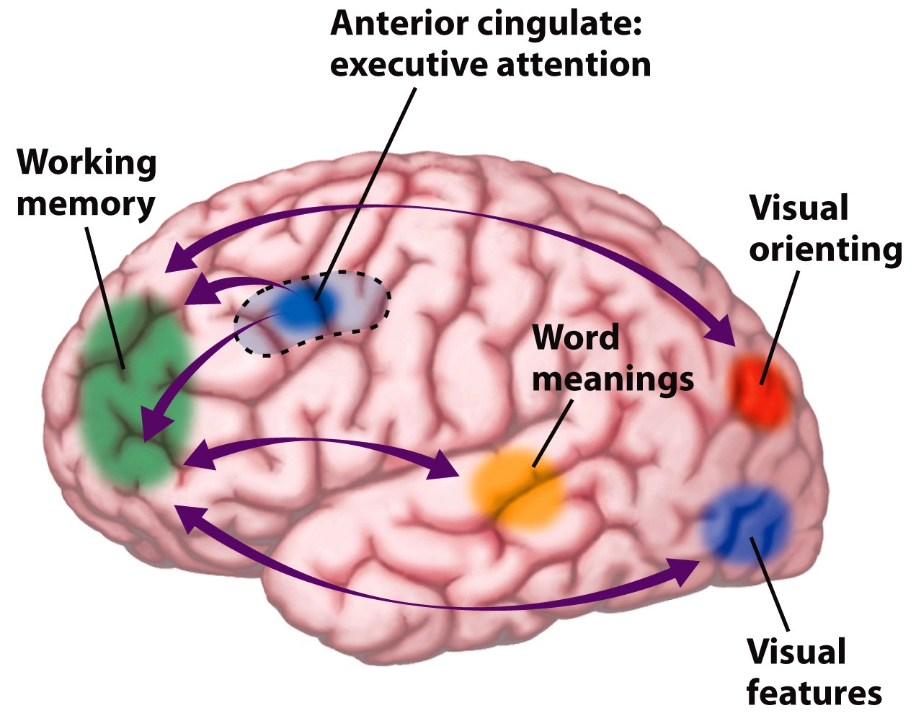
Notes:
﻿Figure 13.29 The anterior cingulate has been hypothesized to operate as an executive attention system. This system ensures that processing in other brain regions is most efficient, given the current task demands. Interactions with the prefrontal cortex may select working memory buffers; interactions with the posterior cortex can amplify activity in one perceptual module over others. The interactions with the posterior cortex may be direct, or they may be mediated by connections with the prefrontal cortex.

Slide 77
cognitive control
Goal-directed behaviors
Initiation of behavior
Maintaining a task set
Sequencing
Shifting set & modifying strategies
Self-monitoring & evaluation
Inhibition

Slide 78
Brain as a Sensory/Motor Association Mechanism (roughly)
Anterior: Motor
Posterior:
Sensory

Slide 79
Insula: the 5th lobe

Slide 80
Insula

Slide 81
Insula in isolation

Slide 82
Sensory-Motor Schema
Practice makes automatic
As we saw above with Controlled vs. Automatic processes
A sensory-motor schema is a sensory-motor association program that has become automatized
A brief look at the motor system to see what that entails, at least

Slide 83
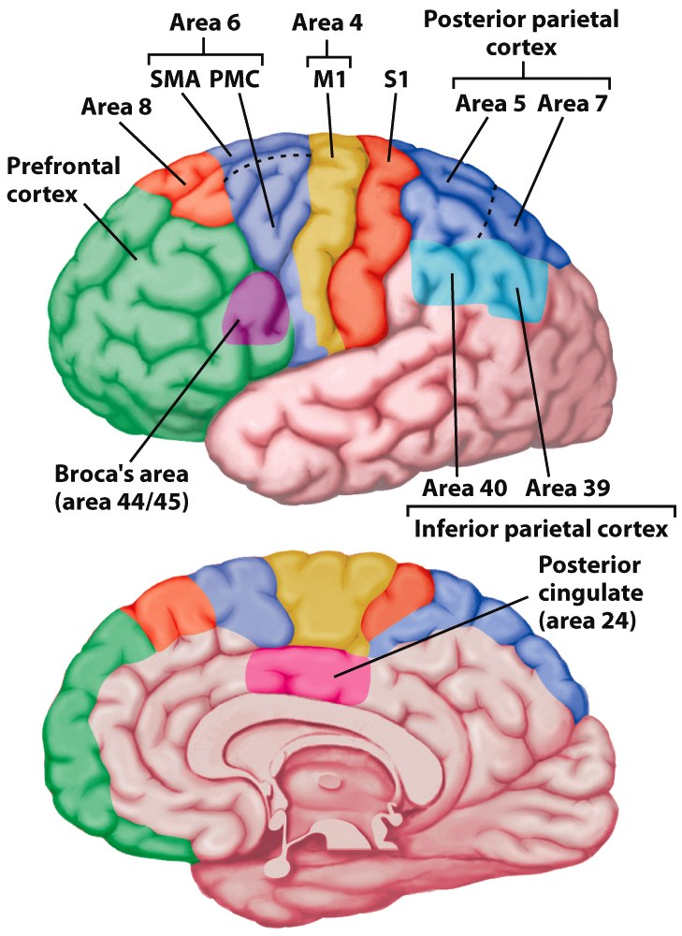
Notes:
Figure 7.6 Motor areas of the cerebral cortex. Area 4 is the primary motor cortex (M1). Brodmann area 6 encompasses the supplementary motor area (SMA) on the medial surface and premotor cortex (PMC) on the lateral surface. Area 8 includes the frontal eye fields. Inferior frontal regions (area 44) are involved in speech. Regions of parietal cortex associated with the planning and control of coordinated movement include S1, the primary somatosensory cortex, secondary somatosensory areas, and posterior and inferior parietal regions.

Slide 84
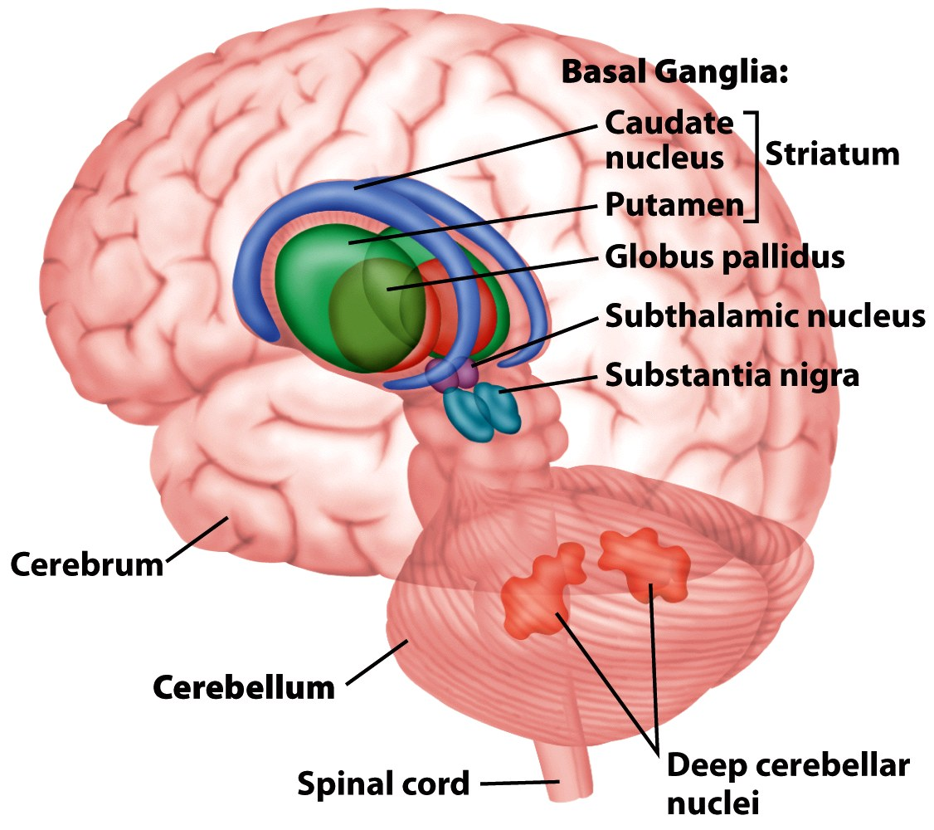
Notes:
Figure 7.5 The basal ganglia and the cerebellum are two prominent subcortical components of the motor pathways. The basal ganglia proper include the caudate, putamen, and globus pallidus, three nuclei that surround the thalamus. Functionally, however, the subthalamic nuclei and substantia nigra also are considered part of the basal ganglia. The cerebellum sits below the posterior portion of the cerebral cortex. All cerebellar output originates in the deep cerebellar nuclei.

Slide 85
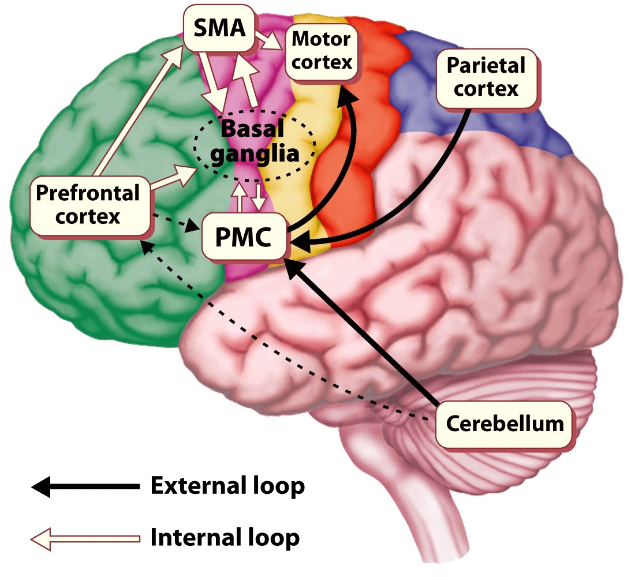
Notes:
Figure 7.27 Movements may vary in terms of the contribution of internal and external sources of information. The external loop, including the cerebellum, parietal cortex, and lateral premotor cortex (PMC), dominates during visually guided movements. The internal loop, including the basal ganglia and the supplementary motor area (SMA), dominates during self-guided, well-learned movements.

Slide 86
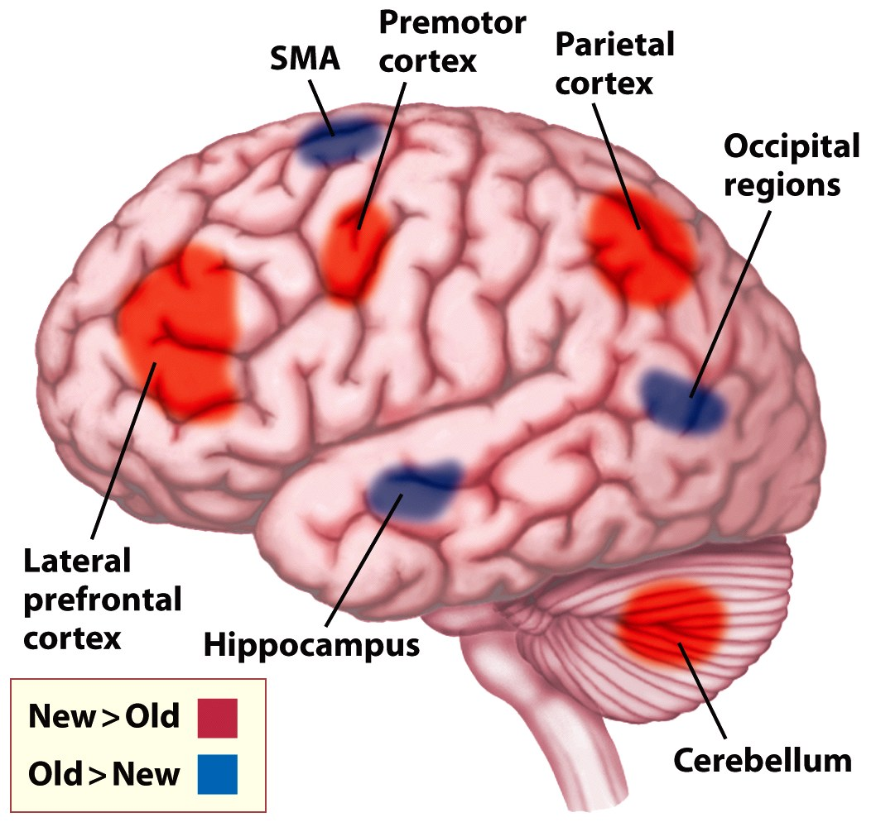
Notes:
Figure 7.29 Shifts in metabolic activity during motor learning. PET scans were obtained under two conditions: while subjects performed a well-learned movement sequence (Old) and during the course of learning a movement sequence (New). Learning was associated with blood flow increases in lateral premotor and prefrontal areas; in contrast, performance of previously learned sequences was correlated with blood flow increases in the supplementary motor area (SMA) and hippocampus.

Slide 87
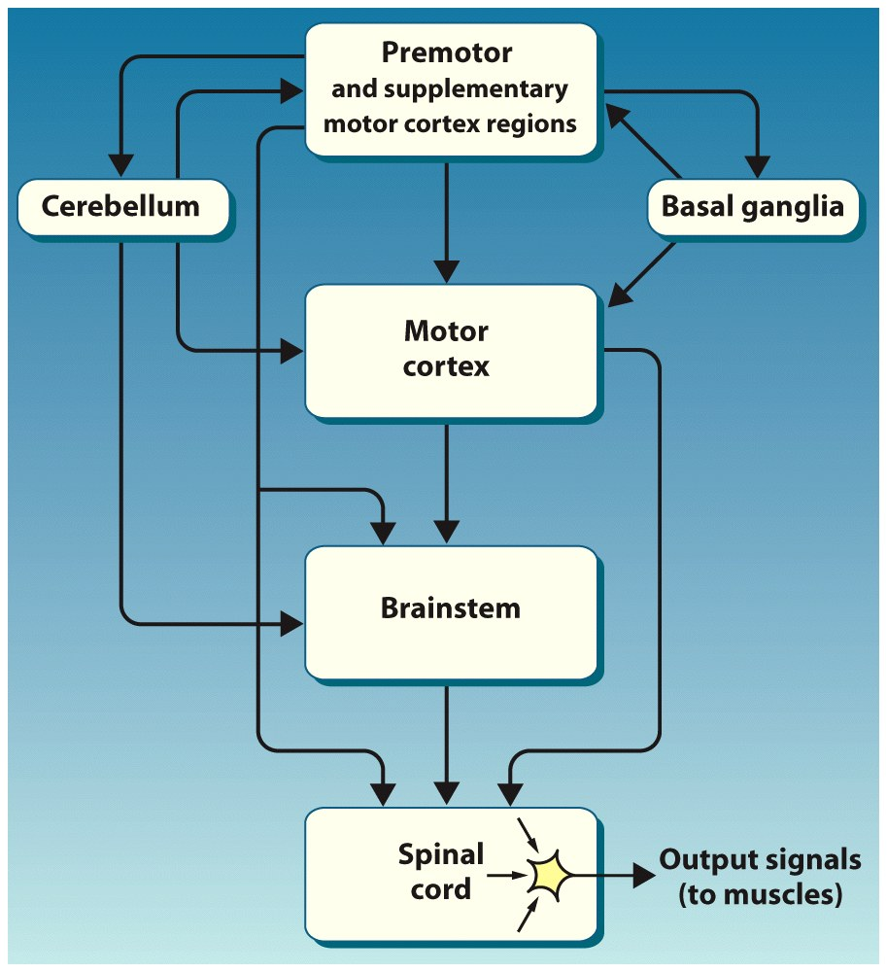
Notes:
Figure 7.7 The descending pathways of the motor hierarchy. All connections to the arms and legs originate in the spinal cord. The spinal signals are influenced by inputs from the brainstem and various cortical regions, whose activity in turn is modulated by the cerebellum and basal ganglia. Thus, control is distributed across various levels of the hierarchy. Sensory information from the muscles is transmitted back to the brainstem, cerebellum, and cortex (not shown).

Slide 88
Role of Frontal Lobes in Action: Prefrontal Cortex
Damage to this region does not impair physical movement but actions become inappropriate or disorganized, and/or inappropriate for current goals
PFC mediates selection of action and maintains the goal of the action
Also distributes attention to actions when circumstances warrant

Slide 89
Planning Actions
Damage to lateral PFC
Perseveration = repeating an action that has already been performed and is no longer relevant
Damage to ventromedial PFC
Utilization behaviour = impulsive actions on irrelevant objects in the environment
These are examples of actions automatically driven by habits and objects in the environment, rather than controlled behaviour that is driven by goals

Slide 90
The critical variable
Automatic
Practice
Controlled
Processing resources needed
Few
Many
Fast
Parallel
Unaware
Cannot be controlled
Obligatory
Autonomous
Slow
Serial
Aware
Controlled
Selected
Dependent

Slide 91
Conscious Processing
This end is (usually) associated with conscious processing

Slide 92
Controlled Vs Automatic Behavior: The SAS Model
Some actions (e.g. driving on familiar route) can be performed in "autopilot" mode, with minimal attention to action and online control
Other actions (e.g. following a diversion) require an interruption of ongoing behavior and setting up novel actions/cognitive procedures
Norman and Shallice (1986) argue that the latter, but not the former, requires the intervention of an executive called the "supervisory attentional system" (SAS)

Slide 93
Controlled Vs Automatic Behavior: The SAS Model (overview)
All behavior is a balance between environmentally-driven and goal-driven inputs
Each behavior (i.e. task/action) can be represented as a schema
Another process (contention scheduling) selects the most appropriate schema
SAS overrides automatic (or environment-driven) behavior
PFC damage results in weaker SAS and more automatically driven behavior (perseveration, utilization behavior), and also problems in establishing novel schemas

Slide 94
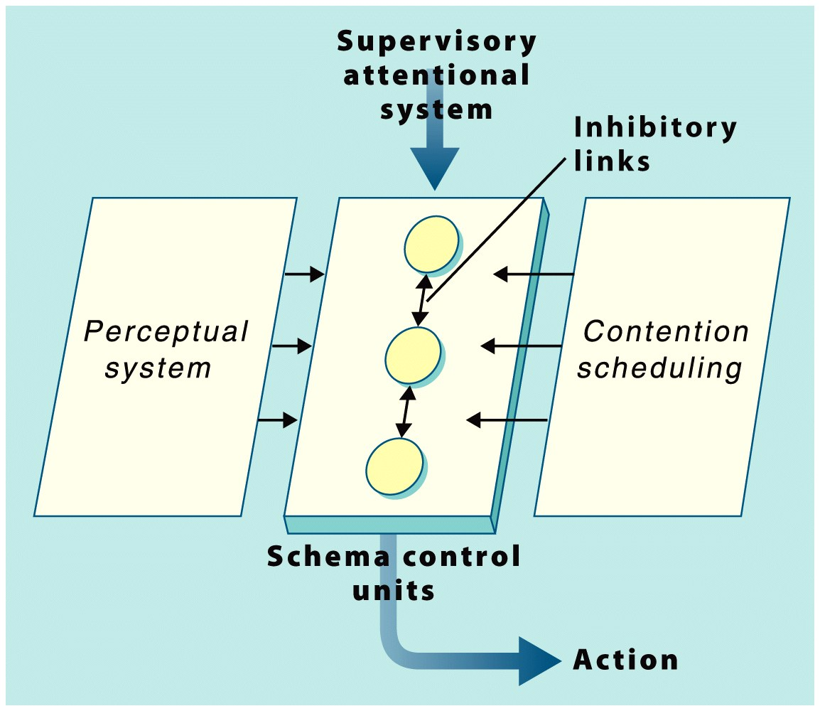
Notes:
﻿Figure 13.27 Norman and Shallice’s model of response selection. Actions are linked to schema control units. The perceptual system produces input to these control units. However, selection of these units can be biased by the contention scheduling units and the supervisory attentional system (SAS). The SAS provides flexibility in the response selection system.

Slide 95
Executive Functions in Practice
Norman and Shallice (1986) identify five general situations requiring executive functions:
(1) Situations involving planning or decision making
(2) Situations involving error correction or trouble shooting
(3) Situations where responses are not well-learned or contain novel sequences of actions
(4) Situations judged to be dangerous or technically difficult
(5) Situations that require the overcoming of a strong habitual response or resisting temptation

Slide 96
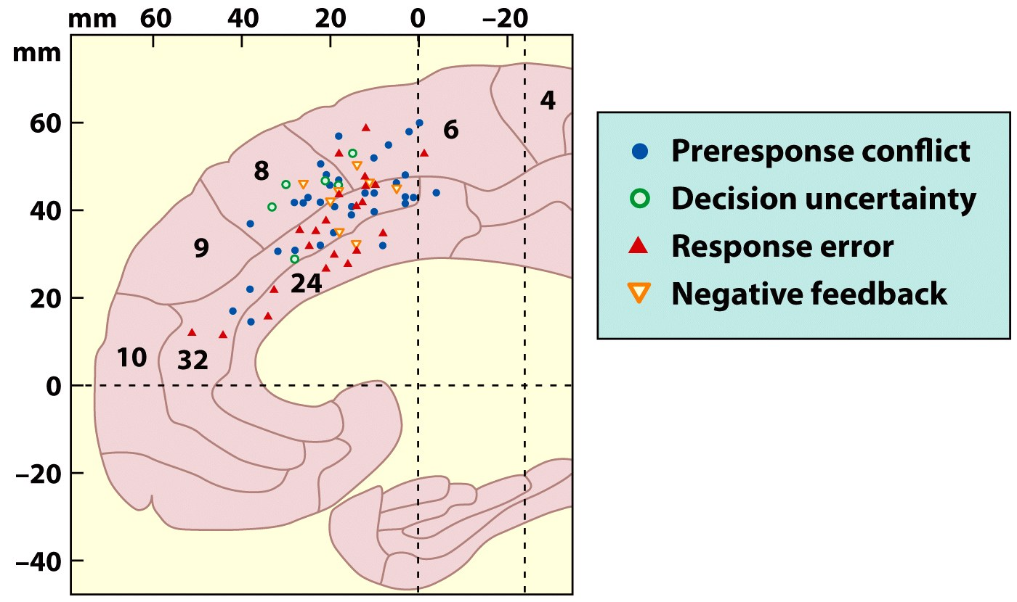
Notes:
﻿Figure 13.28 Meta-analysis showing activation foci in the medial frontal cortex during a range of tasks in which demands on performance monitoring were high. The data are assembled from 38 fMRI studies and result from contrasts looking at four different types of monitoring functions.

Slide 97
Summary
From
Motor Theory of Consciousness
consciousness
R
S
Physiological Process
To
SAS
Much more is known about “physiological Process,” which is now focus on brain processes
But the idea that conscious processes take control when “adaptation to new circumstances is imperative” seems intact, if consciousness is strongly related to attention

Slide 98
The critical variable
Automatic
Practice
Controlled
Processing resources needed
Few
Many
Fast
Parallel
Unaware
Cannot be controlled
Obligatory
Autonomous
Slow
Serial
Aware
Controlled
Selected
Dependent

Slide 99
Automatic Processes
Acquired
Mediated by practice
E.g., shifting gears (standard shift transmission)
Inherited
Evolution has honed millions of specialized neural systems, or processing modules
Evolution favors fast responding

Slide 100
Examples of inherited automaticity
1. Responding to emotional stimuli
2. Tables illusion
3. Necker cube
4. What is consciousness?
5. Anosognosia
6. Capgras’ syndrome

Slide 101
Responding to emotional stimuli
Husky Hiker

Slide 102
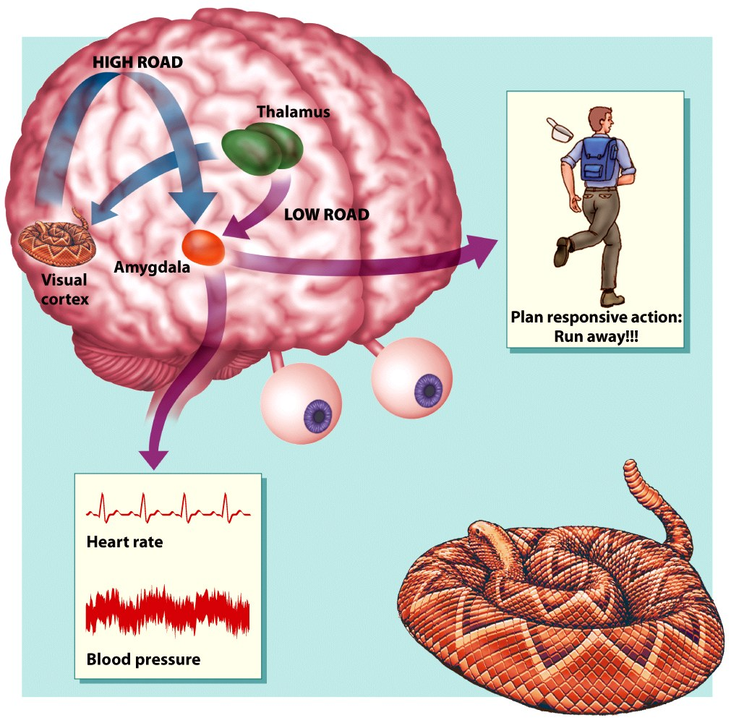
Notes:
﻿Figure 9.9 The amygdala receives visual information along two pathways. When a hiker chances upon a rattlesnake, the visual information activates affective memories through the cortical “high road” and subcortical “low road” projections to the amydgala. These memories not only produce autonomic changes, such as an increase in heart rate and blood pressure, but also can influence subsequent actions through the projections to the frontal cortex. The hiker will use this emotion-laden information in choosing his next action: Turn and run, or slowly move around the snake?

Slide 103
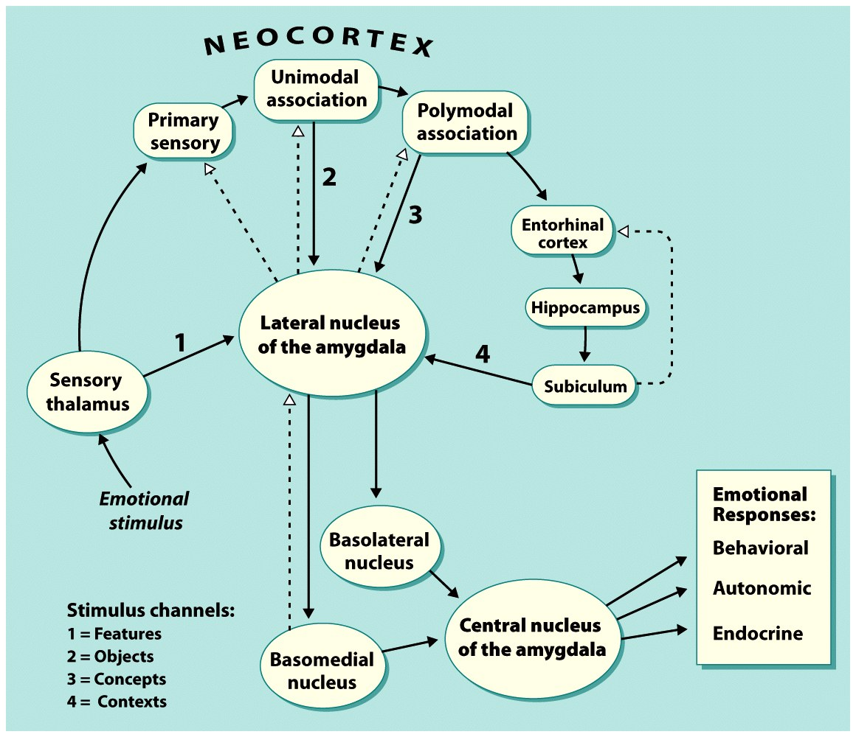
Notes:
﻿Figure 9.8 Amygdala pathways and fear conditioning.

Slide 104
Why did you jump?
suppose you are asked, why did you jump?
“Because I saw a snake.”
But you had already jumped before you were conscious of the snake.
Fast response was made before consciousness processing had time to decide an action

Slide 105
The Interpreter
Most neuroscientists would say that the feeling of agency—that there is an “I” that is “in charge”—is incorrect, is an illusion
Rather, the feeling of agency may be an interpretation, a “narrative” explanation of why I just did that

Slide 106
The Interpreter
Left hemisphere module that takes input of behavioral response, sensory input, emotional response, physiological state, and confabulates;
It creates an account, an explanation of the response

Slide 107
Can conscious processing, knowledge, affect automatic responding
Three visual illusions

Slide 108
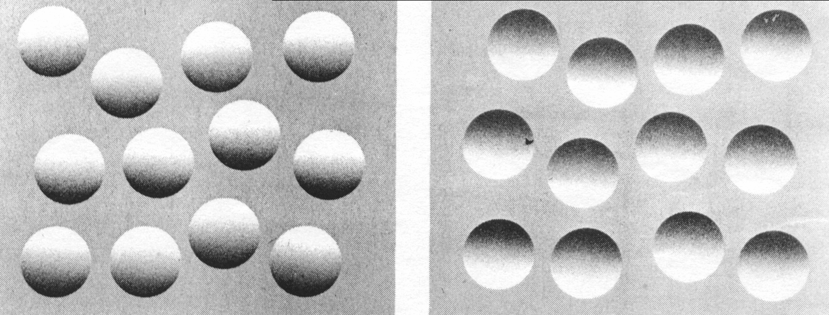

Slide 109
Visual Illusion
http://michaelbach.de/ot/index.html

Slide 110
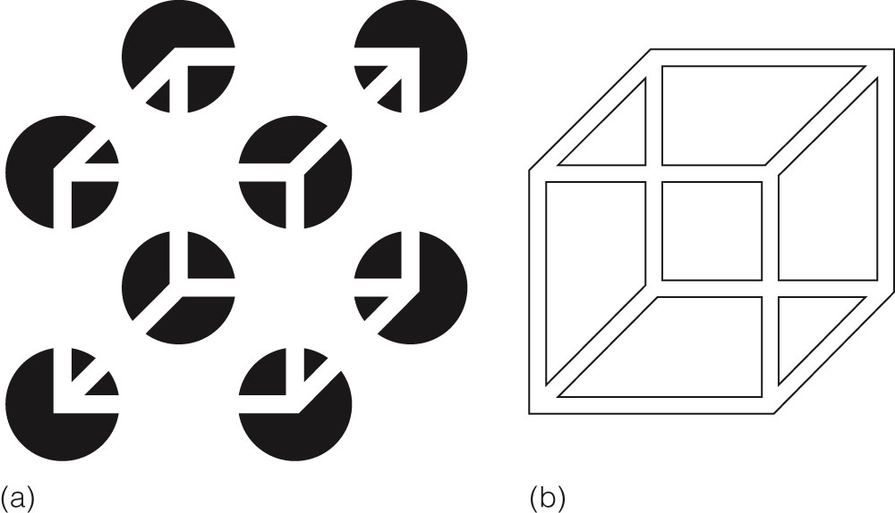
Figure 5.11 (a) This can be seen as a cube floating in front of eight discs or as a cube seen through eight holes. In the first case, the edges of the cube appear as illusory contours. (b) The cube without the black circles. Based on “Organizational Determinants of Subjective Contour: The Subjective Necker Cube,” by D. R. Bradley and H. M. Petry, 1977, American Journal of Psychology, 90, 252-262. American Psychological Association.
Notes:
Illusory contours and bi-stable figures are examples of other phenomenon that the structural approach could not explain since the observer sees things that are not present, such as the sides of the Necker cube.

Slide 111
Consciousness
Cortical processing modules

Slide 112
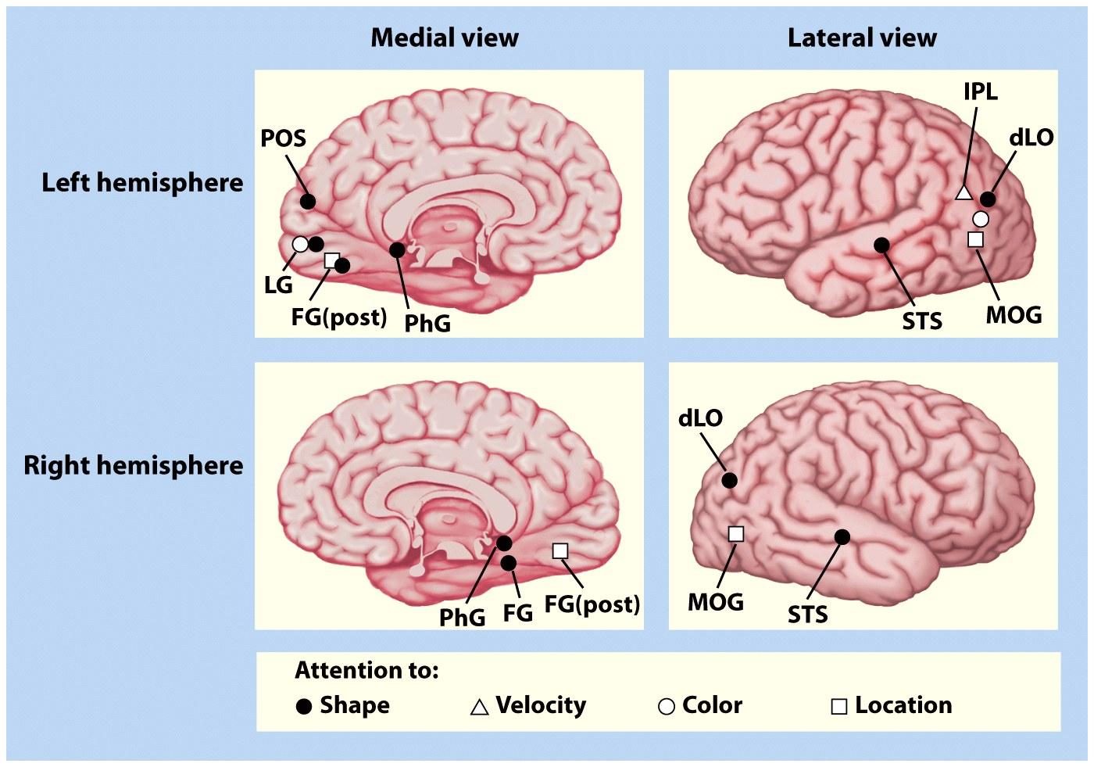
Notes:
﻿Figure 12.27 Summary of early neuroimaging attention studies using position emission tomography (PET) by Corbetta and colleagues (1991), Heinze and colleagues (1994), and Mangun and colleagues (1997). Regions of extrastriate cortex specialized for the processing of color, shape, or motion (from the work of Corbetta) are selectively modulated during visual attention to these stimulus features (feature selective attention). Selective attention to color activated areas in bilateral extrastriate cortex in the lingual gyrus (LG) and dorsolateral occipital cortex (dLO). Attention to shape led to activations in the lingual gyrus, fusiform gyrus (FG), parahippocampal gyrus (PhG), and superior temporal sulcus (STS). Selective attention to the motion (velocity) of the stimuli especially activated the left inferior parietal lobule (IPL), probably corresponding to motion area MT/V5. The PET study by Heinze and colleagues showed that attention to spatial location (selective spatial attention) produced activations in the posterior fusiform gyrus, and Mangun and colleagues replicated and extended this research to show that the middle occipital gyrus (MOG) was also activated during spatial attention.

Slide 113
Hijacking the interpreter
It is only so good as the info it gets from cortical processors
Suppose damage in somatosensory cortex
(show sensory strip)

Slide 114
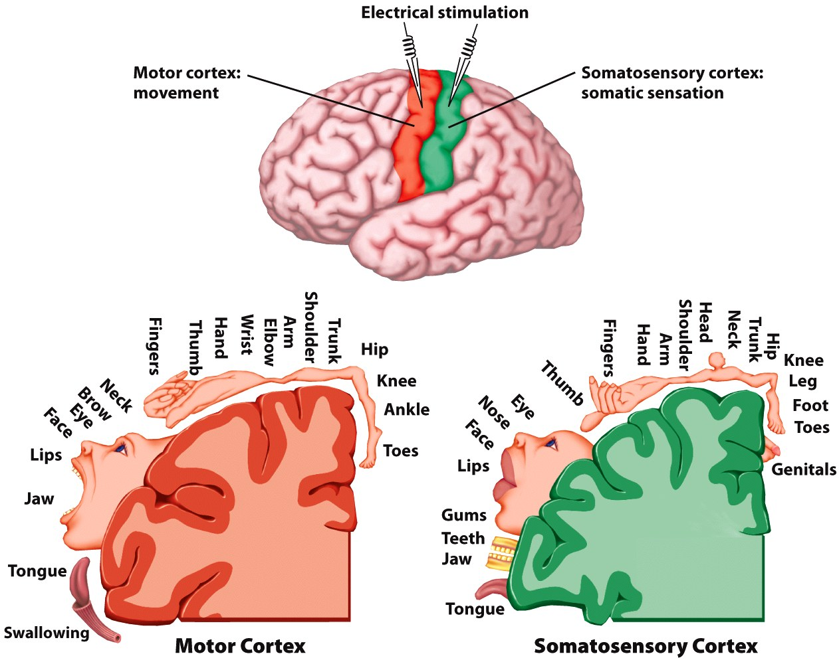
Notes:
Page 75c Cortical Topography

Slide 115
Hijacking the interpreter
Anosognosia
Consider also Capgras’ syndrome

Slide 116
Conclusions
James, Dewey, Münsterberg and others were on the right track when suggesting that consciousness was used only in special circumstances
Strong evidence that verbal explanations of behavior are post hoc, confabulations that are only as good as the information provided

Slide 117
Conclusions
Strong evidence that evolution has created a brain composed of millions of specialized circuits, each designed to perform a particular task and to connect locally
They operate in a parallel distributed manner, and the faster & more efficiently these operated, the more likely there bearer survived to pass these along to their offspring

Slide 118
Conclusions
Conscious processes are far to slow and resource consuming to facilitate survival in a natural world (over millions of years)
Although in today’s modern world they have a place
They are awfully useful in specific circumstances

Slide 119
Thank you

