Slide 1
EVOLUTION: IT’S JUST GENETICS OVER TIME (PART III) Kin selection and the evolution of “altruism”
Community of Reason
October 7th, 2012
Mindy L. Walker, Ph.D.
Associate Professor of Biology
Rockhurst University

Slide 2
Genetics
The study of hereditary material
Genes = elements passed down from generation to generation
Alleles = different forms of genes
Notes:
Coat color in lemmings

Slide 3
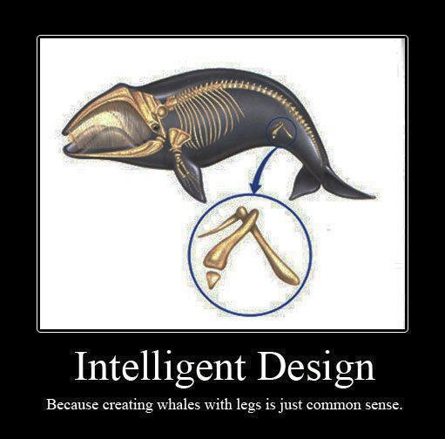
Evolution
Change over time
Change(s in allele frequencies in a population) over time
This can take a long, long time (think 3.5 billion years)

Slide 4
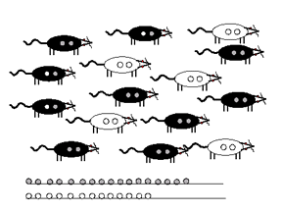
Changes in allele frequencies in a population over a generation
Notes:
17 and 13; 17 and 7

Slide 5
The Evolution of “Altruism”
Notes:
How do you define altruism? A selfless act? Risking your life to save the life of another?

Slide 6
Social Behaviors and the Logic of Natural Selection
Individuals are expected to behave in selfish ways
- NS favors traits that maximize an individual’s fitness, even at the expense of the fitness of others
However, social behaviors frequently involve interactions that appear to be contrary to individual fitness – examples?
Notes:
Examples of Social Interactions that Appear Contrary to Individual Fitness:
In some species:
- social structures include individuals that do not breed or are incapable of breeding (i.e. all termites, most wasps and ants, some bees)
- one generation of offspring assists in rearing the next generation rather than in immediately raising their own offspring (many birds) – Florida Scrub Jay
- mothers nurse, help rear or adopt abandoned offspring that are not their own (some mammals)
- individuals audibly warn others of impending danger (some birds and mammals)
- individuals hunt/defend cooperatively; form "stable" groups (herds, packs, prides, troops, flocks, etc.)

Slide 7
An Expanded View of Fitness
Inclusive Fitness (W.D. Hamilton, 1964) = the sum of an individual’s direct and indirect fitness
- the sum of an individual's contribution to the gene pool of the next generation as a result of the reproductive success of that individual and that of its close relatives; so…
- relatedness of the actors and recipients is the key parameter
Notes:
Direct Fitness – the fitness of an individual due to its reproductive success
Indirect Fitness – the increase in the fitness of close relatives due to the individual’s actions
Inclusive fitness is dependent on the relatedness of the actors and recipients
Gene-level perspective
The inclusive fitness of a gene or genotype is its effect on survival and reproduction of both the organism bearing it and of the genes, identical by descent, in the organism’s relatives.

Slide 8
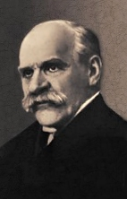
J.B.S. Haldane
(1892-1964)
Would you lay down your
life for your brother?
"No, but I would for two
brothers or eight cousins."

Slide 9
Kin Selection and the Evolution of Social Behaviors
The Coefficient of Relatedness (r)
- is the probability that homologous alleles in two individuals are IBD (the same allele)
Calculation of r requires a path analysis of the pedigree of the actor and recipient

Slide 10
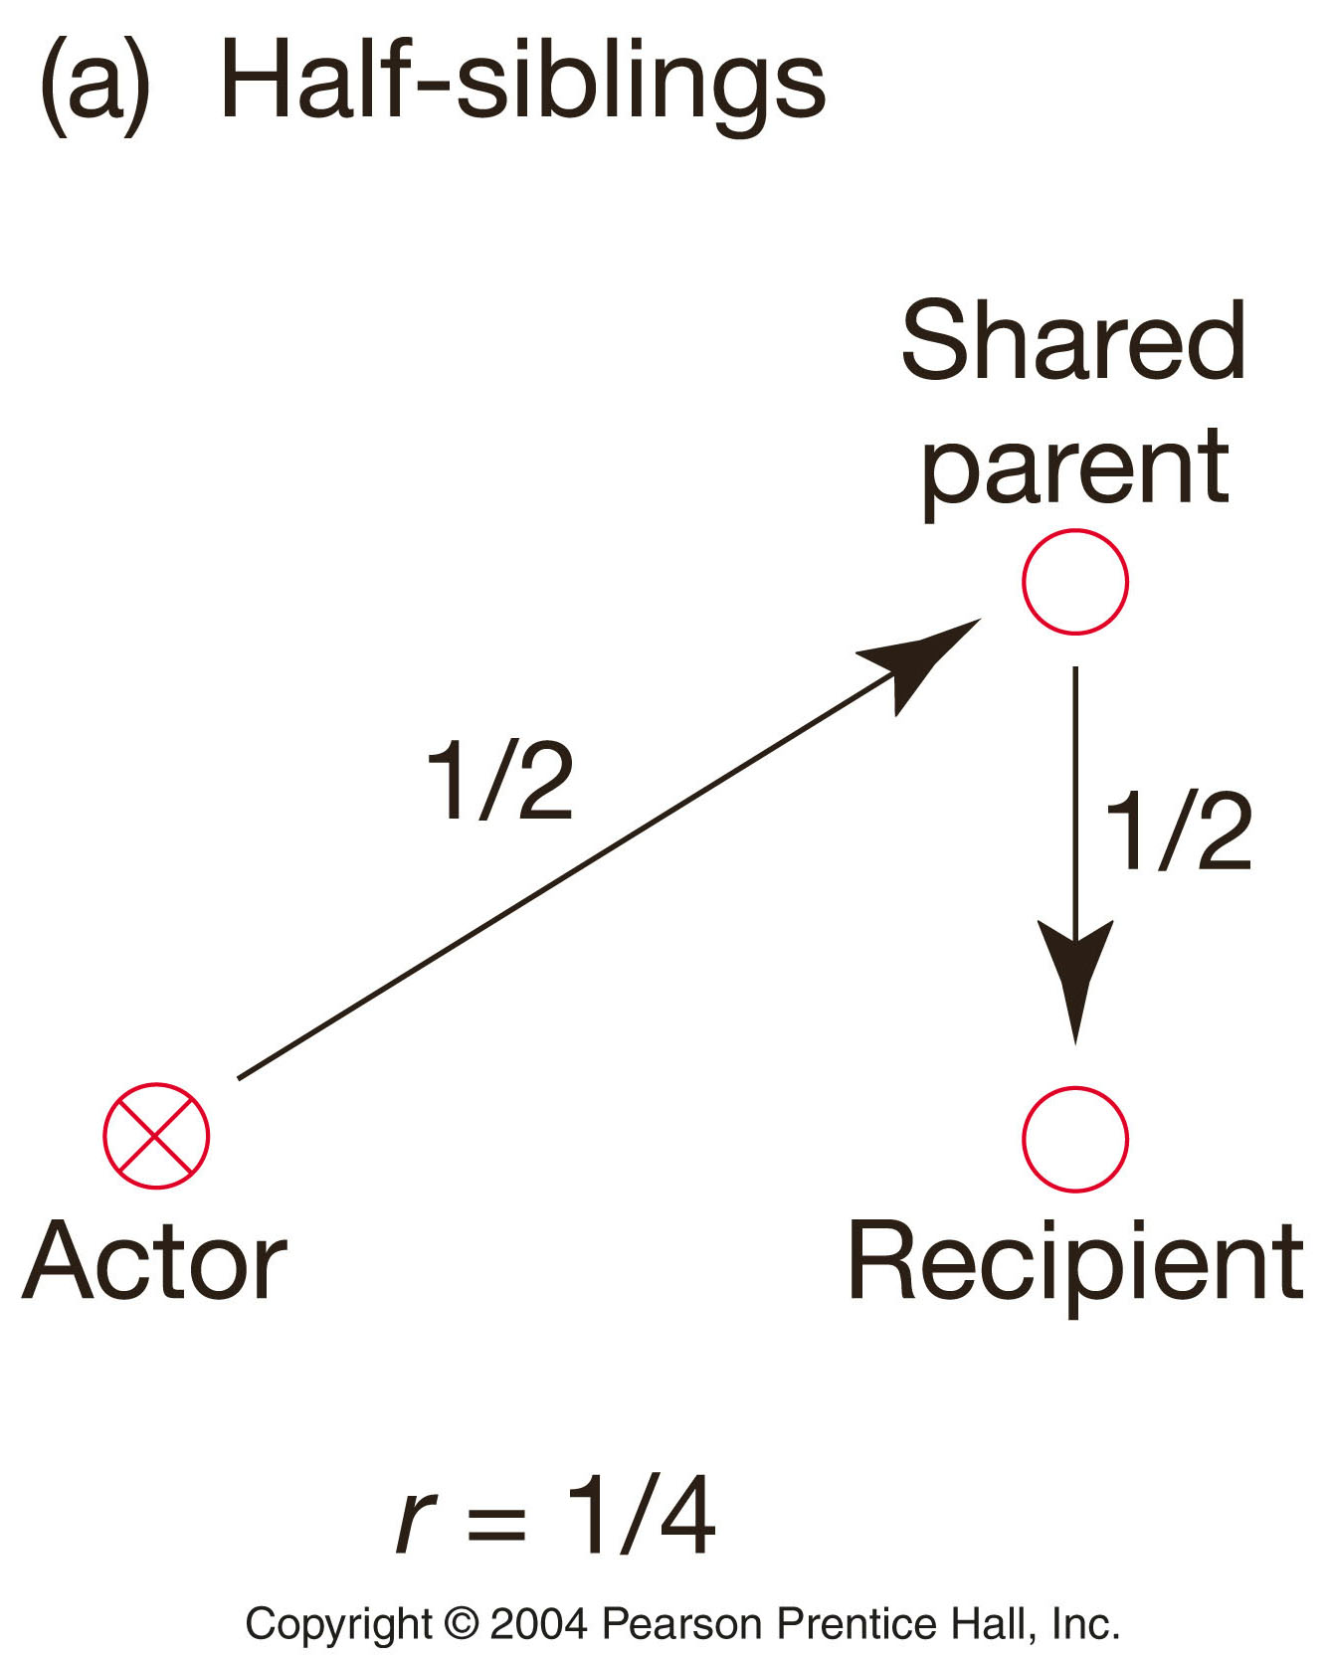
Notes:
For Half Siblings:
- each sibling inherits half of its alleles from the shared parent
in each sibling, the probability that a particular allele was inherited from the shared parent is 1/2
- therefore, the probability that any allele is identical by descent (ibd) between half siblings is 1/2 X 1/2 = 1/4
- r for half siblings is 1/4

Slide 11
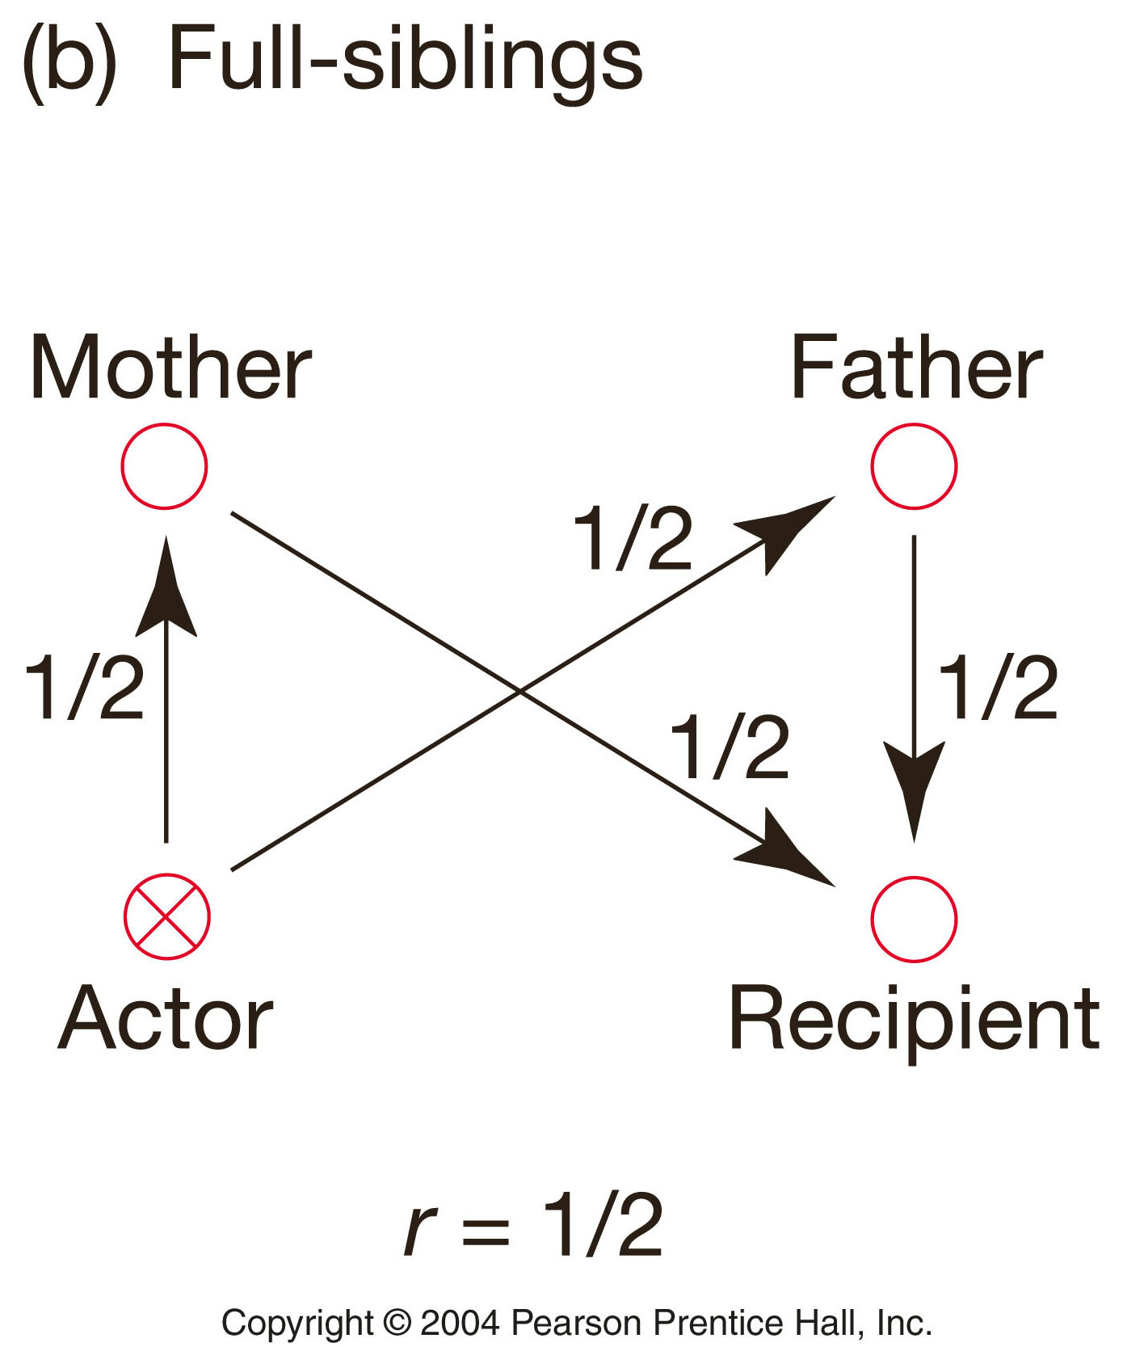
Fig. 12.1b Path Analysis of the Coefficient of relatedness (r)
(assumes sexual species, autosomal alleles, no inbreeding)
For Full Siblings:
have to add the probability that alleles are ibd through the mother to the probability that they are ibd through the father - as for half siblings, the probability that alleles are ibd through one shared parent is 1/4
therefore, the probability that any allele is ibd between siblings that share both parents is 1/4 + 1/4 = 1/2
- r for full siblings 1/2

Slide 12
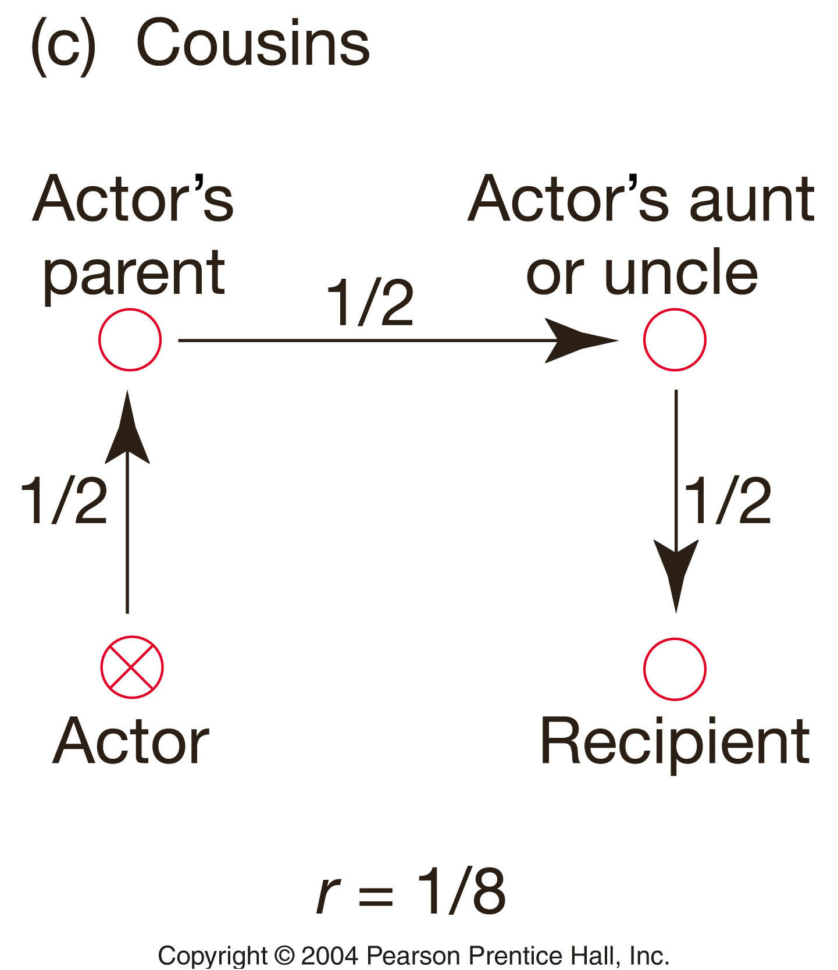
Fig. 12.1c Path Analysis of the Coefficient of relatedness (r)
(assumes sexual species, autosomal alleles, no inbreeding)
For Cousins:
have to account for the probability that alleles are ibd through each of three paths: actor to parent (1/2)
parent to its sibling (1/2)
aunt/uncle to recipient (1/2)
therefore, the probability that any allele is ibd between first cousins is 1/2 X 1/2 X 1/2 = 1/8
- r for full first cousins is 1/8

Slide 13
Coefficients of Relatedness (r)
Sexual organisms, autosomal loci, no inbreeding*
r
Parent – Offspring 1/2
Full Siblings 1/2
Half Siblings 1/4
Grandparent – Grandchild 1/4
Uncle/Aunt – Niece/Nephew 1/4
First Cousins 1/8
Notes:
* if the population is inbred, the actual r will be higher
Estimates of Coefficients of Relatedness
Complete pedigrees are rarely known for natural populations
r values can be estimated from highly polymorphic nuclear loci (such as microsatellites)

Slide 14
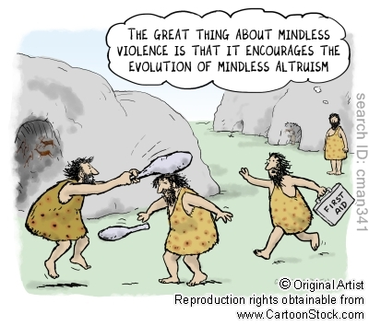
General Types of Social Interactions
Altruism: actor’s fitness is decreased by the action; recipient’s fitness is increased
- true altruism probably never exists in nature
Why not?
How, then, do apparently
altruistic behaviors come
to be?
Notes:
The Evolutionary Enigma of Social Behaviors
Altruism should not evolve
alleles for true altruism yield reduced fitness of the
altruist
altruism alleles should be quickly lost due to directional
selection against the altruist
Altruism/Altruistic Behavior
- the terms "altruism" and "altruistic behavior" are often loosely and incorrectly used in both the scientific and popular literature
- technically, these terms should only be used when the action (behavior) results in a true reduction of the actor’s fitness

Slide 15
Hamilton’s Rule
Given:
B - the fitness benefit to the recipient (recipient’s increase in number of offspring as result of the action of an actor)
C - the proportional fitness cost to the actor (actor’s relative decrease in offspring as consequence of the actor’s action); 0 to 1
An allele for an "altruistic" behavior will increase in frequency in the population if:
Br – C > 0
Thus, an "altruistic" behavior is more likely to evolve when:
- benefits to the recipient are ______
- the participants are closely _______
- the cost to the actor is ___
Notes:
(for the evolution of "altruistic" behavior)Great or high; related; low

Slide 16
Kin Selection
Natural selection that favors behaviors by enhancing the reproductive success of relatives
- natural selection that favors the spread of alleles that increase an individual’s indirect fitness
Most instances of "altruistic" behavior are the result of kin selection.
“Altruistic” behaviors occur almost exclusively among close relatives.
As kin-selected "altruistic" behaviors increase the inclusive fitness of the "altruist," these behaviors are not truly altruistic.

Slide 17
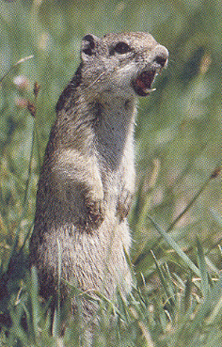
Some individuals (usually females) sound alarm call (trill) when a mammal predator is spotted; alerts others
What else does this do?
Studies indicate that:
- males disperse (do not live near close relatives), rarely trill an alarm
females and offspring are philopatric;
females live near closely related
individuals (offspring, sisters, sisters’
offspring)
- females are significantly more likely to sound alarm when close relatives are near
http://www.youtube.com/watch#!v=1bY8ZsPVgZY&feature=related
Spermophilus beldingi
Female "trilling" alarm call
Notes:
Sounding alarm significantly increases chance of caller being killed by predator; (do not disperse from natal area); meerkats not as closely related but sentinel usually hides first bc she has seen the predator first

Slide 18
The Kin Selection Hypothesis for Hymenopteran Eusociality
Hymenopterans have a haplodiploid genetic system -
Strongly skews the coefficients of relatedness:
females to their daughters, r = 0.5
females to their sisters, r = 0.75
females to their brothers, r = 0.25
Mother
(diploid)
Father
(haploid)
Sisters share half of the genes inherited from their mother and all of the genes inherited from their father.
r = 1/2(1/2) + 1(1/2) = 3/4
1/2
1/2
1/2
1
daughter
daughter
sisters
Numbers are probabilities that homologous alleles are ibd
Notes:
- females are diploid
- males are haploid (develop from unfertilized eggs)
are more closely related to each other than they are to their own offspring (r = 0.5) or brothers (r = 0.25)

Slide 19
The Kin Selection Hypothesis for Hymenopteran Eusociality
In the haplodiploid genetic system:
Fertile females are sisters of workers
Workers (female) and soldiers (male) are sterile
Kin selection favors females (workers) contributing to the fitness of their fertile sisters (r = 0.75) over reproducing (daughters and sons, r = 0.5)

Slide 20
The Kin Selection Hypothesis Hymenopteran Eusociality
In the haplodiploid genetic system:
The inclusive fitness of a female can be greater if she is a worker (assists in raising her fertile sisters)
From Hamilton’s Rule Br – C > 0
Assuming the extreme* C = 1; rearing sisters instead of daughters will be favored if B > 1/r
- for diploids this would be B > 1/0.5 = 2.0
- for haplodiploids this would be B > 1/0.75 = 1.33
*C is likely to be <1

Slide 21
The Kin Selection Hypothesis Hymenopteran Eusociality
In a colony with one singly-mated queen:
The haplodiploid genetic system:
Favors the production of fertile sisters ("potential future queens") over daughters, sons or brothers
Kin selection favors females contributing to the fitness of their fertile sisters (r = 0.75) over reproducing (daughters and sons, r = 0.5)
The inclusive fitness of a female can be greater if she is a worker (assists in raising her fertile sisters)
The conditions for eusociality (reproductive "altruism") are more easily satisfied with kin selection in haplodiploids.
Notes:
Not all eusocial animals are haplodiploid (e.g. termites, NMRs); and all hymenopterans are haplodiploid but not all are eusocial

Slide 22
Notes:
By Carol Frost

Slide 23
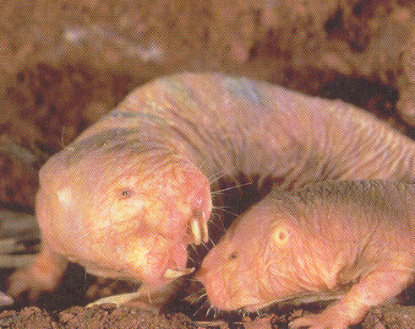
Eusociality in Naked mole-rats
High levels of inbreeding yield high overall r’s among members of the colony.
Diploid, XX/XY
Live in fossorial colonies
Each colony has:
- single queen
- 2-3 reproductive males
- up to several hundred nonreproductive workers (male and female)
Colony is highly inbred:
- mean r ~ 0.8 (almost all matings are mother/son or sibling)
Queen aggressively enforces role and activity of nonrepro. workers.
Heterocephalus glaber
http://www.youtube.com/watch?v=_C6a4ZTWDXk

Slide 24
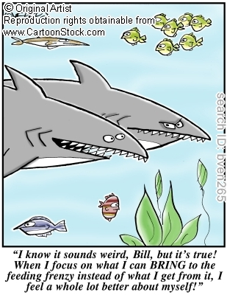
Can cooperative behavior evolve among non-kin?
Reciprocal Altruism (Robert Trivers, 1971)
- Natural selection can favor "altruistic" behavior if the recipient reciprocates
- an actor can be selected to exhibit "altruistic" behavior if equally beneficial behavior is returned by the recipient

Slide 25
Conditions for the evolution of Reciprocal Altruism
The cost to the actor must be < or = the benefit to the recipient
Alleles for high-cost, low benefit behaviors cannot increase in the population even if this action is reciprocated
- both interactors suffer reduced fitness
Reciprocation must be enforced
- individuals that fail to reciprocate must be "punished” in some way
- in the absence of reciprocation, the actor suffers an actual reduced fitness
- unchecked, alleles that lead to "cheating" would be directionally selected and reciprocal altruism would be quickly eliminated

Slide 26
The Prisoner’s Dilemma
a classic game theory simulation of the problems of reciprocal altruism

Slide 27
You and your co-conspirator are arrested for a crime.
You are interrogated separately, and each offered the same deal:
- if neither confesses or implicates the other (cooperation), both receive a short sentence (the state’s evidence is weak)
- if both defect (implicate the other), both get a medium sentence
- if you defect (testify against the other prisoner) and he/she does not defect, you go free and he/she gets a life sentence
- if he/she defects (testifies against you), but you do not defect, he/she goes free and you get life
What should you do?

Slide 28
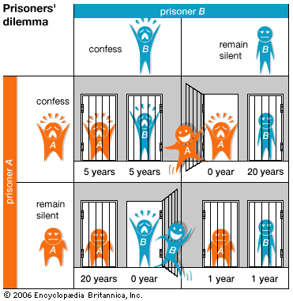

Slide 29
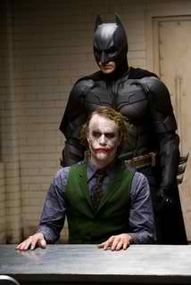
What should you do?
This is an Analog of Reciprocal Altruism.
The best solution is cooperation.
- neither prisoner defects and both receive a short sentence.
Can you count on your buddy not to defect?
- There will always be the temptation to implicate your buddy (defect) and get off free.

Slide 30
What if the players interact continually?
This problem has been extensively modeled.
The Tit for Tat Strategy
In first encounter always cooperate; subsequently,
always copy the opponent’s previous move
- cooperate in reward for past cooperation
- defect in retaliation to past defection
Is the best of all possible strategies.
In fact, is an ESS.
Notes:
Iterated PD; quid pro quo is an evolutionarily stable strategy

Slide 31
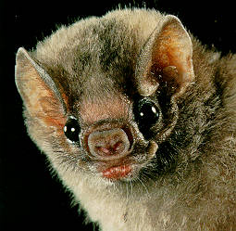
Species Characteristics Favoring Reciprocal Altruism
- long-lived
- small, highly social and stable groups
- "intelligent" (highly developed central nervous system)
- low rates of dispersal from the group
- mutual dependence on group behavior: defense, foraging, etc.
Reciprocal Altruism is unlikely to occur in species with strong social dominance (social hierarchy)
- social subordinates are rarely able to sufficiently reciprocate
What about primates?
Notes:
Live long enough to play this iterated game

Slide 32
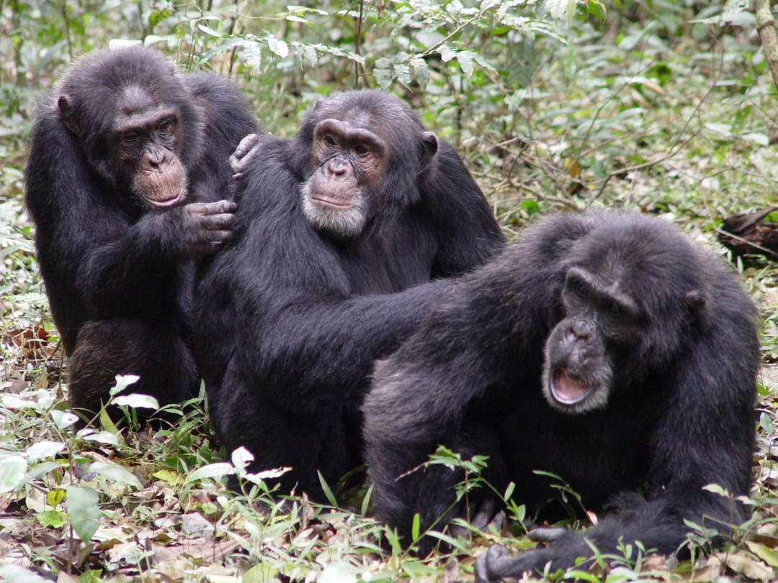
“Altruism” in Non-Human Primates
Langergraber et al., PNAS 2007
Males are philopatric cooperate most often with maternal brothers
Indirect fitness
Many cooperations
between non-kin
Direct fitness
What about us?

Slide 33
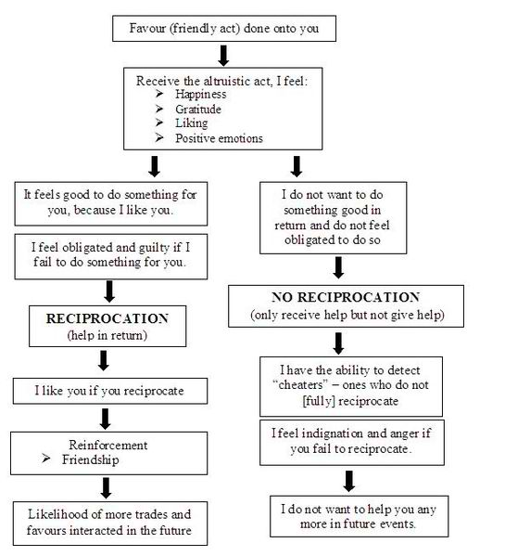

Slide 34
Trivers – regulation of altruism
Friendship and emotions of liking and disliking.
Moralistic aggression. A protective mechanism from cheaters acts to regulate the advantage of cheaters in selection against the altruists. The moralistic altruist may want to educate or even punish a cheater.
Gratitude and sympathy. A fine regulation of altruism can be associated with gratitude and sympathy in terms of cost/benefit and the level in which the beneficiary will reciprocate.
Guilt and repetitive altruism. Prevents the cheater from cheating again. The cheater shows his regret in order to save him from paying too dearly for his acts.
Subtle cheating. A stable evolutionary equilibrium could include a low percentage of mimics (in controversial support of adaptive sociopathy).
Trust and suspicion. These are regulators for cheating and subtle cheating.
Partnerships. Altruism with the purpose of creating friendships.
Notes:
According to Trivers the following emotional dispositions and their evolution can be understood in terms of regulation of altruism. Trivers, R.L. (1971). "The evolution of reciprocal altruism". Quarterly Review of Biology 46: 35–57.

Slide 35
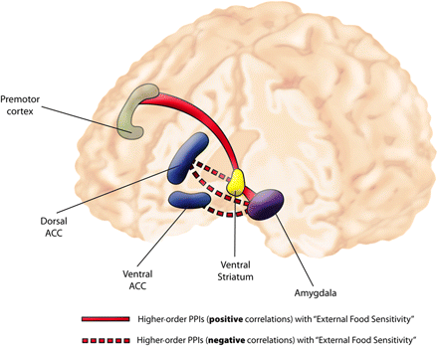
Greg Berns and James Rilling
found that the act of helping another person triggers activity in the caudate nucleus and anterior cingulate cortex regions of the brain, the parts involved in pleasure and reward.
serving others may produce the same sort of pleasure as gratifying a personal desire
Notes:
Both from Emory (Center for Behavioral Neuroscience) – Berns is a Psychiatrist and Neuroeconomist - Gregory S. Berns, M.D., Ph.D., co-investigator and associate professor of psychiatry in the Emory University School of Medicine Department of Psychiatry and Behavioral Sciences and member of the CBN. ; Caudate is part of the dorsal striatum

Slide 36
used fMRI to scan the brains of 36 women while they played the "Prisoner's Dilemma;“ each was awarded a sum of money that depended upon the interaction of both players' choices in that round. Mutual cooperation was the most common outcome, even though a player was maximally rewarded for defecting when the other player cooperated. During the mutually cooperative social interactions, activation was noted in those areas of the brain that are linked to reward processing: the nucleus accumbens, the caudate nucleus, ventromedial frontal/orbitofrontal cortex and rostral anterior cingulate cortex. "Our study shows, for the first time, that social cooperation is intrinsically rewarding to the human brain, even in the face of pressures to the contrary, " said Gregory S. Berns, M.D., Ph.D. "It suggests that the altruistic drive to cooperate is biologically embedded-- either genetically programmed or acquired through socialization during childhood and adolescence." "Reciprocal altruism activates a reward circuit, and this activation may often be sufficiently reinforcing to override subsequent temptations to accept but not reciprocate altruism. This may be what motivates us to persist with cooperative social interactions and reap the benefits of sustained mutual cooperation," said Dr. Rilling.
Notes:
http://www.mybrainfacts.com/basisofsocialbrain.html In the first experiment, 19 subjects were scanned in four game sessions designed to observe neural function during cooperation and non-cooperation during both human interactions (social) and interactions with a computer (non-social). The results of the first experiment revealed different patterns of neural activation depending on whether the playing partner was identified as a human or a computer. In the second experiment, 17 subjects were scanned during three game sessions, focusing specifically on human interaction.

Slide 37
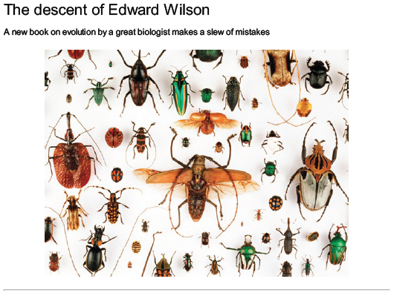
Controversy
E.O. Wilson: The Social Conquest of Earth – 2012
vs.
Richard Dawkins

Slide 38
Wilson (and others, like Chris Boehm)
Rejects kin selection and replaces it with a resurrected version of group selection.
Evolution is driven by differential survival of entire groups of organisms.
Calls this “multilevel selection.”
Notes:
Boehm: Moral Origins; multilevel bc it still recognizes direct fitness, NS

Slide 39
Dawkins (and the vast majority of Evolutionary biologists)
Evolution results from differential survival of genes in gene pools.
Depends on the survival and reproduction of their “vehicles.”
Individuals benefit from living in groups and cooperating; group welfare is incidental.

Slide 40
Implications
Dawkins’ review is more about his own hypotheses than Wilson’s book
Divisive
This row makes the very idea of evolution seem controversial to the lay public.
Notes:
Yet he accuses Wilson of “Wanton arrogance”

Slide 41
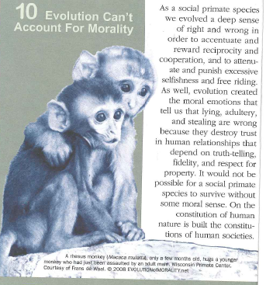

Slide 42
Thank you!

