Slide 1
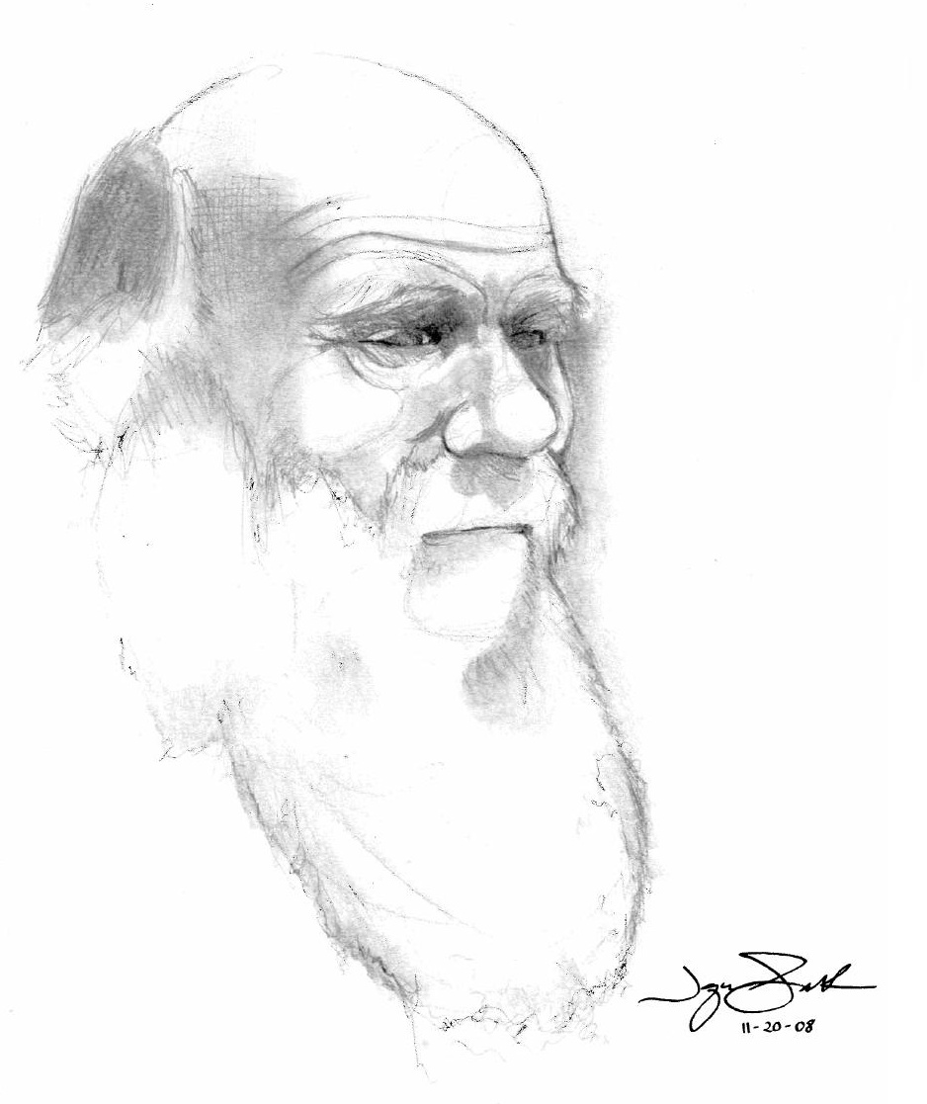
Evolution: it's just Genetics over time Community of reason 18 March, 2012
Mindy L. Walker, Ph.D.
Assistant Professor of Biology
Rockhurst University

Slide 2
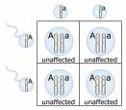
Genetics
The study of hereditary material
Genes = elements passed down from generation to generation
Alleles = different forms of genes

Slide 3
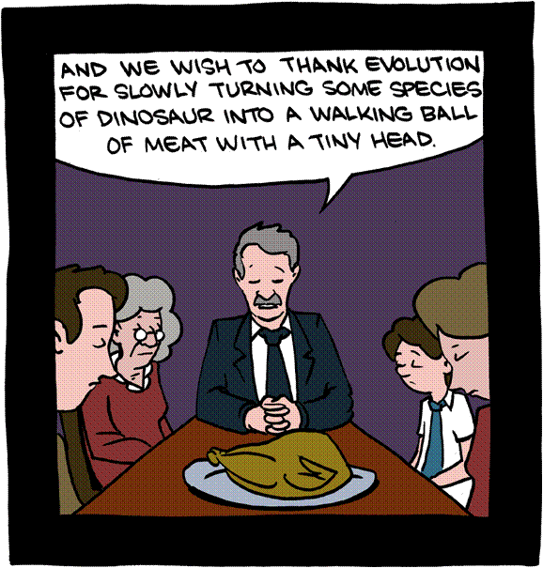
Evolution
Change over time
Change(s in allele frequencies in a population) over time
This can take a long, long time (think 3.5 billion years)

Slide 4
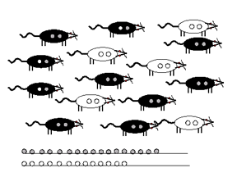
Changes in allele frequencies in a population over a generation

Slide 5
Experiment time.
Initial frequencies:
Milk Chocolate = 16
Krackel = 14
Mr. Goodbar = 14
Special Dark = 1
After one generation of selection…
Milk Chocolate =
Krackel =
Mr. Goodbar =
Special Dark =

Slide 6
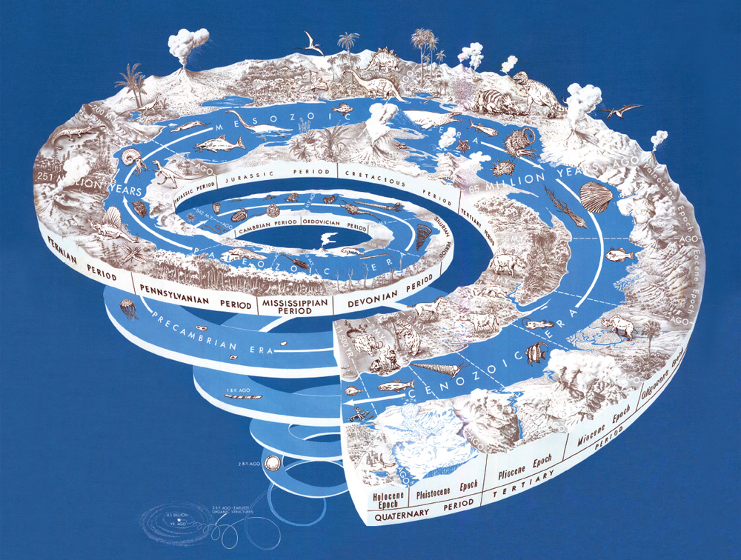
Survey – consider this question
Do you believe that evolution, as the explanation for the diversity of all life, is true, false or are you not sure?

Slide 7
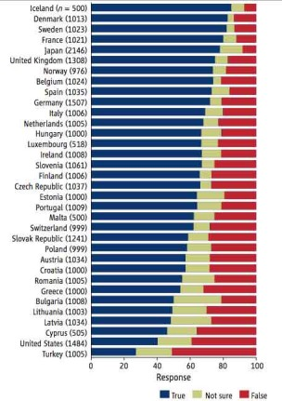
Survey says…
Notes:
Do you believe that evolution, as the explanation for the diversity of all life, is true, false or are you not sure?

Slide 8
One more time
Do you believe that evolution, as the explanation for the diversity of all life, is true, false or are you not sure?
Notes:
So should you accept evolution? …

Slide 9
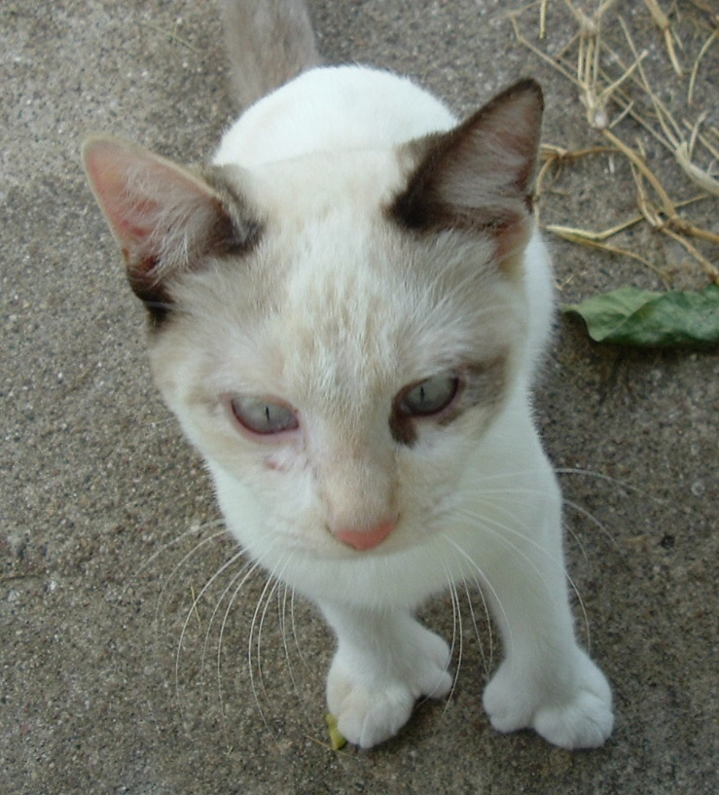
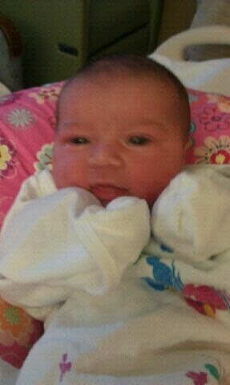
Do you believe in…
Mutation?
Reproduction?

Slide 10
Then, whether you like it or not…
Evolution
Mutation
Time
Reproduction
you believe in evolution.
Notes:
And the diversity of all life

Slide 11
If you believe in drug-resistance…
Evolution
Selection for resistant individuals
Variation in genes
Treatment
Resistant ones pass on their genes
you believe in evolution.

Slide 12
http://www.answersingenesis.org/articles/nab/is-natural-selection-evolution
Notes:
Helicobacter pylori; clarithromycin resistance

Slide 14
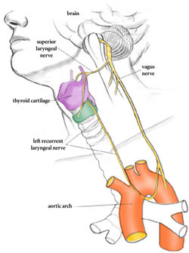
If you believe you have a tailbone…
Evolution
Appendix
Back aches
Tailbone
Hiccups
Hernias
Heart problems
Embryonic tail
Embryonic gills
Choking
Goose- bumps
Obesity
Wisdom teeth
Blind spot
Laryngeal nerve
you believe in evolution.
Notes:
Auricularis muscles (wiggle ears); vitamin C gene “broken” in the same way in all great apes, functional in other mammals; grasping reflex in human babies (grasping for hair on breasts); male nipples; www.freewebs.com/oolon/SMOGGM.htm

Slide 15
If you believe in lactose intolerance…
you believe in evolution.

Slide 16
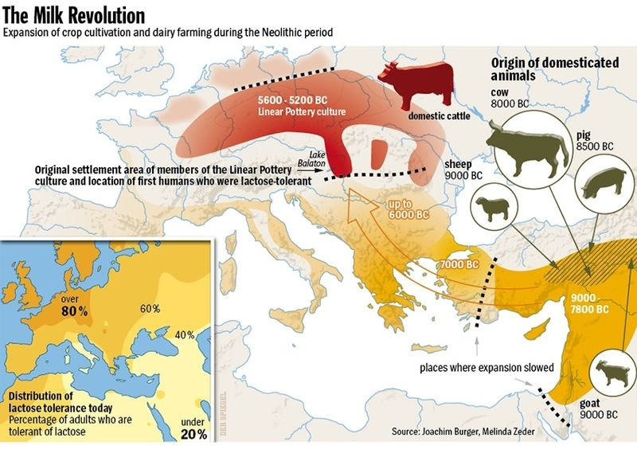
http://www.spiegel.de/international/zeitgeist/0,1518,723310,00.html

Slide 17
Mechanisms of evolution

Slide 18
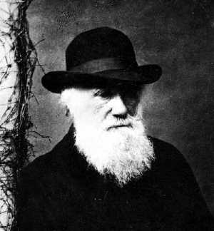
5 processes
Tendency toward pan-selectionism – often used by Creationists/ID “theorists” as evidence against evolution
Natural Selection
Gene Flow (migration)
Genetic Drift (chance)
Mutation
Nonrandom Mating
Ultra-
-ism
Notes:
Creationists - Not everything could have been selected for in increments; because you can understand NS without understanding genetics – Darwin did

Slide 19
Selection

Slide 20
Gene Flow

Slide 21
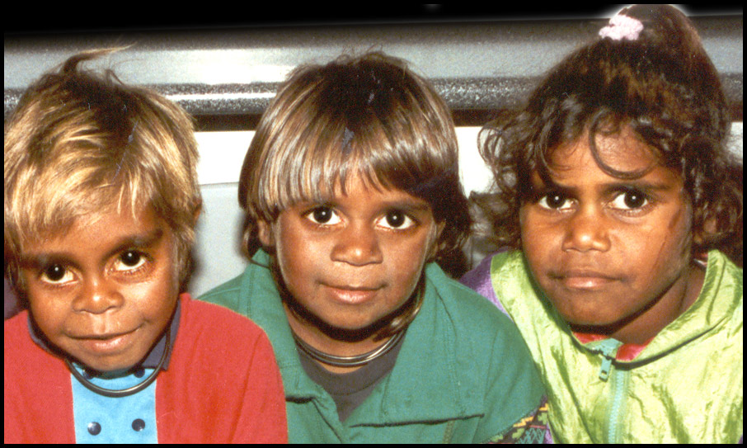
Genetic Drift
Sampling error in founding pop or in survivorship
Notes:
It is possible that Australia was colonized by a small founder population that lacked the B allele;
Can graft skin and won’t be rejected; Golden Hamster, of which the vast majority are descended from a single litter found in the Syrian desert around 1930; bison almost to extinction by 1890; YearAmerican bison (est) Before 1492: 60,000,000; 1890:750; 2000: 360,000

Slide 22
Mutation

Slide 23
Nonrandom Mating
Notes:
Snow geese (blue, white, experimentally pink) – pos. assortative mating

Slide 24
Genetic evidence of evolution

Slide 25
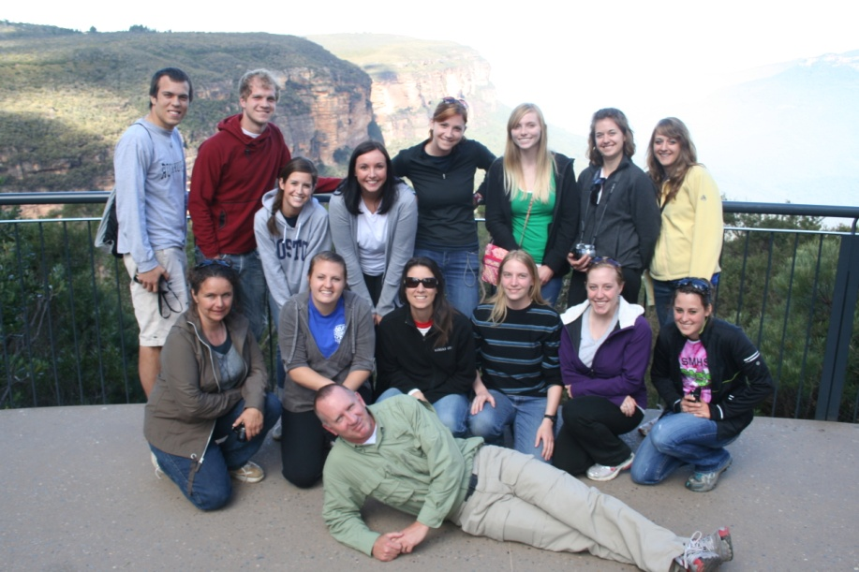
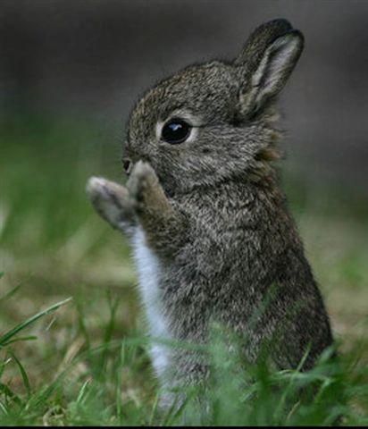
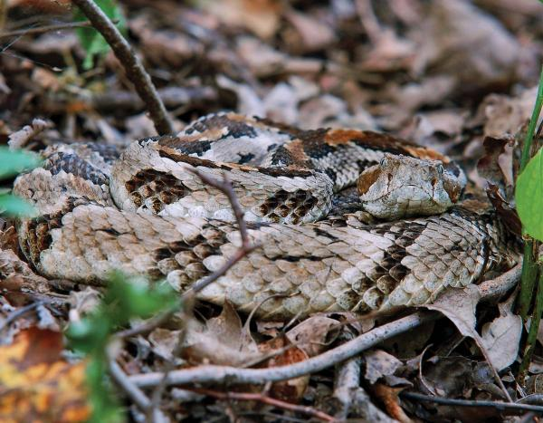
DNA
…is universal.
Notes:
Coincidence or common ancestry?

Slide 26
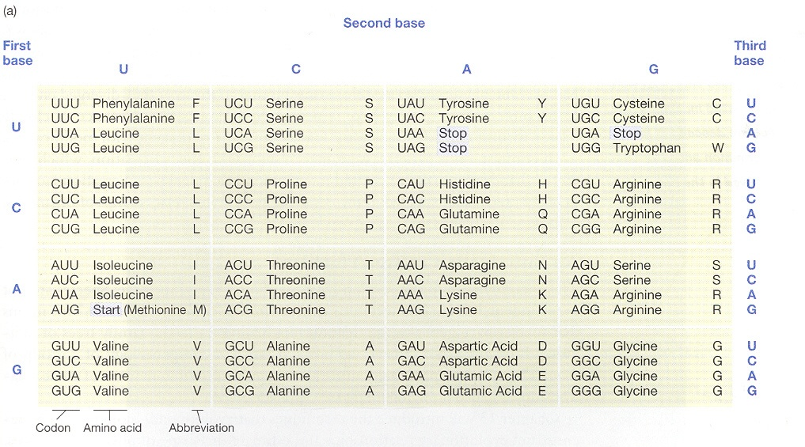
The Genetic Code
…is universal.
http://www.pnas.org/content/105/43.cover-expansion

Slide 27
Chromosomes
“Modern Genetics Confirms Evolution”
http://www.thetech.org/genetics/ask.php?id=229
Notes:
Start at 2 minutes

Slide 28
Genes are shared
http://genome.cshlp.org/content/20/8/1001.full
Notes:
We analyzed more than 1000 orthologous genes in 33 fully sequenced mammalian genomes, reconstructed their ancestral isochore organization in the maximum likelihood framework, and explored the evolution of third-codon position GC content in representatives of 16 orders and 27 families.
Figure 1. Genomic third-codon position GC-content (GC3) evolution in placental mammals. Colors reflect current or estimated average GC3 on 1138 orthologous genes (green, low GC; yellow, medium GC; red, high GC). current or estimated average GC3 on 1138 orthologous genes. Branch lengths quantify the amount of GC3 divergence: the branch connecting nodes i and j has a length proportional to D_{i,j} (Equation 2). The estimated ancestral GC content of the placental ancestor is 46.2%.

Slide 29
ERVs
Sequences in the genome thought to be derived from ancestral viral infection
“Evolution: Genetic Evidence – ERVs”

Slide 30
Pseudogenes
Nonfunctional sequences
“Evolution: Genetic Evidence – Pseudogenes”

Slide 31
Transposons
“Jumping genes”
“Evolution: Genetic Evidence – Transposons”

Slide 32
Regulatory Genes
Genes that regulate the timing and expression of other genes
Small changes can bring about large-scale transformations.

Slide 33
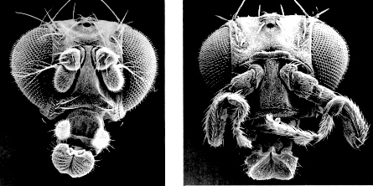
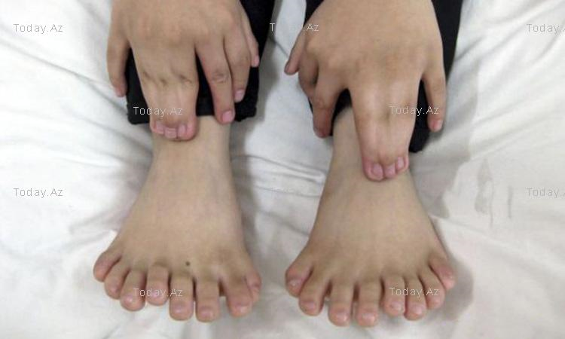

Slide 34
How much difference can genes possibly make?

Slide 35
Changes in dog gene frequencies
www.Nationalgeographic.com
Notes:
“dog diversity is from a small genetic toolkit”

Slide 36
Genes make all the difference!
Evolution is just genetics over time.

Slide 37
Thank you!
Questions?

